Slide 1
Cylinder block and piston
1 Maintenance instructions .................................................................................. 170
2 Assembly drawings .............................................................................................. 171
3 Disassembly of the cylinder .............................................................................. 172
4 Inspection of the cylinder .................................................................................. 172
5 Disassembly of piston ......................................................................................... 173
6 Inspection of pistons and piston rings ......................................................... 173
7 Installation of piston rings ................................................................................ 174
8 Installation of piston ........................................................................................... 174
9 Cylinder installation ............................................................................................. 174
English
version
169

Slide 2
Maintenance instructions
Caution.
-The cylinder head lubricating oil goes to the cylinder head through the small oil hole next to the left body AB pin of the engine, make sure the small oil hole next to the left body AB pin is clear before installing the cylinder. Do not put the cylinder solid locating pin into the oil passage hole.
Cylinder, piston, piston ring, piston pin, specification parameters
item |  |  | standard values mm | Maintenance limit values mm
cylinder | Cylinder bore diameter |  | φ94.5～φ94.52 | φ94.528
 | deroundness |  | 0.05 | 0.01
 | Flatness of cylinder surface |  | 0.03 | 0.05
Piston Piston ring piston pin | Piston outside diameter |  | φ94.453～φ94.467 | φ94.43
 | Piston pin bore bore diameter |  | φ20.004～φ20.01 | φ20.015
 | Clearance between piston pin and piston pin hole |  | 0.004～0 .018 | 0.025
 | Piston ring closing clearance | Top ring/second ring | 0.2～0.35 | 0.5
 |  | Oil ring | 0.2～0.7 | 1.4
 | Piston ring groove clearance | Top ring | 0.03～0.07 | 0.08
 |  | Second ring | 0.02～0.06 | 0.08
 | Clearance between cylinder and piston |  | 0.033～0.067 | 0.07
 | Outside diameter of piston pin |  | φ19.992～φ20 | φ19.99
Small end of connecting rod | Inside diameter |  | φ20.015～φ20.025 | φ20.04
 | Clearance between small end of connecting rod and piston pin |  | 0.015～0.033 | 0.05
English
version
170

Slide 3
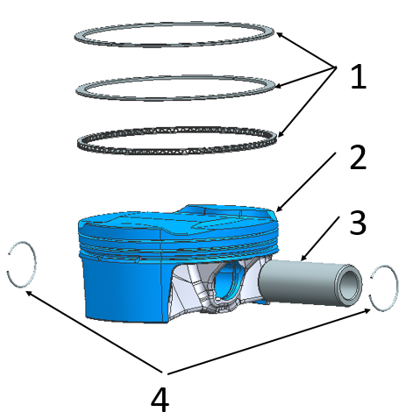
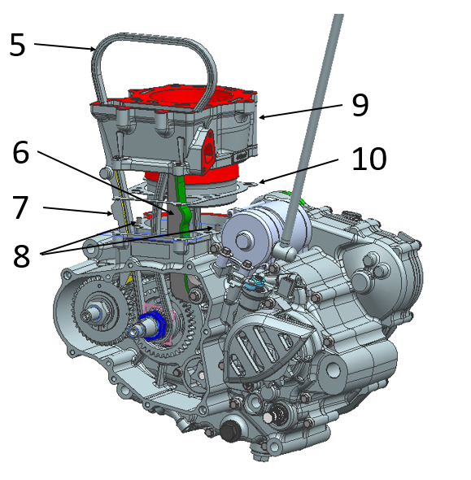
Assembly drawings
1、NC450S piston ring assembly.
2、NC450S piston.
3、NC450S piston pin.
4、NC450S piston pin retaining ring.
5、NC450S timing chain assembly (5×134_tooth chain).
6、NC450S chain tensioning plate combination (2#).
7、NC450S chain guide plate combination.
8、Cylinder pin φ6×12.
9、NC450S cylinder block parts (cylinder standard 449_passivated by shot blasting).
10, NC450 cylinder block gasket (foam metal rubber composite plate).
English
version
171

Slide 4
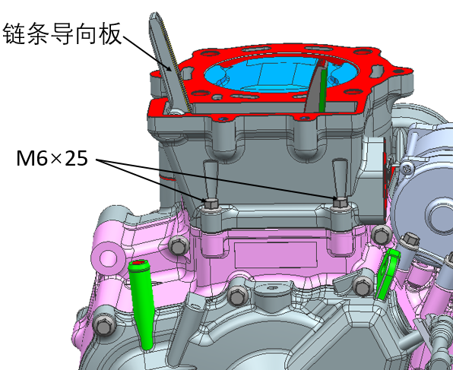
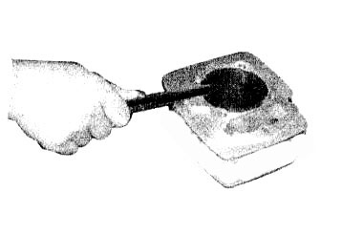
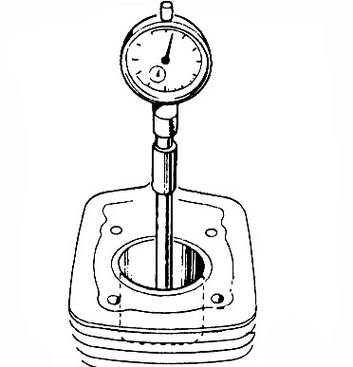
Disassembly of the cylinder
1、Take off the chain guide plate, remove the two cylinder block and box connecting bolts M6×25, remove the cylinder block.
Chain guide plate
2、Scrape the remaining gasket on the cylinder surface with a scraper.
Inspection of the cylinder
1、Check whether the cylinder block is worn or destroyed.
2、Measure the cylinder bore, should measure three positions, namely the top, middle and bottom of the piston stroke, the measurement should be made in two directions at right angles to each other.
Repair limit value: φ94.528mm
English
version
172

Slide 5
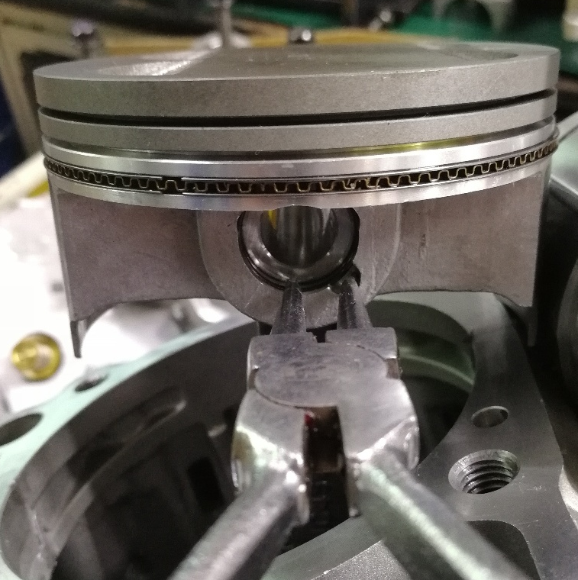
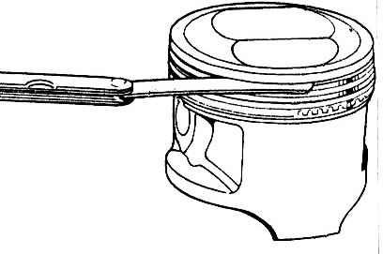
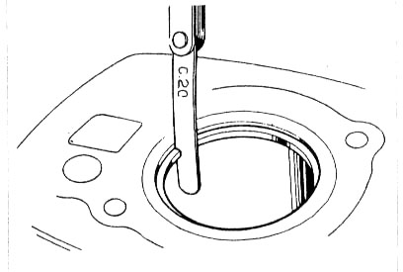
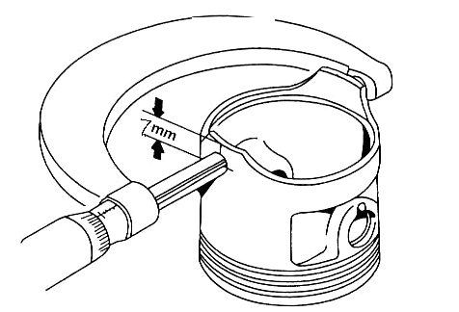
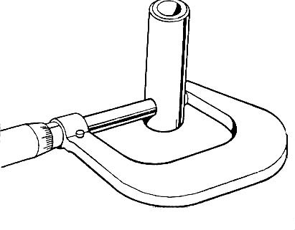
Disassembly of piston
Remove the piston pin retainer with sharp nose pliers and take off the piston pin and piston.
Caution.
-The piston pin retainer should not be dropped into the crankcase when removing the retainer.
Inspection of pistons and piston rings
1、Remove the piston ring.
2、Measure the clearance between the piston ring and the piston ring groove, repair limit value.
First ring: 0.08 mm
Second ring: 0.08 mm
Oil ring: 0.08 mm
3、Check whether the piston is worn or cracked, and whether the piston ring groove is worn.
4、Insert the piston ring into the cylinder, then measure the piston ring closing gap.
Repair limit value.
The first ring: 0.5mm
Second ring: 0.5mm
Oil ring: 1.4 mm
5. Measure the outside diameter located at a height of 7 mm from the piston skirt.
Repair limit value: φ94.43 mm
6、Figure out the clearance between the cylinder and the piston.
Repair limit value: 0.1mm
7、Measuring the outer diameter of the piston pin.
Repair limit value: φ19.99 mm
8、 Calculate the clearance between the piston and the piston pin.
Repair limit value: 0.025 mm
English
version
173

Slide 6
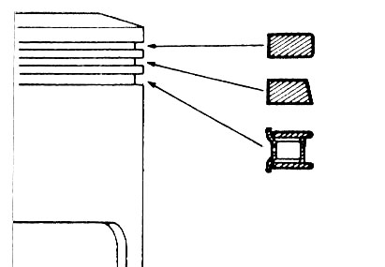
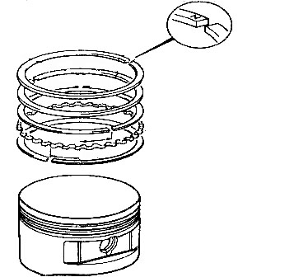
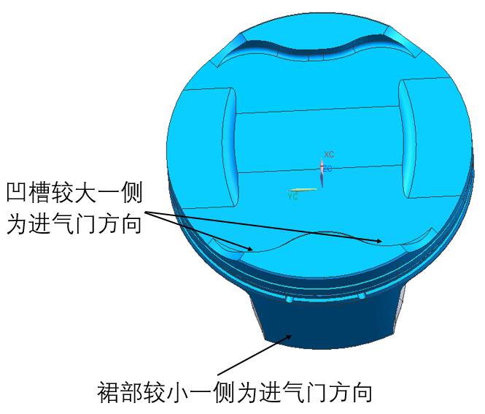
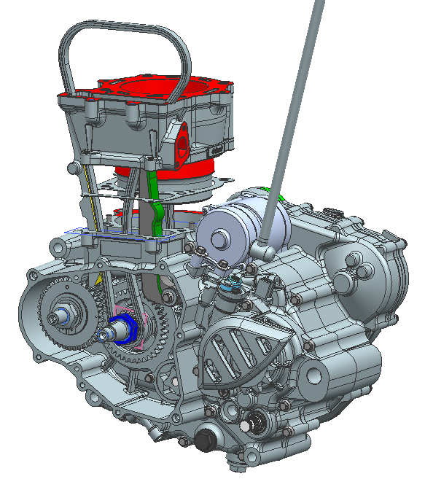
Installation of piston rings
1, the piston ring groove will be thoroughly cleaned.
2、Fit the piston ring.
Caution.
1, in the installation, should prevent the piston and piston ring from being destroyed.
2、When installing the piston ring, the first ring and the second ring should not be installed wrongly, and the side of the first ring and the second ring with the mark should face the top of the piston.
3、After installation, the piston ring should rotate flexibly.
3、The gap between each ring in the oil ring should be matched with the gap of the spacer ring; when installing the oil ring, the spacer ring should be installed first, and then the side guide.
Installation of piston
Install the piston ring, piston pin and new piston pin retainer on one side.
Attention.
1. when installing the piston, the smaller side of the skirt should face the intake side of the engine, or the larger side of the top groove should face the intake side.
2. the opening of the piston pin retaining ring end gap should be facing downward.
3. the piston pin retaining ring must be replaced with a new retaining ring if the deformation is serious.
4. Do not let the piston pin retainer fall into the crankcase.
The larger side of the concave transverse is the direction of the intake valve
The smaller side of the skirt is the direction of the intake valve
Cylinder installation
1, install the cylinder block locating pin, new cylinder block gasket.
2, in the cylinder block, piston and piston ring surface evenly coated with a layer of oil;.
3、First stagger the openings between the piston rings 120° from each other, then gently assemble the cylinder block in place.
4、Assemble the chain guide plate in place.
English
version
Note: When installing the cylinder block, avoid destroying the piston rings.
174

