Slide 1
Magneto, balance driving and driven gear
1 Repair instructions ................................................................................................. 188
2 Disassembly of the left crankcase cover, magneto stator and rotor ... 189
3 Disassembly of balancing master and slave gears, left body oil pump ... 190
4 Inspection of the left crankcase cover, magneto stator and rotor ........... 190
5 Balancing master and slave gears Inspection and installation of the left body oil pump .............................................................................................................. 191
6 Installation of magneto stator and rotor, left crankcase cover ............... 192
English
version
187

Slide 2
Repair instructions
The removal and installation of the magneto and balanced master and slave gears described in this section
This can be done by simply removing the left crankcase cover without removing the engine.
English
version
188

Slide 3
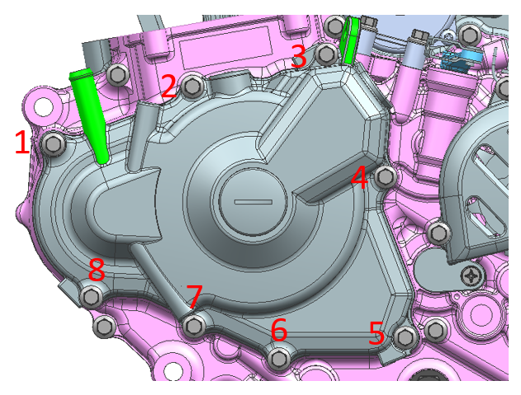
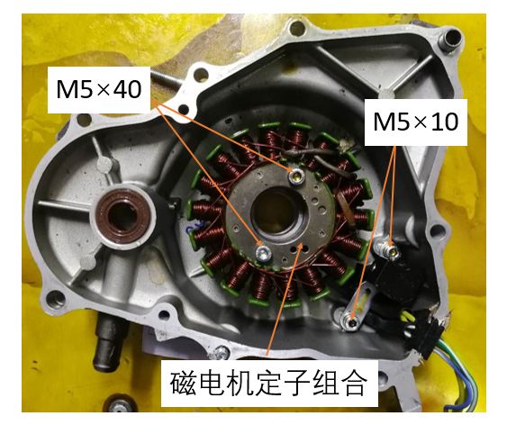
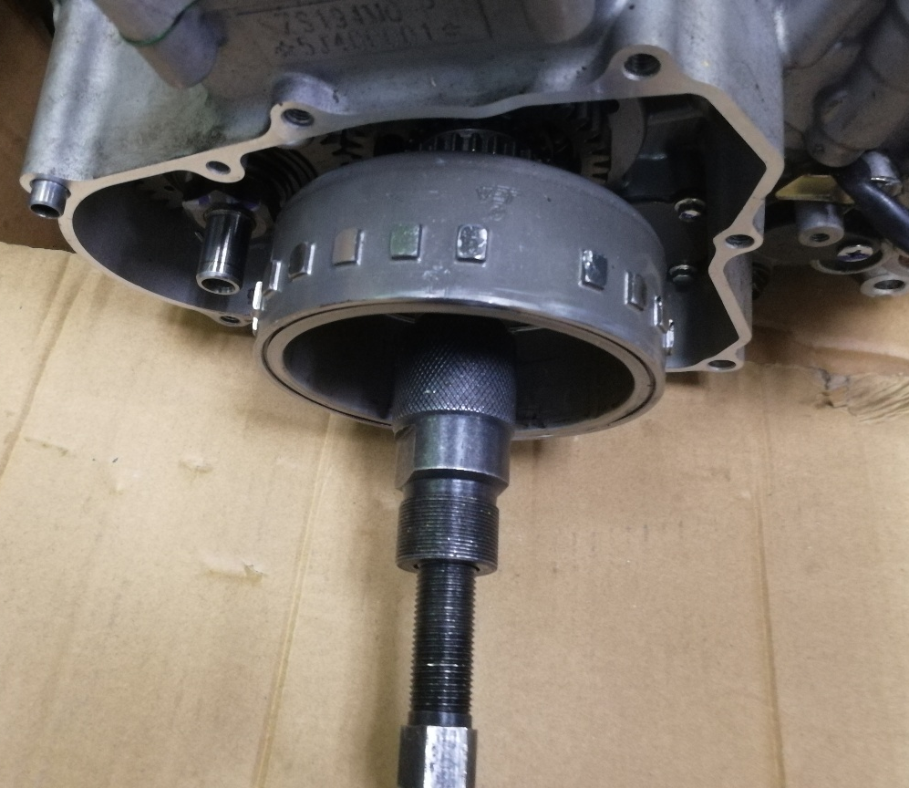
Disassembly of the left crankcase cover
Remove the left front cover 8 fastening bolts and remove the left crankcase cover.
Disassembly of magneto stator
1、Remove the 2 bolts M5×10 fastening screws of sensing.
2、Remove the 2 bolts M5×40 fastening screws of the stator coil, and then remove the magneto stator combination from the left crankcase cover.
Magneto stator assy
Disassembly of rotor
Remove the magneto rotor lock nut and remove the magneto rotor with special tools.
Attention.
1. magneto rotor disassembly can only be disassembled with special tools, do not allow knocking magneto rotor.
2. The magneto rotor should be replaced with a new magneto rotor if the rotor is subjected to accidental impact during disassembly and assembly, such as if the magneto rotor falls to the ground or is struck by a foreign object.
English
version
189

Slide 4
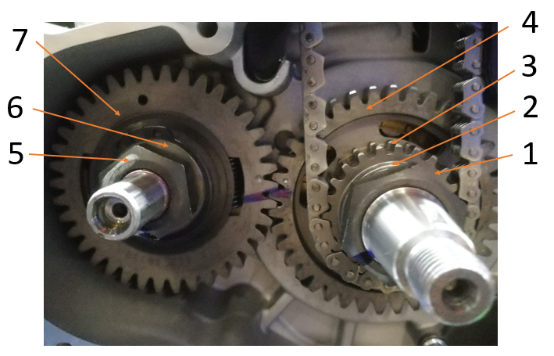
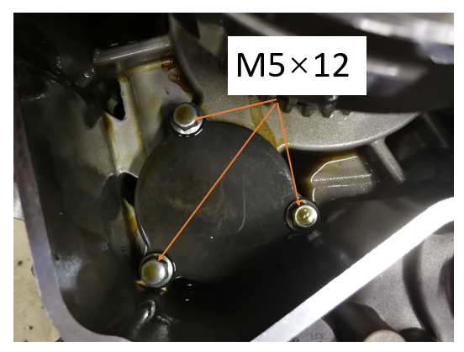
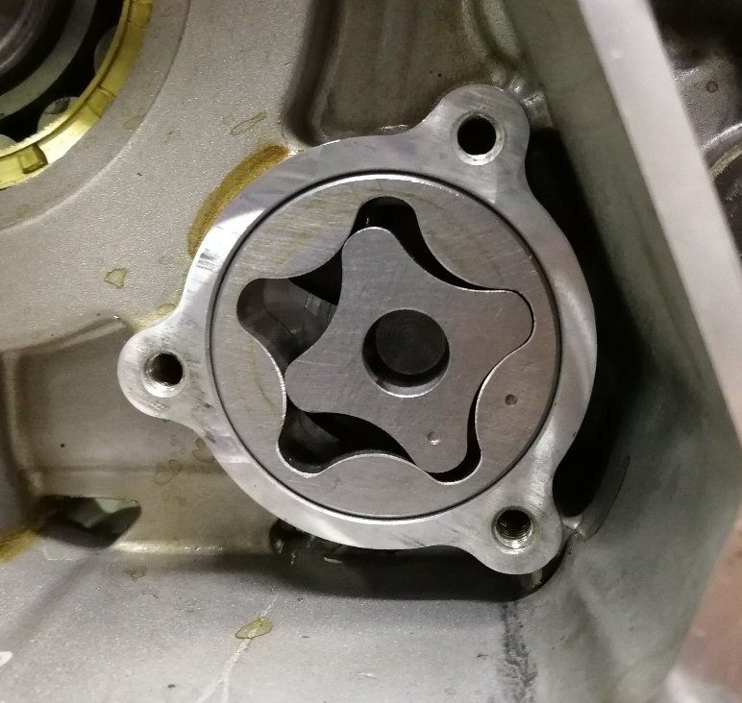
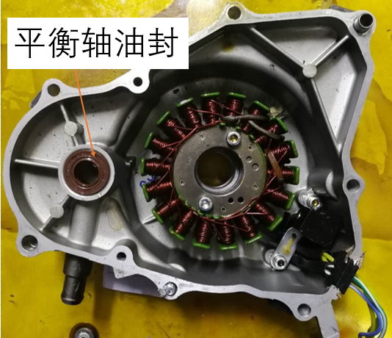
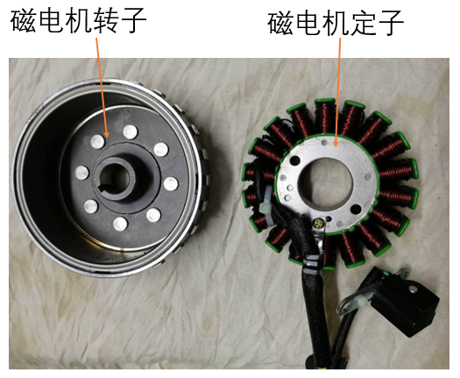
Disassembly of balancing master and slave gears
1、Remove the balance active gear lock nut (1) and active gear lock nut washer (2), respectively.
2、Remove the crankshaft timing active sprocket (3) and balance active gear (4).
3、Remove the balance follower gear lock nut (5) and disc washer (6).
4、Remove the balance tooth driven wheel (7), crankshaft sleeve and balance shaft flat key.
Disassembly of left body oil pump
1、Remove the 3 bolts M5×1 2 that fasten the left oil pump cover plate.
2、Remove the oil pump cover plate, remove the left oil pump rotor assembly, the oil pump pin should be properly stored to avoid loss.
Balance shaft oil seal
Inspection of the left crankcase cover
Check the balance shaft oil seal of the left crankcase cover for damage. If so, replace the balance shaft oil seal.
Inspection of magneto stator and rotor
1、Check whether the magnetic motor rotor tile is cracked or broken, if so, it needs to be replaced with a new magnetic motor rotor.
2, check whether the magneto stator coil is black, if there is a need to replace the new magneto stator.
Magneto rotor
Magneto stator
English
version
190

Slide 5
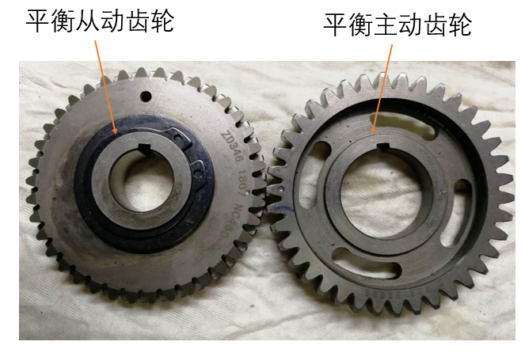
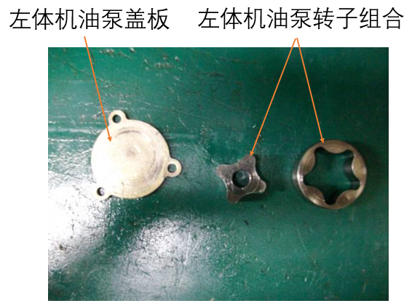
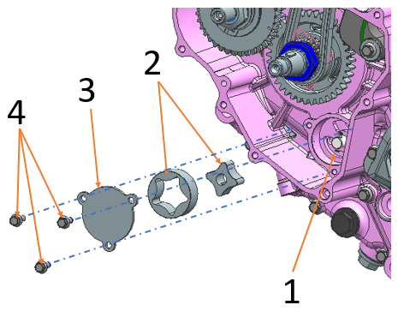
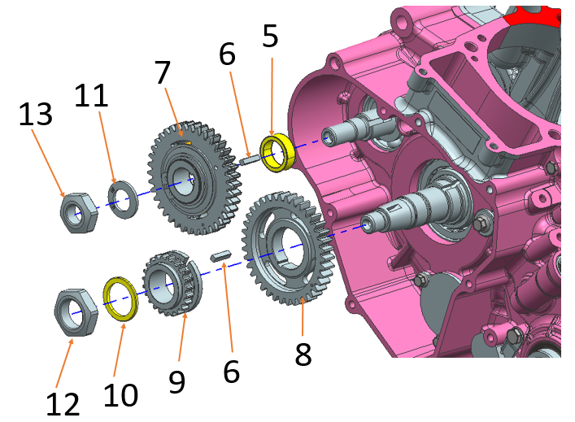
Balance driving gear
Balancing master and slave gears Inspection
1、Check whether the balance master and driven gears are worn or damaged.
2、Balance driven gear buffer spring is broken, if there is broken need to replace the new gear.
Inspection of the left body oil pump
1、Check the left body oil pump rotor assembly for wear and damage.
2、Check the left body oil pump cover plate for wear and damage.
oil pump plate
oil pump rotor assy
Installation of the left body oil pump
1、Fit the left body oil pump pin (1) into the corresponding hole of the oil pump shaft, and then fit the left body oil pump (2) into the corresponding hole of the left body.
2、Fasten the oil pump left cover (3) with 3 bolts M5×1 2 (4).
Attention.
1. when installing the oil pump rotor, the marked surface of the inner and outer rotor should face the same direction.
2. tightening torque of the left oil pump cover bolt: 7 to 9N-m.
3. Check whether the oil pump shaft rotates flexibly after tightening.
Inspection of the left body oil pump
1、First install the crankshaft sleeve (5) to the balance shaft, then install the balance shaft flat key (6) into the keyway of the balance shaft, and finally install the balance driven gear combination (7) to the balance shaft.
2. first install the balance active gear (8) onto the left crank, then install the balance shaft flat key (6) into the keyway of the crankshaft, and then install the crankshaft timing sprocket (9) onto the left crank.
English
version
Attention.
When loading the balanced master and driven teeth, the timing marks of the balanced master and driven teeth should be corrected, i.e. the teeth with timing marks of the balanced master and driven teeth should be engaged with each other.
191

Slide 6
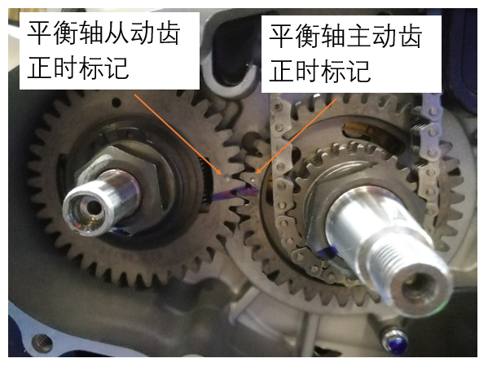
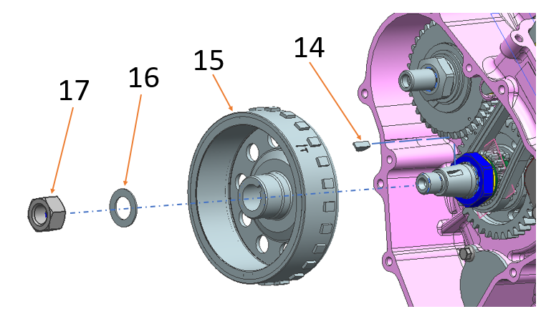
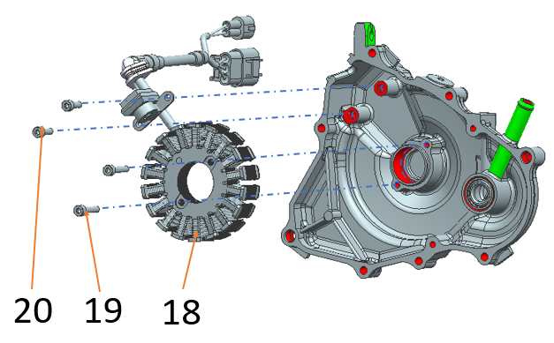
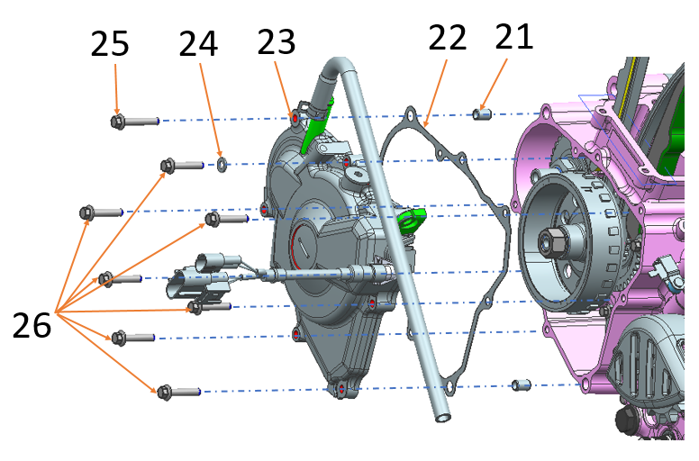
(10) and disc washer (11) onto the crankshaft timing active sprocket (9) and balance driven gear combination (7), and put 3 to 4 teeth of thread fastening adhesive on the balance shaft active tooth lock nut M24×1 (12) and balance shaft driven tooth lock nut M16×1 (13) and then put them onto the crankshaft and balance shaft and fasten them.
Balancing driven tooth lock nut tightening torque.
80～90N.m.
Balancing active tooth locking nut tightening torque
115~125N-m.
Balance shaft driven tooth timing mark
Balance shaft driving tooth timing mark
Installation of magneto rotor
1, magneto semi-circular key (14) a, installed in the crankshaft semi-circular key slot.
2, the magneto rotor (15) will be installed on the left crank, and then the magneto nut (17) will be installed on the left crank and fastened with the washer (16) after applying 3 to 4 teeth of thread fastening adhesive.
Note: the magneto rotor lock nut tightening torque: 80-90 n. m
Installation of magneto rotor
Fasten the magneto stator assembly (18) to the left crankcase cover with 2 screws M5×10(20) and 2 screws M5×40(19), tightening torque: 7 ~ 9N·m.
Installation of magneto left crankcase cover
1, remove the old gasket (21), install the new gasket;.
2, the two locating pins (22) will be installed to the box body.
3, then the left crankcase cover (23) assembly in place and two M6 × 35 bolts (24) fastened, six M6 × 30 bolts (25) fastened, tightening torque: 11 ~ 13 N .m.
English
version
Note: One of the M6 × 30 bolts (26), the disk part coated with three and glue, set into the flat washer (27), inserted into the corresponding position shown in the figure
192

