Slide 1
Crankcase, crankshaft, variable speed drive, balance shaft
1 Maintenance instructions ..................................................................................... 194
2 Crankcase Disassembly, Crankshaft/Balance Shaft/Main shaft and Co-Shaft Disassembly....................................................................................................................... 195
3 Inspection of crankshaft and left and right case bearings ............................ 195
4 Inspection of fork jaws/shift drum/ main and subshaft assembly/oil filter parts, oil screen ............................................................................................................... 196
5 Transmission/crankshaft/balance shaft assembly/combined box ............ 197
6 Assembly of oil screen ........................................................................................... 198
English
version
193

Slide 2
Maintenance instructions
This section introduces the installation and testing of transmission, crankshaft and balancing mechanism. When carrying out the above work, the crankcase should be separated first, and the disassembly of other parts about the engine should be carried out before the crankcase is separated.
Work before crankcase separation:
-Disassembly of cylinder head
-Cylinder/piston disassembly
-Disassembly of clutch, oil pump, gearshift mechanism, balance gear
-Disassembly of magneto
Shift forks/Shift fork shaft/Crankshaft /Balance Shaft Specifications
item |  |  | standard values mm | Maintenance limit values mm
Shift forks | Internal diameter of the right fork of the secondary shaft / Internal diameter of the left fork of the secondary shaft |  | φ12.016～φ12.043 | φ12.045
 | Internal diameter of spindle fork |  | φ12.016～φ12.043 | φ12.045
 | Jaw thickness |  | 4.8～4.9 | 4.8
Shift fork shaft | Spindle fork shaft OD |  | φ11.973～φ12 | φ11.95
 | Subshaft fork shaft OD |  | φ11.973～φ12 | φ11.95
 | Cylindricity |  | 0.006 | ----
Crankshaft | Connecting rod small head inner diameter |  | φ20.015～φ20.025 | φ20.04
 | Big end side clearance of connecting rod | axial direction | 0.15～0.4 | 0.7
 |  | radial direction | 0.008～0.016 | 0.02
Balance Shaft | diameter of axle |  | φ19.98～φ19.993 | φ19.96
English
version
194

Slide 3
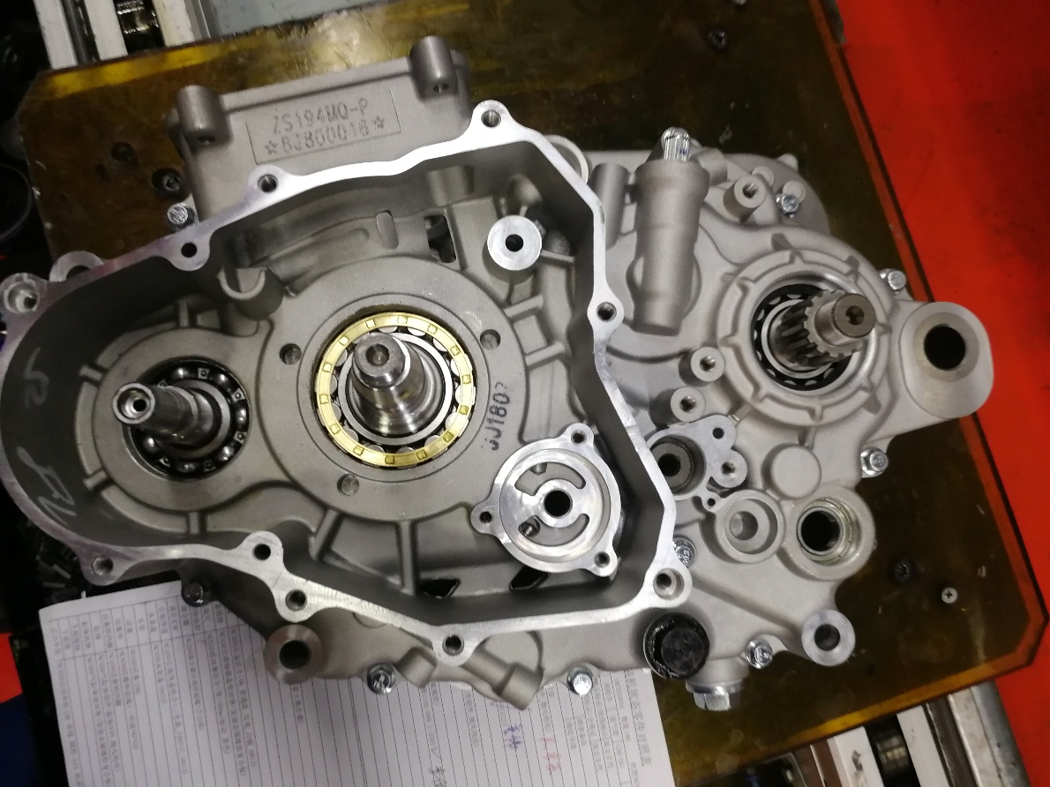
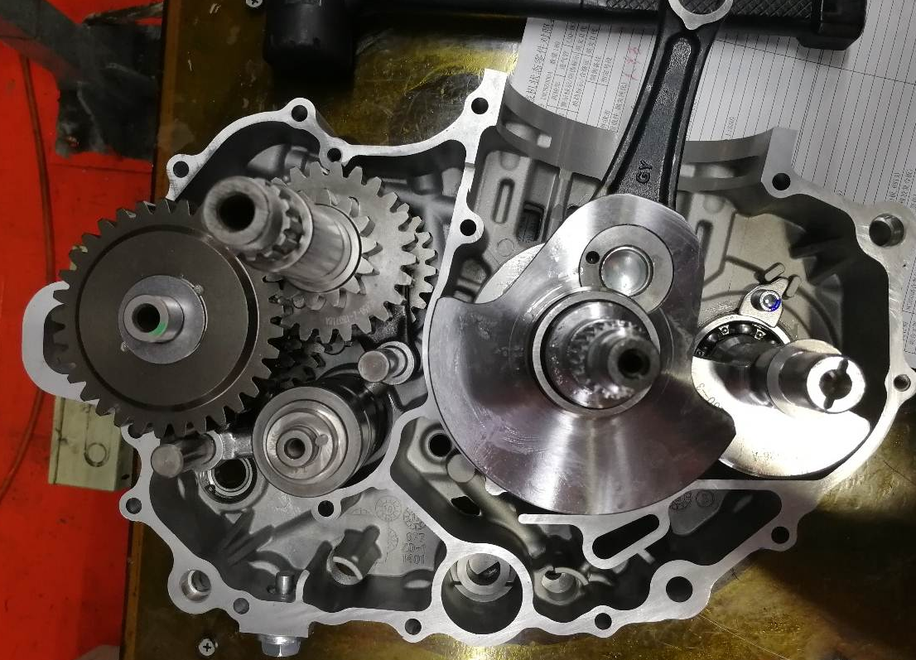
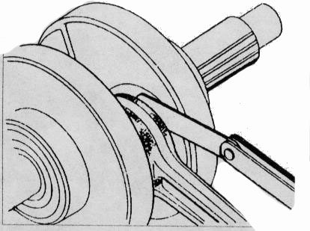
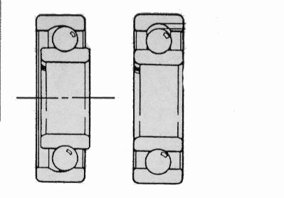
Crankcase Disassembly
1. Place the left crankcase of the engine upward; 2, remove the 3 bolts M6 M6 x 65 x 70, 3 bolt, six bolt fastening screws M6 x 45, separate left crankcase and right crankcase, remove the two pins.
Crankshaft/Balance Shaft/Main shaft and Co-Shaft Disassembly
Remove the crankshaft assembly, balance shaft, fork shaft, fork, shift drum, Main shaft and Co-Shaft from the box.
Caution.
Make sure no parts are left behind when picking up the Main shaft and Co-Shaft assemblies.
Inspection of crankshaft
Measure the side clearance of the big head of the connecting rod with a thickness gauge.
Repair limit value: 0.7 mm
Inspection of the left and right box bearings
1, check the left and right box all bearing rotation is flexible; If the rotation is not flexible or there is a card phenomenon, the same type of bearing should be replaced.
English
version
195

Slide 4
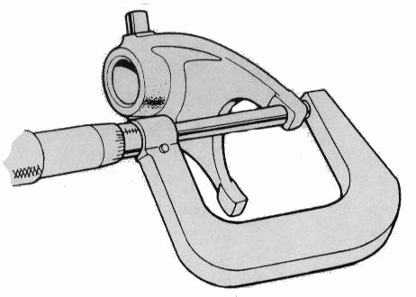
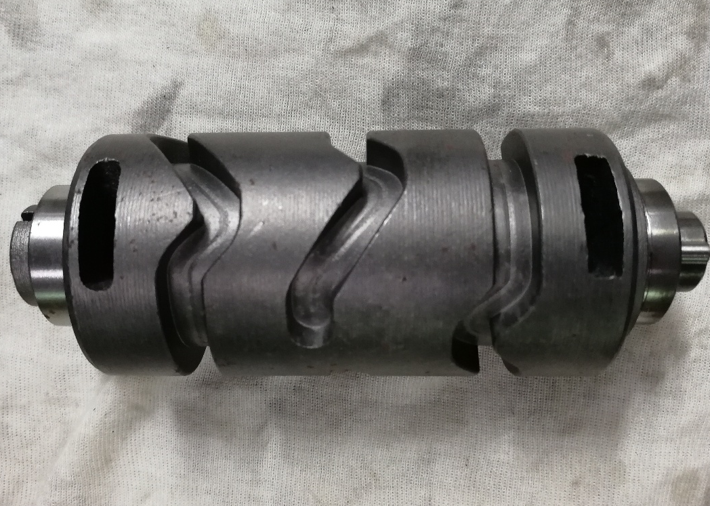
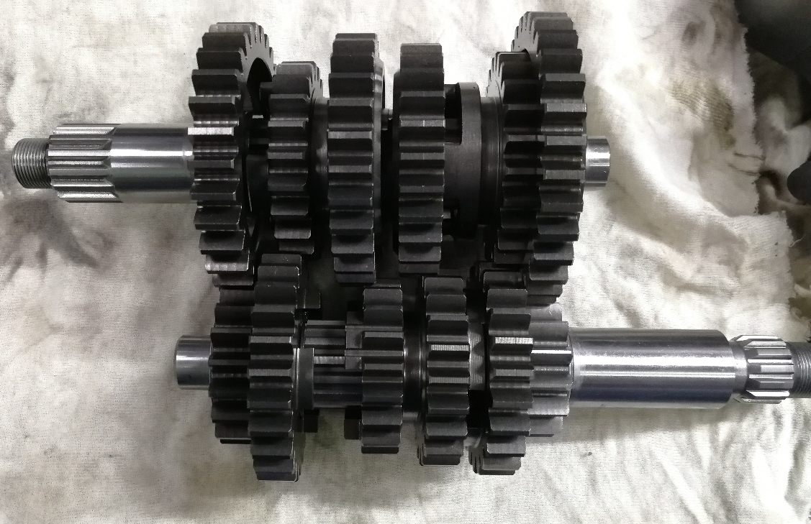
Measure the thickness of the fork claw. Maintenance limit value: 4.7 mm
Check the variable speed drum surface and grooves for wear or damage.
Inspection of main and auxiliary shaft components
Check whether the gears of the main and auxiliary shaft components have excessive or abnormal wear, and check whether the rings between the gears have deformation and fall off.。
Inspection of oil filter parts and oil screen
1、Check the cleanliness of the oil filter parts and oil screen; rinse the poorly cleaned oil filter parts and oil screen with clean gasoline.
2、Check whether the oil filter parts and oil screen are damaged; if there is damage, replace the oil filter parts and oil screen with new ones.
English
version
196

Slide 5
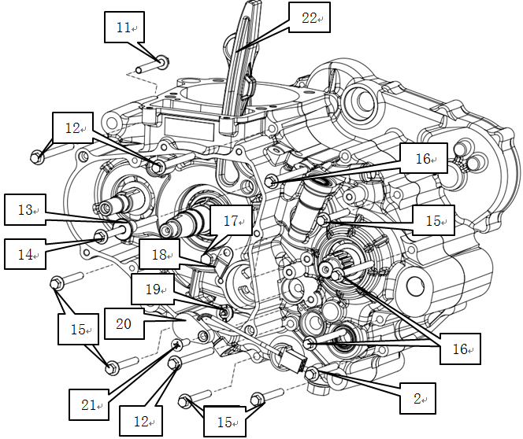
Transmission/crankshaft/balance shaft assembly
1, the balance shaft (1), (2) the crankshaft to the corresponding hole in the left body, 2 (3), the main and auxiliary shaft component to the left the corresponding hole in the body, then fork (4), (5), (7) assembly to the corresponding position,
Attention.
1. the fork marked with --R is installed into the side of the secondary shaft against the right body.
2. The fork marked with --L is installed into the side of the secondary shaft against the left body.
3. The fork marked with --C is mounted on the main shaft.
Caution.
The long fork shaft passes through the fork marked -R, marked -L, and the short fork shaft passes through the fork marked -C.
3. Install the shift drum (5) into the corresponding hole of the left body, then assemble the other end of the fork into the corresponding slot of the shift drum, and finally install the fork shaft (8) and (9) into the corresponding fork.
combination
1. apply a layer of sealant evenly on the combined box surface of the right box body, install the positioning pin (10) into the corresponding hole of the left box body, and then close the right box body on the left box body.
2, take six M6 × 45 screws (15), three M6 × 65 screws (16), three M6 × 70 screws (12), one M6 × 40 bolts (11), apply 3 to 4 teeth of thread adhesive, then insert them into the corresponding bolt over hole in the crankcase, and tighten them with a pneumatic gun.
3、Take the tensioning plate (22), tensioning plate bushing (13) and one M6×105 bolt (14), apply 3~4 teeth thread glue to the bolt, first insert the tensioning plate bushing into the corresponding hole of the tensioning plate, then fasten the tensioning plate in the corresponding hole of the left body with a screw;.
4、Put the CG125D-2# gear dynamic contact (19) into the corresponding slot of the gear drum, then take the gear wire harness (20), put it into the corresponding hole of the left body, and fasten it with one M6×20 screw (21).
5. Take one M6×12 bolt (17), press the gear display harness under the CB125 foot-2# block wire piece (18) and fasten it tightly in the corresponding position of the left body.
English
version
197

Slide 6
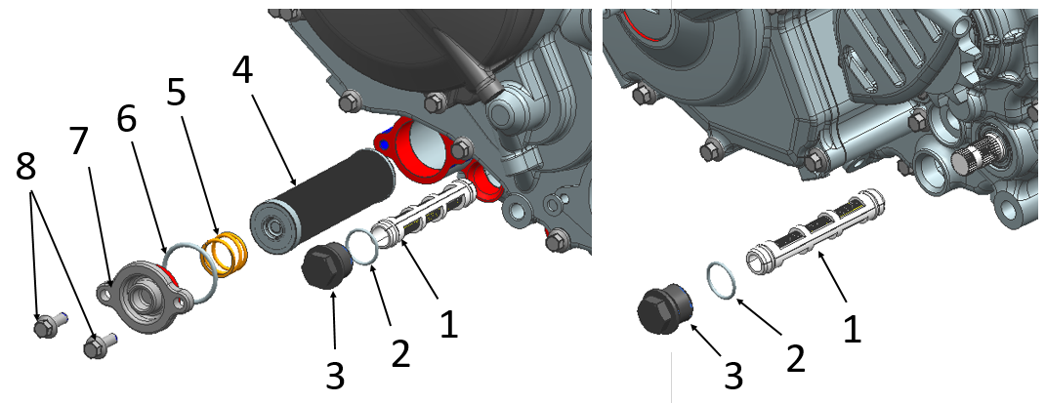
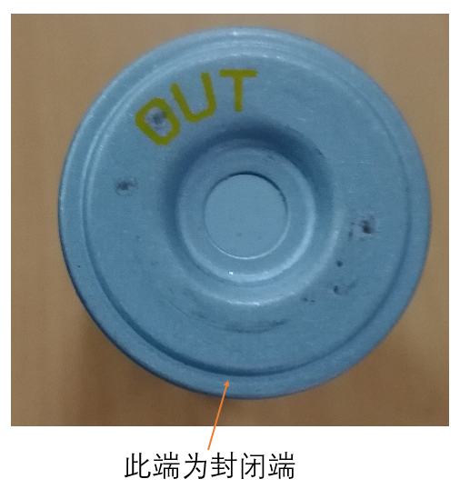
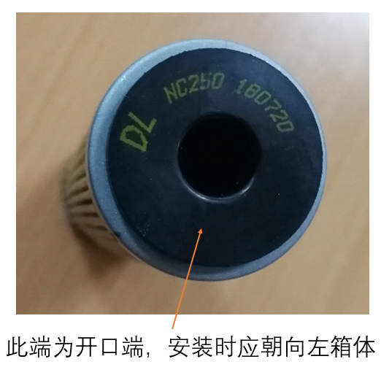
Fastening torque: 11 ~ 13 N·m.
Assembly of oil screen
1、Assembly of the left body oil filter
Take 1 oil screen combination (1), apply a small amount of oil on its O-ring and put it into the corresponding oil screen hole. Fit the oil screen cover 0-ring (2) to the oil screen cover, apply an appropriate amount of grease to the inner hole of the oil screen cover (3), and fasten it to the case.
Fastening torque: 11 ~ 13 N-m.
2, the right body oil screen assembly
a. Take 1 oil screen combination (1), apply a small amount of oil on its O-ring, install it into the corresponding oil screen hole, install the oil screen cover 0-shaped seal (2) onto the oil screen cover, play an appropriate amount of oil in the inner hole of the oil screen cover (3), and fasten it on the box.
Fastening torque: 11~13 N-m.
b. Take the oil filter part (4) and put it into the corresponding hole of the right box
c. Put the fine filter spring (5) onto the oil filter parts, set the fine filter cover 0-shaped seal (6) into the seal groove of the fine filter cover (7), take 2 small disc bolts M6×16, put them into the corresponding holes of the fine filter cover, and fasten them in the corresponding positions of the right body
Fastening torque: 7 to 9 N-m.
closed end
Caution.
When installing the oil fine filter, the open end should face the left box
opened end The installation should face to the left of the box
English
version
198

