Slide 1
Rear wheel, suspension
1 Overview ..................................................................................................................... 217
2 Troubleshooting ...................................................................................................... 217
3 Component Location ............................................................................................. 218
4 Rear wheel ................................................................................................................. 219
5 Rear flat fork ............................................................................................................. 221
6 Rear shock/suspension assembly ..................................................................... 222
English
version
216

Slide 2
Overview
-When repairing the rear wheel and suspension and related parts, you need to support the motorcycle with a professional workbench or equivalent.
-Do not operate the brake pedal after removing the rear wheel.
-Check the brake operation by depressing the brake pedal after installing the rear wheel.
-After installing the rear wheel, perform an air gap check.
-All suspension pivots and suspension points can only be replaced with genuine Escalade bolts and nuts.
Troubleshooting
Steering to one side or not straight ahead
-Drive chain adjuster unevenly adjusted
-Shaft bent
-Flat fork shaft wear
Rear wheel shaking
-Tires have deformation
-Wheel bearings worn or damaged
-Slave flange bearings worn or damaged
-Shaft not properly tightened
-Rear flat fork pivot bearing is damaged
-Suspension assembly bolts not properly tightened
-Tires and rims unbalanced
Wheel is difficult to turn
-Damaged wheel bearings
-Bent axle
-Drive chain too tight
-Braking resistance
Soft suspension
-Low tire pressure
-Incorrect suspension adjustment
-Shock absorber spring weakness
-Shock absorber unit leaking oil
Stiff suspension
-Tire pressure is high
-Suspension incorrectly adjusted
-Shock absorber rod bent
-Damaged suspension or slew pivot bearing
-Slewing pivot improperly tightened
Rear suspension noise
-Loose suspension fasteners.
-Suspension pivot bearing worn or damaged
-Shock absorber failure
English
version
217

Slide 3
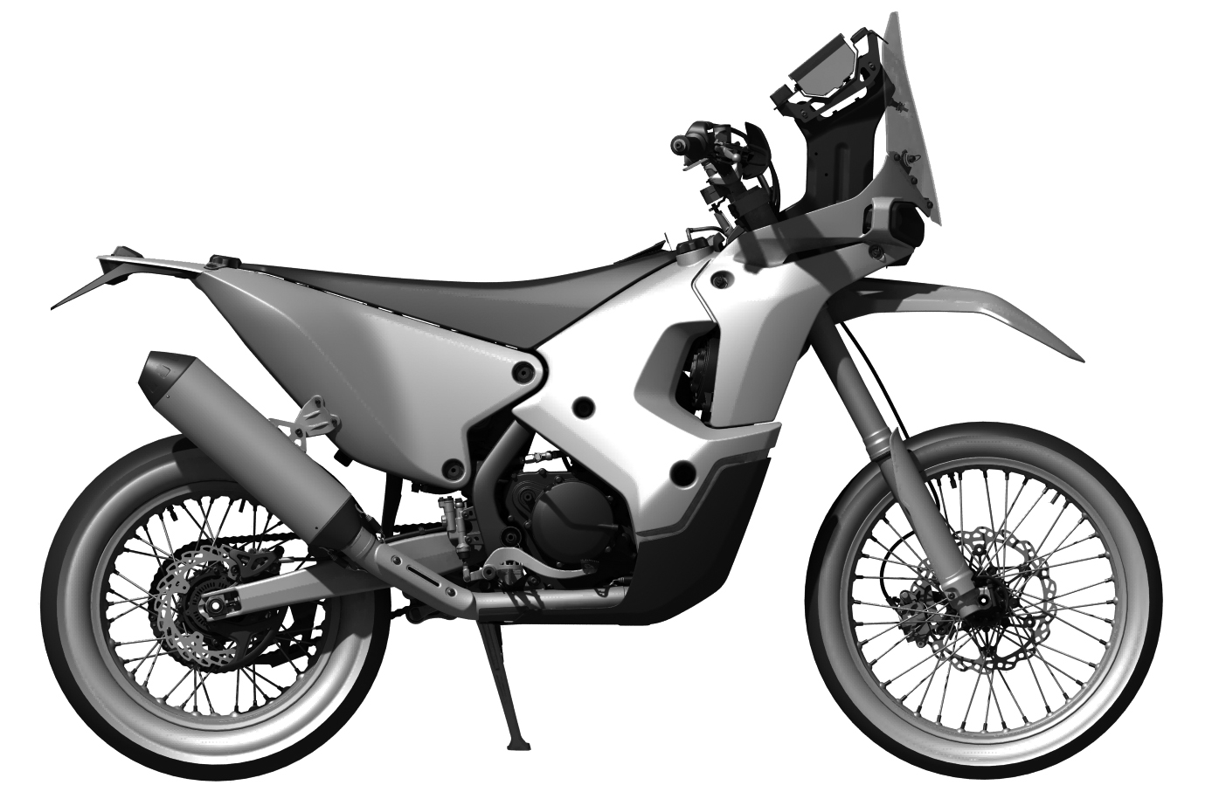
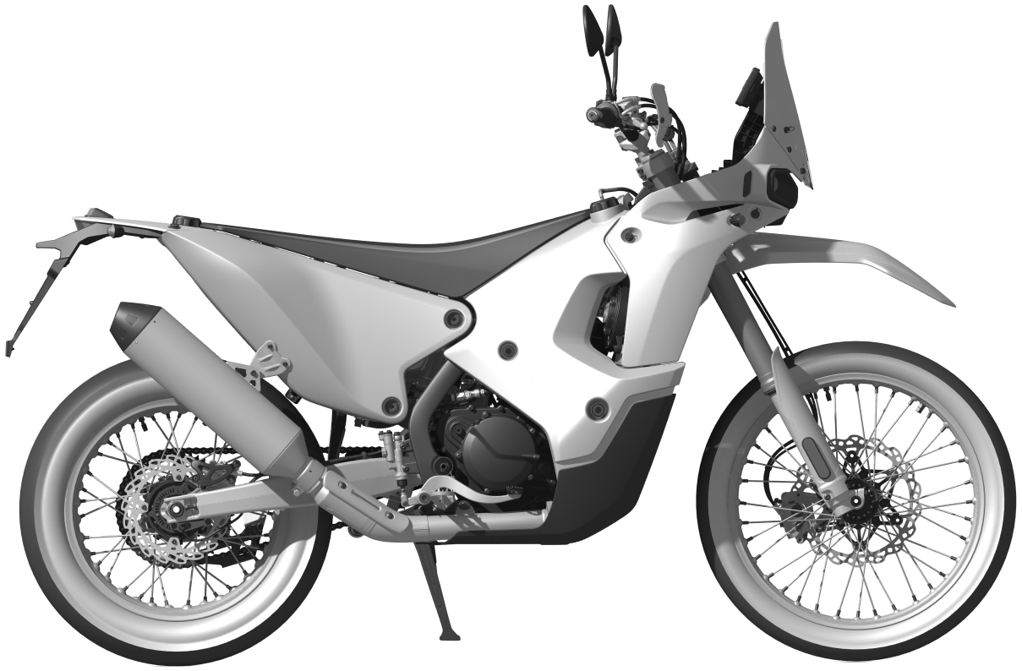
Component Location
factory edition
Rear wheel
Rear fork
regular edition
Rear wheel
Rear fork
English
version
218

Slide 4
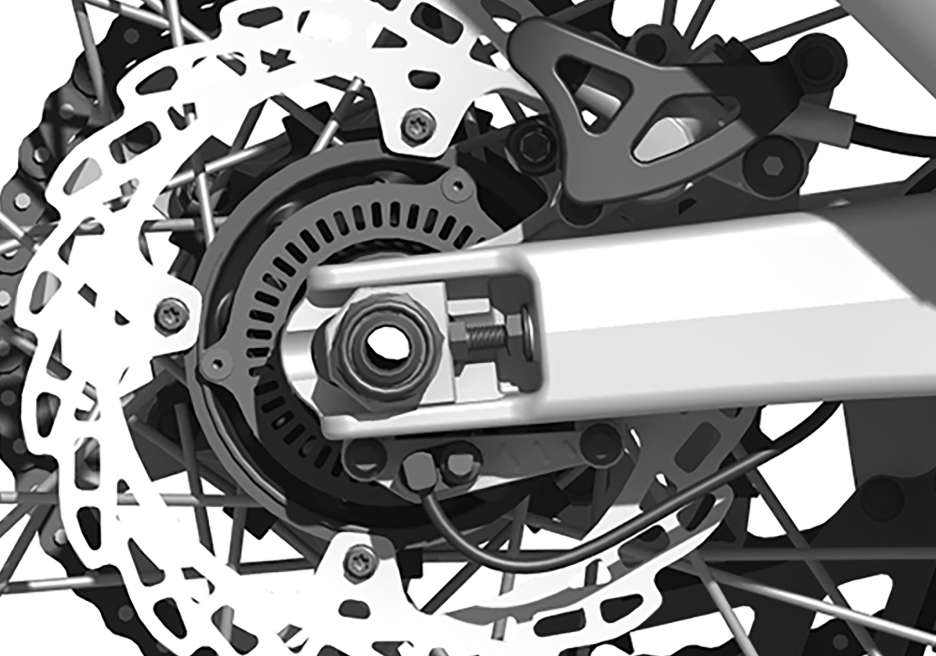
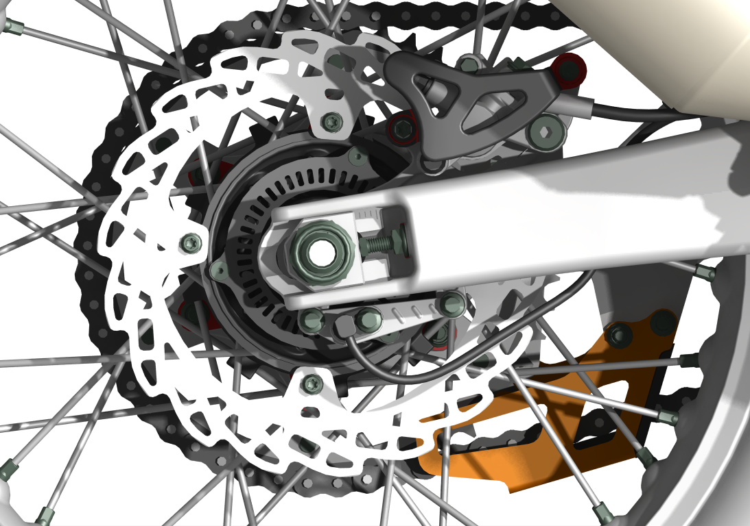
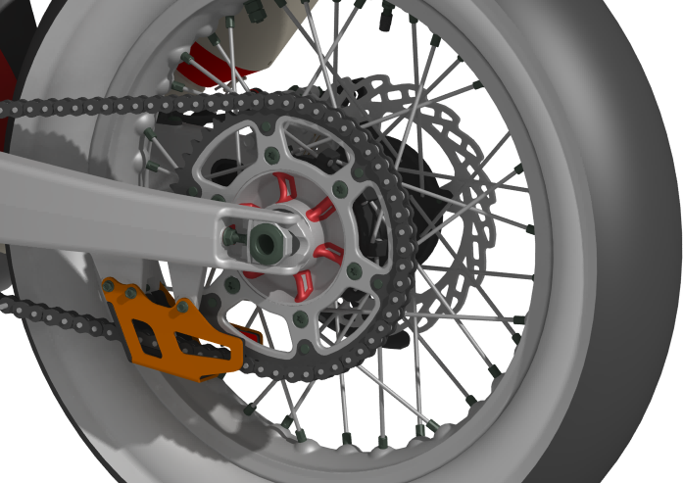
※Rear wheel
Place a bench or equivalent under the engine to lift the rear wheels off the ground.
Disassembly/Installation
Remove the following components.
- 1 bolt [1].
- Rear wheel speed sensor [2].
- 2 bolts [3].
- Removal of the wheel speed sensor bracket [4].
[3]
[2]
[1]
[4]
Disassembly/Installation
Remove the following components.
- Loosen the rear axle lock nut [1].
- Remove the rear wheel axle [2] by holding the rear wheel.
- Push the rear wheel forward to disengage the chain from the large sprocket [3].
- Remove the rear brake caliper and caliper bracket [4]
- Remove the rear wheel assembly [5];
Torque.
Rear wheel axle lock nut
128 N.m (12.8 kgf.m, 95 lbf.ft)
Installation is in reverse order of removal.
[1]
[4]
[3]
Note: after, remove the wheels do not operate the brake pedal.
[5]
[2]
Remove the following parts.
Rear wheel T-bush - left side [1];
Rear wheel bushings-right side [2];
English
version
219
[1]
[2]

Slide 5
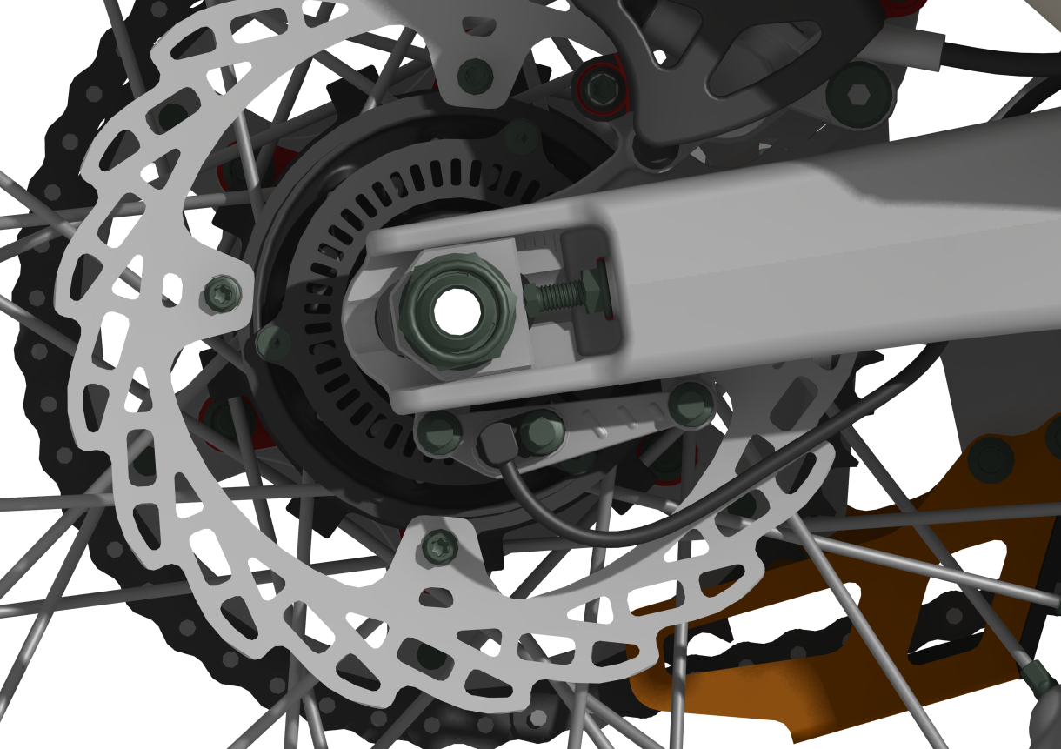
Caution.
-When installing the wheels, be careful not to let the calipers fall out of the rear flat fork tabs or damage the brake pads.
Install the rear axle from the left side.
-Before installing the rear wheel speed sensor [1], wipe the sensor tip and mounting area to remove any foreign material.
-Adjust drive chain slack.
-Check the clearance between the wheel speed sensor and the gear ring.
[1]
Inspection.
Turn the inner ring of each bearing with your finger, and the bearing should turn smoothly and quietly.
Also check that the outer ring of the bearing fits snugly in the hub.
If the bearing does not turn smoothly, rotate smoothly, or is not securely installed in the hub, replace the bearing.
English
version
220

Slide 6
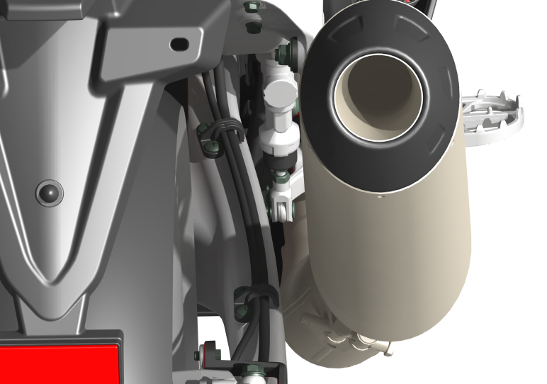
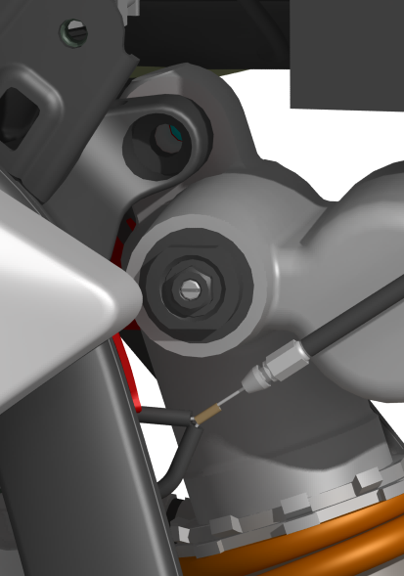
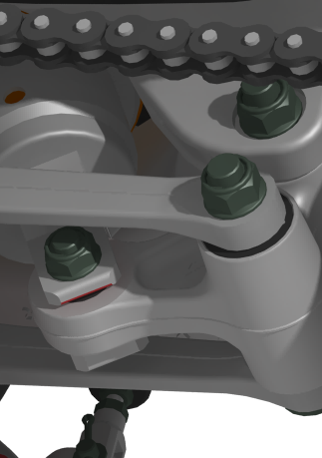
※Rear fork
Disassembly/Installation
Remove the following parts.
- Rear brake disc trim [1] factory edition models.
- Rear caliper trim [2].
- Rear wheel speed sensor [3] regular edition models.
- Disconnect the wheel speed sensor 2P (black) plug.
- Remove the screw [1] and the wire clip x2 [2].
[2]
[2]
[3]
[1]
[1]
[2]
- Removal of the rear shock absorber attachment bolts [1].
- Removal of U-shaped rocker attachment bolts [2].
- Removal of the lower rear shock absorber and triangular rocker attachment bolts [3].
- Removing the rear flat fork nut [4].
- Take out the flat fork shaft [5]
Remove the brake hose, speed sensor wire and drive chain.
Install in the reverse order of removal.
Caution.
Install the rear flat fork shaft from the left side.
Apply grease to the flat fork shaft.
Torque.
Flat fork shaft nut.
88 N.m (8.8 kgf.m, 65 lbf.ft)
[1]
[3]
[2]
[4]
[5]
English
version
221

Slide 7
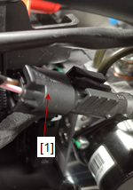
※Rear shock absorber/suspension assembly
Rear Shock Absorber
Remove the following components.
- Seat cushion assembly.
- Loosen the rear fuel tank assembly attachment nut [1].
- Loosen the lower nut [2] of the rear fuel tank to bracket connection.
[1]
[1]
- Remove the rear muffler and muffler bracket attachment bolts [3] lifting the rear fuel tank assembly.
- Disconnect the wheel speed sensor 2P (black) connector [4].
[2]
[2]
Rear shock absorber / triangle rocker / U-shaped rocker
Disassembly/Installation
Disassemble the following components.
- Removal of the U-shaped rocker to triangular rocker attachment nut [1].
- Remove the rear shock absorber and triangular rocker attachment nut [2].
- Remove the flat fork and triangular rocker attachment nut [3].
- Remove the nut [4] connecting the U-shaped rocker to the frame and take off the bolt.
- Removing the bolts connecting the upper part of the rear shock absorber to the frame [5].
Install in the reverse order of disassembly.
Caution.
Install the mounting bolts from the left side.
U-shape rocker and frame attachment nut.
Flat fork and triangle rocker attachment nut.
Rear shock absorber to triangle rocker attachment nut.
U-frame to triangle crankset attachment nut.
Torque.
60 N-m (6.0 kgf-m, 44 lbf-ft)
Upper rear shock absorber to frame attachment bolt :
Torque: 44 N-m (4.5 kgf-m, 32 lbf-ft)
[4]
[3]
[3]
[4]
[2]
[1]
[5]
English
version
222

