Slide 1
EFI
1. Overview ...................................................................................................... 90
2 System Location ........................................................................................ 91
3 EFI System Related Components ....................................................... 92
4 Introduction to System Troubleshooting Functions ................. 105
5 Inspection and Diagnosis Process ..................................................... 109
6 Troubleshooting based on fault codes .......................................... 109
7 Troubleshooting based on fault phenomena ............................. 118
8 Fault Code List....................................................................................... 123
English
version
89

Slide 2
1. Overview:
-This section introduces the EFI system service of MSE8.0, which is equipped with self-diagnostic function, when troubleshooting, please check and troubleshoot according to the fault diagnosis code and fault phenomenon.
-EFI system failure is usually related to poor connector connection or connector corrosion, please check the connector before troubleshooting.
Caution.
- During the repair process, it is prohibited to disassemble the parts of the EFI system.
- Repair process, take electronic components (electronic control unit, sensors, etc.), be very careful not to let them fall, and do not touch the electrical components pin parts to avoid damage caused by electrostatic breakdown.
- Do not arbitrarily remove any parts of the EFI system plug-in from its installation position to avoid accidental damage or water, oil and other foreign objects into the plug-in, affecting the normal work of the EFI system.
- When disconnecting and connecting the plug-in, be sure to put the ignition switch in the off position, otherwise it will damage the electrical components.
- As the idle speed adjustment is completely completed by the EFI system, no manual adjustment is required. The throttle limiting screw of the throttle body has been adjusted at the factory, and the user is not allowed to change its initial position at will.
-The car adopts the trigger signal of 24-2 teeth to identify the speed.
The following color codes used are indicated through this section
Bl=black | G=green | Lg=light green | R=red | Y=yellow
Br=brown | Gr=gray | O=orange | V=violet
Bu=blue | Lb=light blue | P=pink | W=white
English
version
90

Slide 3
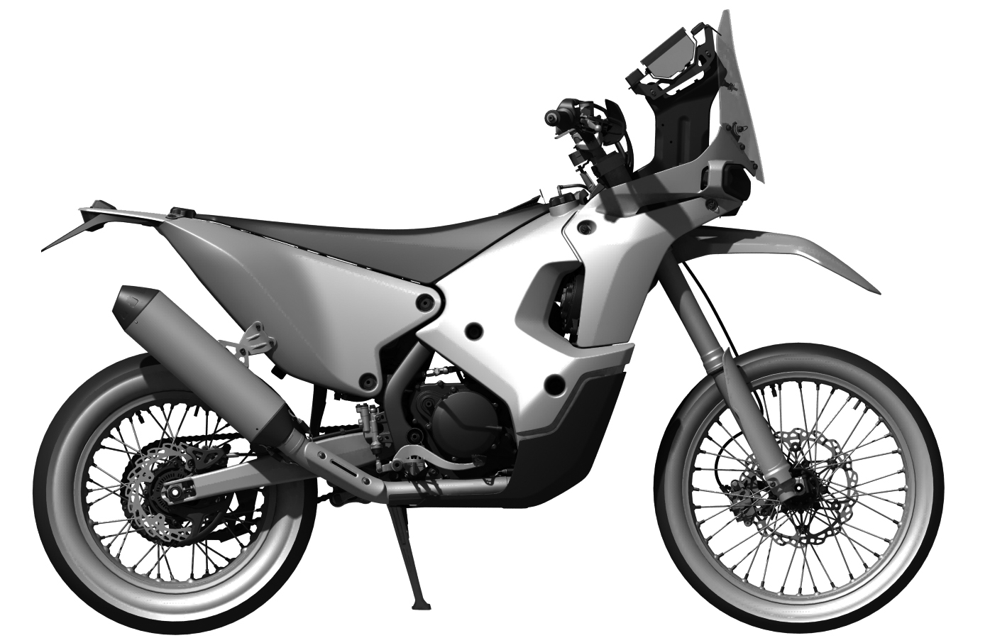
2. System location
Racing version
ECU
Ignition coil spark plug
Throttle Assembly
Oxygen Sensor
Civilian version
ECU Control Unit
Ignition coil spark plug
English
version
Throttle Assembly
Oxygen Sensor
91

Slide 4
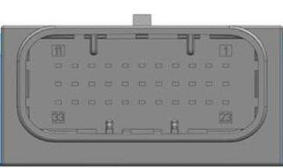
3. EFI system-related components
3.1 ECU electronic control unit
The electronic control unit is the brain of the entire EFI system and electrical appliances. It analyzes and processes the various information provided by the sensors and sends the resulting conclusions in the form of commands to the actuators so that the engine runs in an optimal state.
ECU Form Factor
Caution.
-Do not allow to add load to the housing or to the cover: take it gently and do not allow to drop it on the ground.
Function of each ECU pin.
ECU Connector Outline View
PIN-NO | SIGNAL | FUNCTION | PIN-NO | SIGNAL | FUNCTION
1 | A_P_LSVK | Upstream oxygen sensor 1 heating | 18 | A_S_MIL | MIL灯
2 | A_P_STPA | Stepper motor A | 19 | A_S _IIIR | Headlight relay (competitive version)
3 | E_F_ VSIN | Speed signal input (civilian version) | 20 | E_A_LSVK1 | Upstream oxygen sensor 1
4 | U_U_UBD | UBD continuous power supply | 21 | E_A_DKG | Throttle position sensor
5 | E_F_DGA | Engine speed sensor A terminal | 22 | NC | Reserved
6 | E_F_DGB | Engine speed sensor B terminal | 23 | NC | Reserved
7 | M_M_GND1 | Power ground 1 | 24 | A_P_STPC | Stepper motor C
8 | E_A_DS | Intake pressure sensor | 25 | A_P_STPB | Stepper motor B
9 | A_P_NMOT | Engine speed output | 26 | E_S_KL15 | Ignition Switch
10 | M_M_GND2 | Power ground 2 | 27 | M_R_SEN | Sensor ground
11 | A_P_ZUE1 | Ignition coil 1 | 28 | A_S_REL | Oil Pump Relay
12 | A_P_EV1 | Injector 1 | 29 | A_S_MR | Main Relay
13 | A_P_STPD | Stepper motor D | 30 | E_A_DUMP | Dump switch DUMP
14 | E_S_NGEAR | Neutral switch | 31 | E_S_RES1 | Side support switch
15 | A_U_5V1 | 5V power supply1 | 32 | E_A_TMOT | Engine coolant temperature sensor (water temperature sensor)
16 | B_D_CANL | CAN communication line low | 33 | E_A_TANS | Intake air temperature sensor
17 | B_D_CANH | CAN communication line height
English
version
92

Slide 5
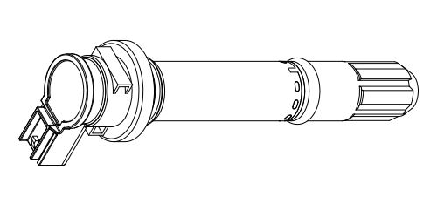
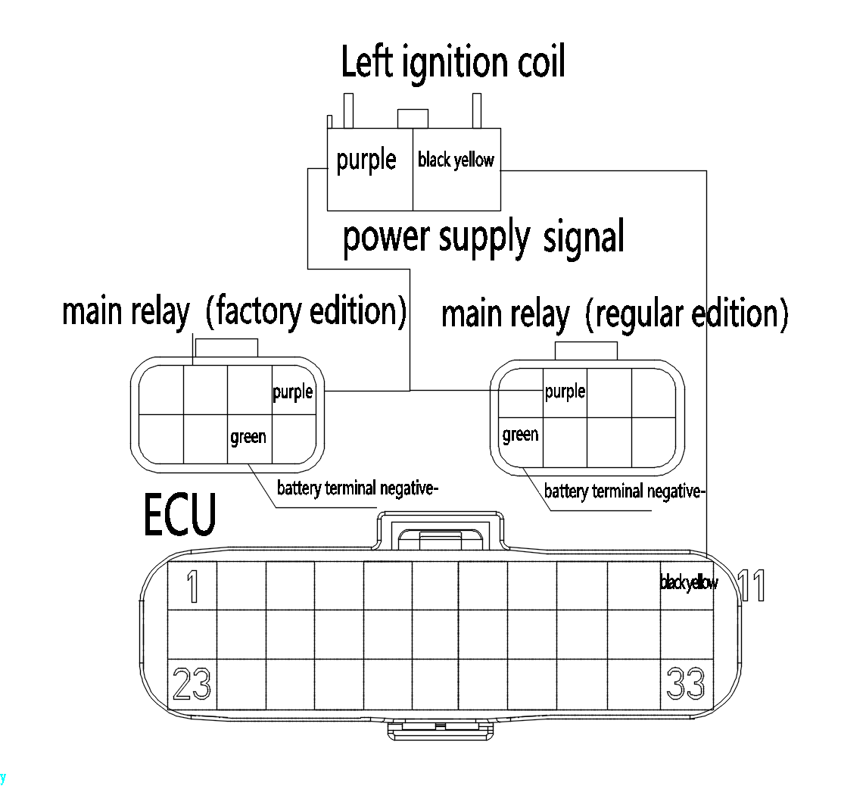
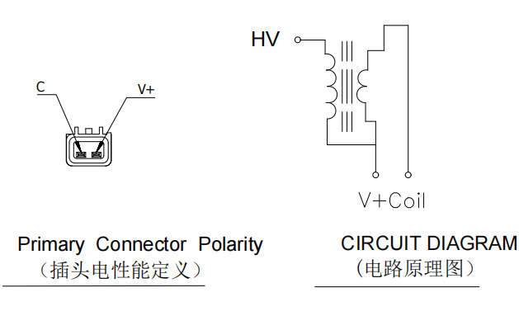
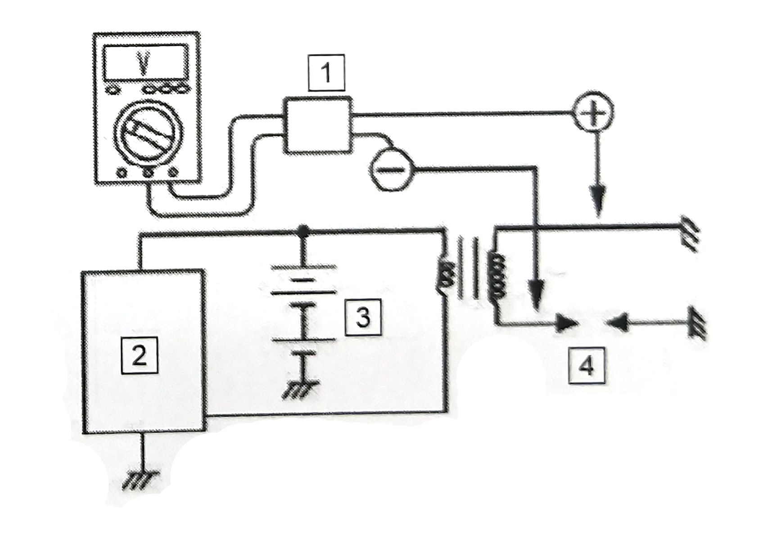
Ignition coil shape drawing
3.2 Ignition Coil
The ignition coil converts the low voltage electricity from the primary winding to the high voltage electricity from the secondary winding, which is discharged through the spark plug to produce a spark that ignites the fuel mixture in the cylinder.
Fig. 1
Definition of the function of each pin.
Power: connects to the main relay (violet)
Signal: connect to ECU pin 11 (black and yellow)
Figure 1: shows the wiring diagram of the ignition coil and ECU.
Measure the secondary ignition voltage.
Connecting the engine according to the EFI schematic.
Connecting the peak voltage measuring instrument according to the diagram.
Start the engine.
After starting, the secondary ignition voltage should be >22,500V.
Ignition coil parameter table
1. Static parameters
Primary resistance: 1.3±10%Ω
Secondary resistance: 8.7±10%KΩ
Primary inductance: 3.0±15%mH
Secondary inductance: 16±15%H
2.Dynamic parameters.
Supply voltage: 14±0.5V
Primary current: 7±0.9A
Ignition pulse width: 2.05±0.5msec
Secondary high voltage: MIN22.5KV at 25pF load
Ignition energy：MIN21.5mj
Operating temperature: -35℃-125℃
English
version
1 | Peak voltage measuring instrument | 3 | Battery
2 | ECU | 4 | Spark Plug
93

Slide 6
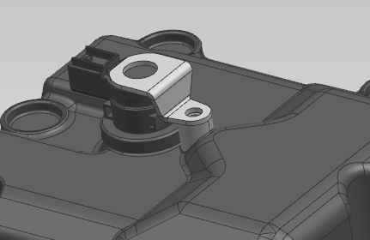
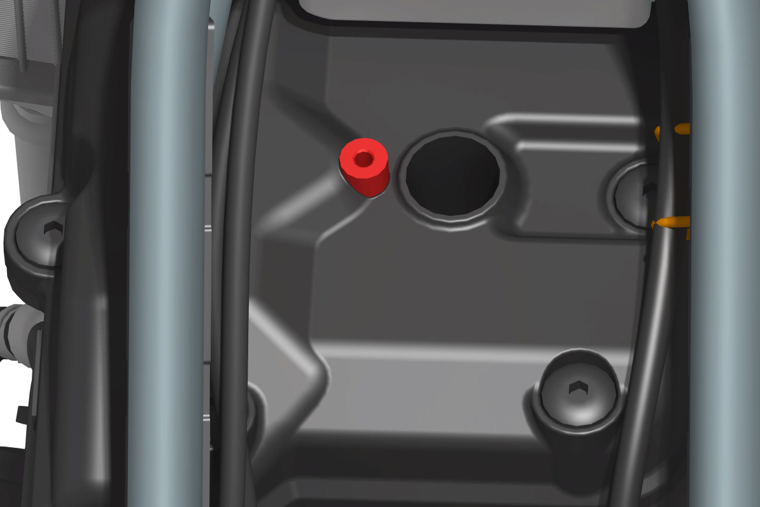
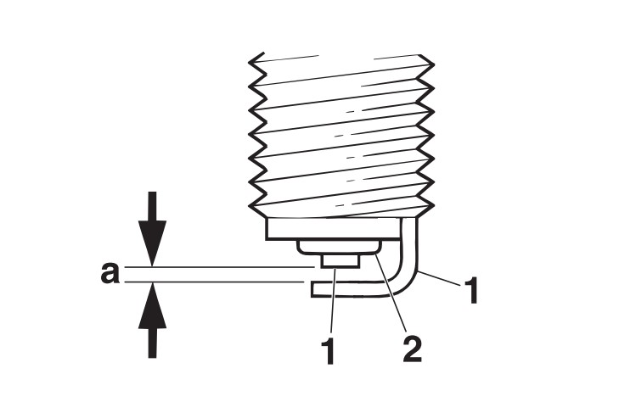
3.3 Spark plug
Caution.
-Before removing the spark plug use an air gun to blow and clean the spark
around the plug base and also make sure that no dust has fallen into the cylinder.
1. Check.
● Spark plug type
Incorrect → Replace.
Manufacturer / Model
NGK/LMAR8A-9CR8E
2. Check.
- Electrode "1"
Damaged / depleted → Replace the spark plug.
- Insulator "2"
Abnormal color → Replace the spark plug.
Normal color should be tan or light tan.
3. Cleaning.
- Spark plugs
(Use spark plug cleaner or wire brush)
4. Measurement.
- Spark plug gap "a"
(Thickness gauge measurement)
Out of specification → Adjust the gap.
Spark plug gap
0.80-0.90 mm (0.031-0.035 in)
5. Installation.
- Spark plugs
Install spark plugs tightened to specified torque of
13 N-m (1.3 kgf-m, 9.6 lb-ft)
Caution.
-Clean the spark plug and gasket surfaces before installing the spark plugs.
[1]
[2]
[2]
English
version
94

Slide 7
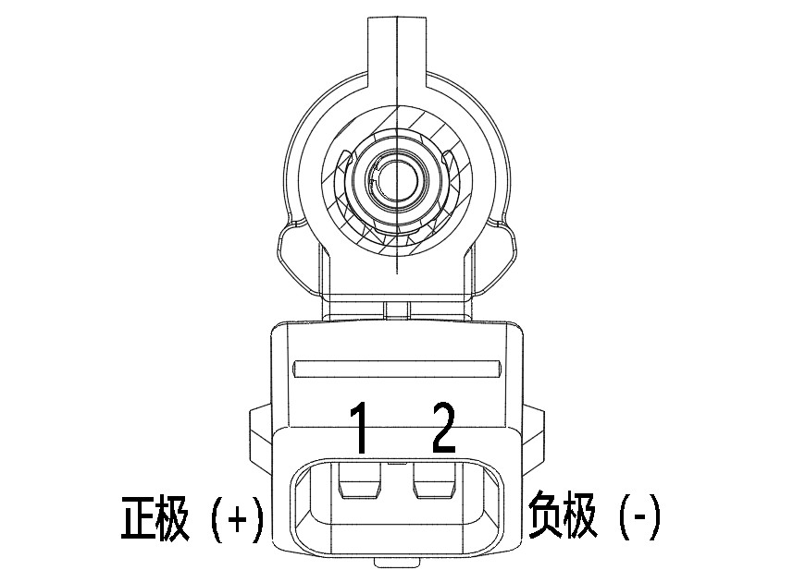
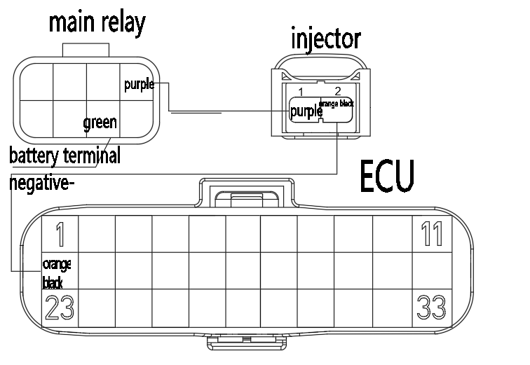
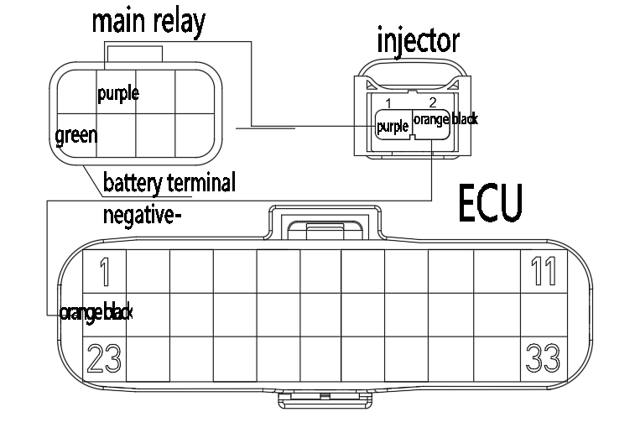
Injector profile drawing
3.4 Injector
One end of the injector is mounted on the injector holder, and the other end is connected to the fuel pipe through the injector cap. It injects fuel within the specified time according to the instruction of ECU, by which fuel is supplied to the engine and atomized. This injector adopts four-hole injection and shall not be rotated after fixing the card spring.
Definition of the function of each pin.
1: Positive (+) connected to the main relay (purple)
2: Negative (-) connects to pin 12 of ECU (orange and black)
factory edition wiring diagram
Fig1
Injector resistance: 12.5Ω±5%
Fig 1: shows the wiring diagram of the injector and ECU
Tips 1. in order to avoid contamination of the injector injection area, the injector inlet end should always be located above the outlet end (at the injector installation location on the entire vehicle).
2. In order to achieve the best injector assembly, clean silicone-free engine oil must be used to lubricate the upper and lower O-ring circumference; lubricant must not contaminate the injector interior and spray holes;
3. Removal and reassembly of the injector must be replaced when the O-ring, the operation does not allow damage to the sealing surface.
regular edition wiring diagram
Fig1
Injector installation.
Injector installation by hand, prohibit the use of hammer and other tools to knock
O-ring must be replaced when removing and installing the injector.
when disassembling the injector, if necessary, first carry out pressure relief treatment.
After installing the injector, carry out the sealing test to ensure that there is no leakage.
English
version
95

Slide 8
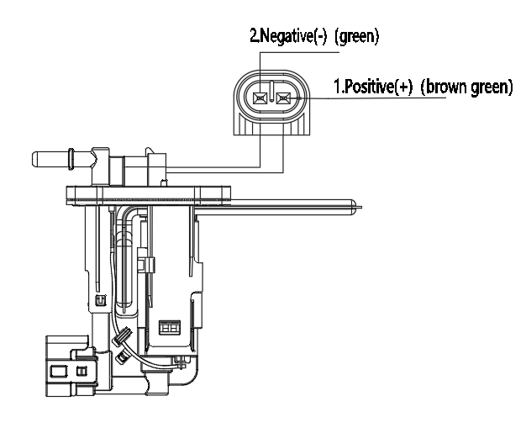
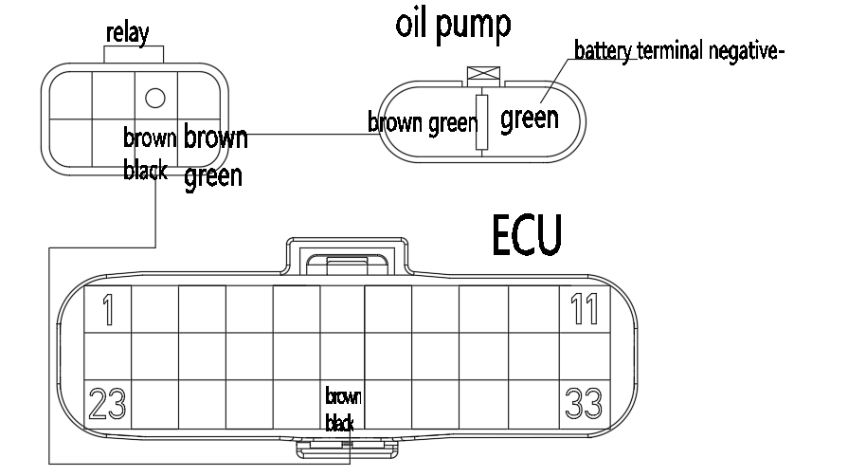
3.5 Fuel Pump
The fuel pump assembly and the wiring diagram of the connection with the fuel pump relay ECU.
This fuel pump assembly integrates a fuel pump, a plastic holder coarse and fine filter and a regulator, which works to pump fuel from the fuel tank to the engine at a certain oil pressure and flow rate.
Fuel pump outline drawing
Function definition of each pin.
1: connected to the fuel pump relay output (+) (brown-green)
2: Connected to the negative terminal of the battery (-) (green)
Performance parameters.
Regulator opening pressure: 0.33±0.01mpa
When the flow rate is 40L/h, the corresponding rated pressure value 330±10 kPa
This fuel pump assembly is installed at the bottom of the fuel tank on the left front side of the vehicle.
Do not run the fuel pump assembly in the no-load, no-oil condition to avoid damage.
Hold it gently when installing or disassembling, and do not drop it to the ground.
Fig1
Measuring oil pressure
Connect the oil pressure gauge to the fuel pump assembly outlet, and lock it with clamps to ensure that there is no leakage at the combination Press the ignition off switch, the fuel pump will work for 5 seconds and then stop rotating.
Figure 1: shows the wiring diagram of the fuel pump and ECU.
Fuel line pressure relief treatment
The fuel supply pressure of the EFI system is high, and all fuel lines are made of high-pressure resistant fuel lines, so even if the engine is not running, the fuel line also maintains a high pressure, so only during the repair process, note: do not easily disassemble the fuel line: when repairing the fuel system in need of repair, remove the fuel line before the fuel system should be unpressurized, as follows: remove the fuel pump relay, or remove the fuel pump harness connector 2P ( Black), start the vehicle and idle until the engine turns off on its own.
English
version
96

Slide 9
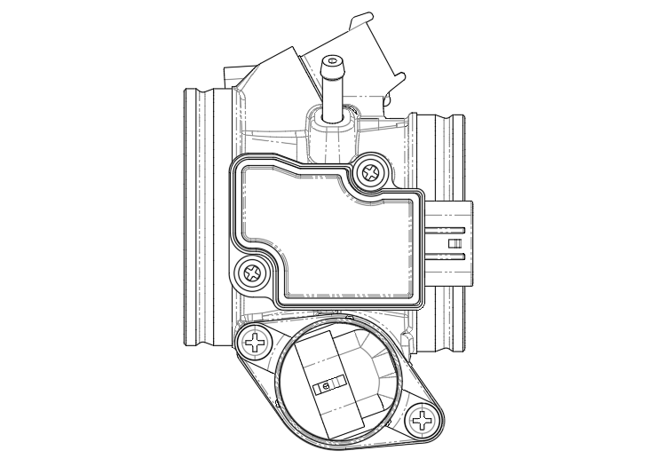
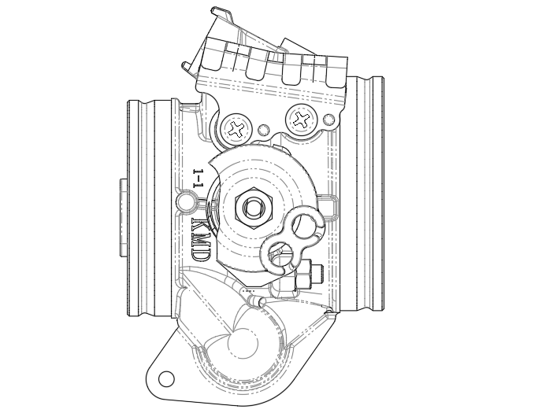
Fig1
[3]
[3]
3.6 Throttle Body Assembly
Connects the air filter and engine, controls the opening and closing angle of the throttle plate by the throttle cable, and sends the turning angle signal to the ECU by the throttle position sensor.
[1]
[4]
As shown in figure 1 on the right sensor locations.
1. intake air temperature, intake air pressure, throttle position [1];
2. Idle speed stepper motor [2];
[2]
[4]
If not for maintenance
disassembly is prohibited
Three in one sensor mounting screw specifications.
M4x12 screw
Screw tightening torque at position [3]: 2.0±0.4N.m
Stepper idle motor mounting screw specification: M4x12 screw
M5x14 spring pad combination screw
Screw tightening torque at position [4]: 4.0±0.4N.m
Sensor installation precautions.
1. The terminals must not be sticky with water, oil and other liquids.
2. Do not contact with harmful gases (Cl, SO₃, etc.).
3. Do not use falling parts.
4. Do not use external force to deform or break the parts.
5. Do not allow direct contact with the terminals (to prevent static electricity).
6. When cleaning the throttle, the pressure channel must be blocked.
Fig2
[3]
[2]
As in Fig 2 idle speed limit screw [1] is not allowed to be adjusted.
[1]
-Engine idle speed is completely adjusted by EFI system, manual adjustment of idle speed limit bolt is not allowed.
-It is not allowed to add load on the shell or cover.
-Take it lightly when disassembling and do not allow it to fall on the ground.
NO disassembly
Specification for installation of the pull wire bracket: M5×10 screws.
Screw tightening torque at position [2] 3.5±0.5N.m
Screw tightening torque at position [3] 4.5±0.3N.m
Throttle valve body inspection.
1. flexible movement of the throttle plate, no stalling.
2. throttle body and the oil and gas channel without foreign matter (foreign particles size <0.34mm).
3. Each product without omissions, misgrouping, under-products, internal parts installed securely without falling off.
4. Throttle screw fastening reliable, no loose.
English
version
97

Slide 10
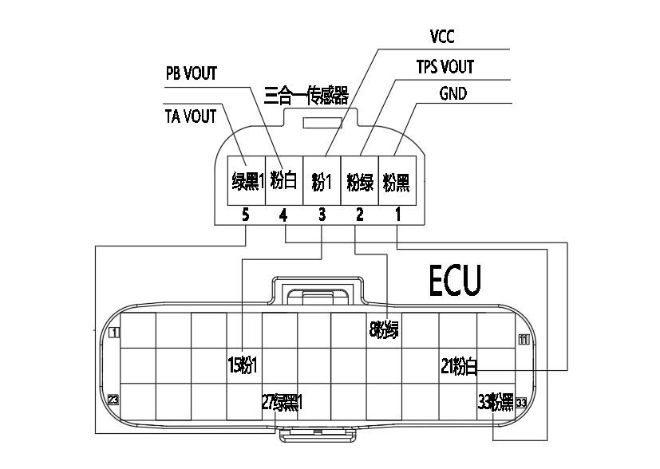
3.7 Three-in-one sensor
Intake air temperature
The intake air temperature sensing element is a negative temperature coefficient (NTC) resistor, the resistance of which varies with the intake air temperature.
This sensor delivers a voltage to the ECU controller that indicates the change in intake air temperature.
Intake Pressure
Monitors intake tube pressure to provide the ECU with information on engine load.
Three-in-one shape drawing
Fig1
Throttle Position
This sensor is used to provide throttle angle information to the ECU. Based on this information, the ECU can obtain engine load information, operating condition information (e.g., start, idle, reverse tow, part load, full load), and acceleration and deceleration information.
Fig 1: shows the wiring diagram of the 3-in-1 sensor and ECU.
Function definition of each pin.
1. Intake air temperature signal output (GND) (pink and black)
2. Intake air pressure signal output (TPS VOUT) (pink-green)
3. Connected to 5V power supply (VCC) (pink 1)
4. Throttle position signal output (PB VOUT) (pink white)
5. Ground (TA VOUT) (green-black 1)
Characteristic parameters of intake air temperature sensor
Operating temperature: -40C°/+130C°
Rated voltage: pull-up resistor 1 k operating at 5V or at a constant current of 1mA
20C° rated voltage: 2.5 kΩ ± 5%
Installation.
The permissible installation range, which ensures that condensation does not form inside the sensor, as condensation can damage the sensitive components inside the sensor.
Characteristic parameters of pressure sensors
Parameters | value |  |  | Unit
 | Minimum | Typical | Maximum
Pressure test range | 10 |  | 115 | kPa
Operating temperature | -40 |  | 130 | C
Supply Voltage | 4.75 | 5.0 | 5.25 | V
Throttle position sensor characteristics parameters
English
version
Quantity | value |  |  | Unit
 | Minimum | Typical | Maximum
Total resistance (pins 1-2) | 1.6 | 2.0 | 2.4 | KΩ
Supply voltage |  | 5 |  | V
98

Slide 11
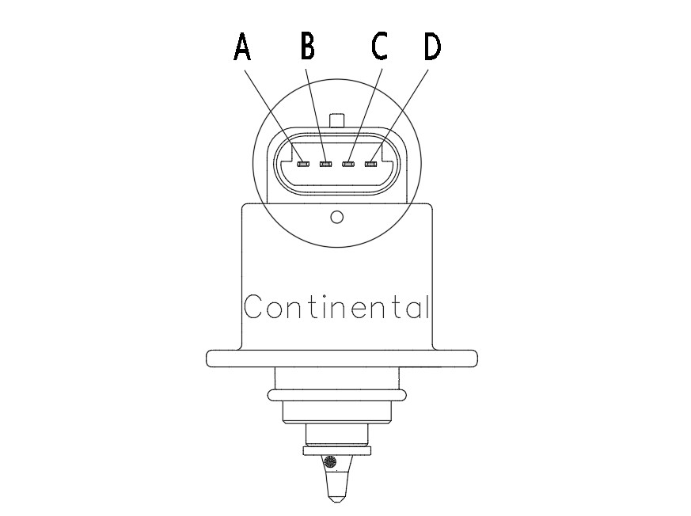
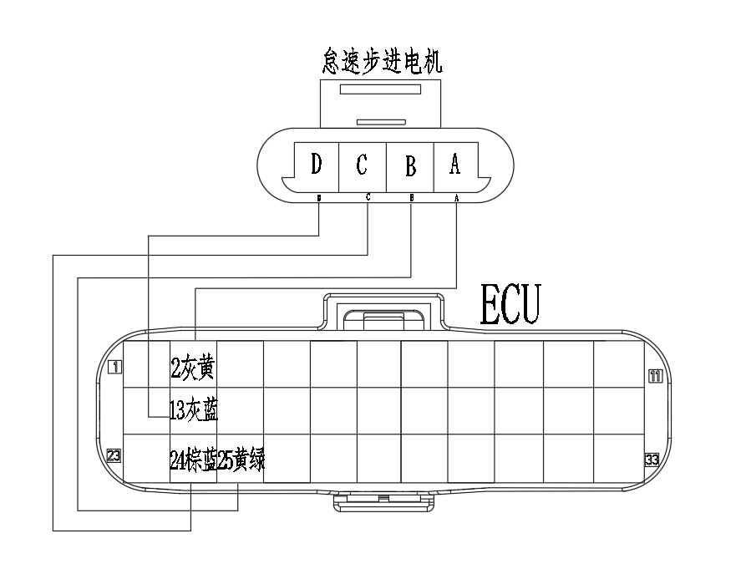
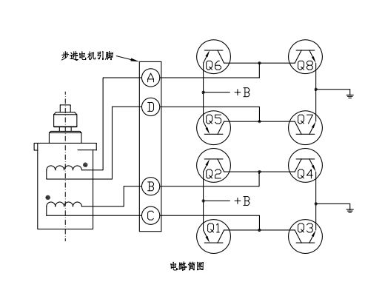
3.8 Idle stepper motor
Control the flow of bypass airflow, stepper motor by the ECU according to the engine load, through the engine sensor to control the stepper motor in different operating conditions, the injection volume is also different, so the stepper motor is needed to make up the air intake, so it should be connected according to the specified connection, otherwise it may cause unstable idle speed.
Idle stepper motor profile drawing
Fig1
Function of each pin.
Stepper motor pin A / connected to the ECU's 2 (gray-yellow)
Stepper motor pin B / connected to the ECU's 25 (yellow-green)
Stepper motor pin C / connected to the ECU's 24 (brown-blue)
Stepper motor pin D / connected to the ECU's 13 (gray-blue)
Fig 1: The wiring diagram for the idle stepper motor and ECU.
Fig2
Fig 2: The circuit diagram for the idle stepper motor.
The following table shows the characteristic parameters of the idle stepper motor.
Characteristic parameters
NO | Item | Spec | Terms
1 | Rated Voltage | 12V DC
2 | Mini/maxoperating voltage | 7.5V-14V
3 | Phase Resistor | 53±5.3Ω | 27℃
4 | Operating temperature | -40℃-125℃
English
version
99

Slide 12
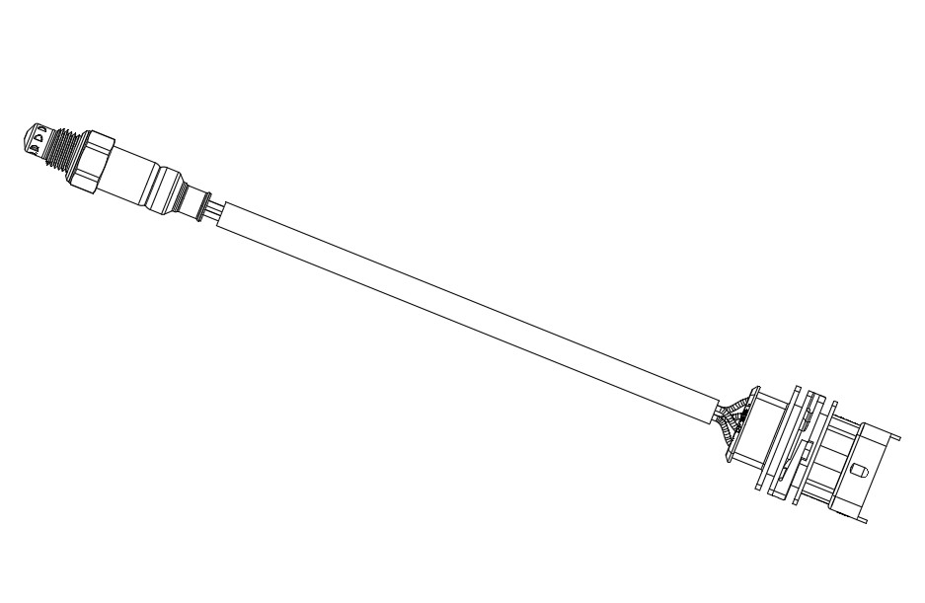
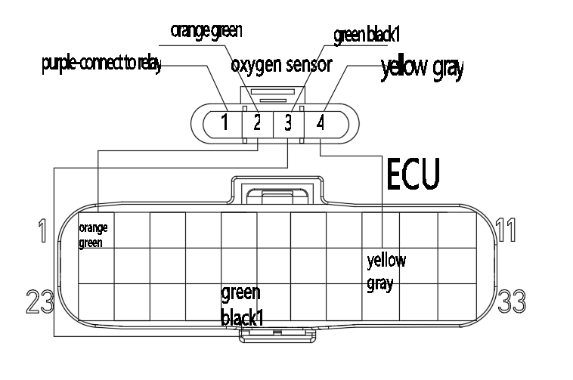
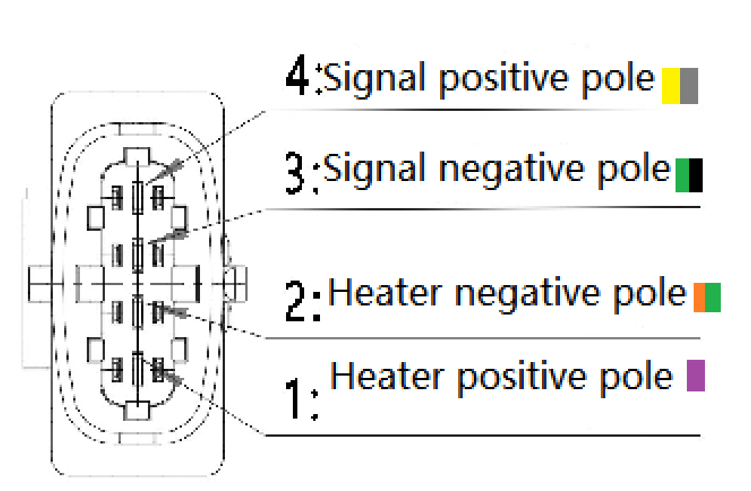
3.9 Oxygen sensor
This sensor is used in the feedback system of the electronically controlled fuel injection device to achieve closed-loop control and improve the accuracy of the ECU's control of the air-fuel ratio, which is installed on the front section of the exhaust pipe to determine the oxygen content in the exhaust gas to determine whether the gasoline and air are completely combusted to ensure that the three-way catalytic converter has the maximum conversion efficiency of HC CO and NOx in the exhaust.
Oxygen Sensor Outline Drawing
Fig1
Fig 1: shows the wiring diagram of oxygen sensor and ECU.
Definition of each pin function.
English
version
100

Slide 13
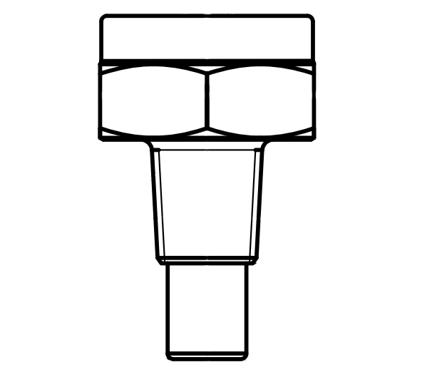
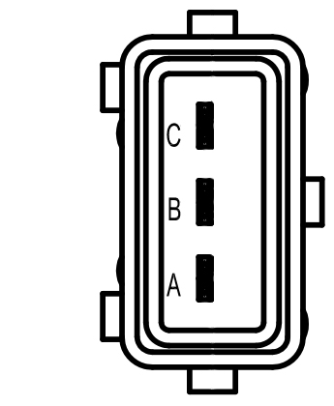
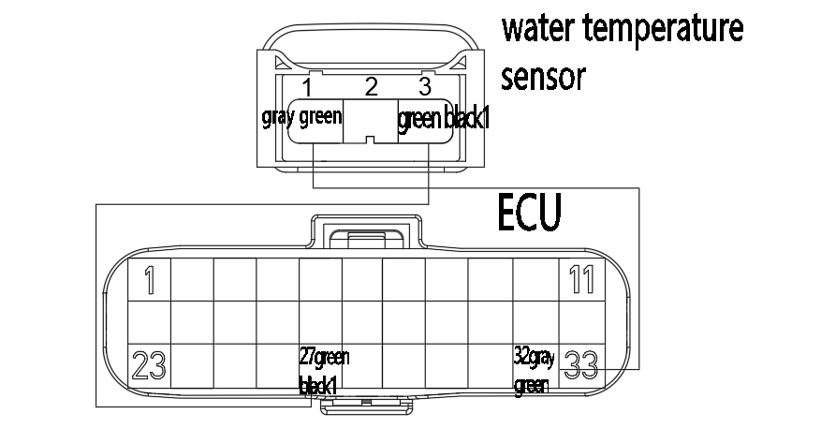
3.10 Engine water temperature sensor
This sensor is two sets of negative temperature coefficient (NTF) thermistor, its resistance value decreases with the increase of coolant temperature, but not a linear relationship. One group is provided to the ECU to monitor the thermal status of the engine, and A group is provided to the ECU for the water temperature signal.
Water temperature profile
A: Temperature sensor signal +
C: Signal ground-
Definition of the function of each pin.
A:Signal + connected to ECU pin 32 (grey-green)
C:Signal - connect to ECU pin 27 (green and black 1)
Fig1
Fig 1: The wiring diagram for the water temperature sensor and ECU.
ECU resistance value parameter
Temperature range °C±1 | Resistance value（kΩ）
 | Min | Standard | Max
-20 | 13.65 | 14.93 | 16.33
20 | 2.286 | 2.435 | 2.591
80 | 0.306 | 0.316 | 0.327
100 | 0.178 | 0.183 | 0.187
The table on the left shows the characteristics of the temperature and the signal is transmitted to the ECU.
English
version
101

Slide 14
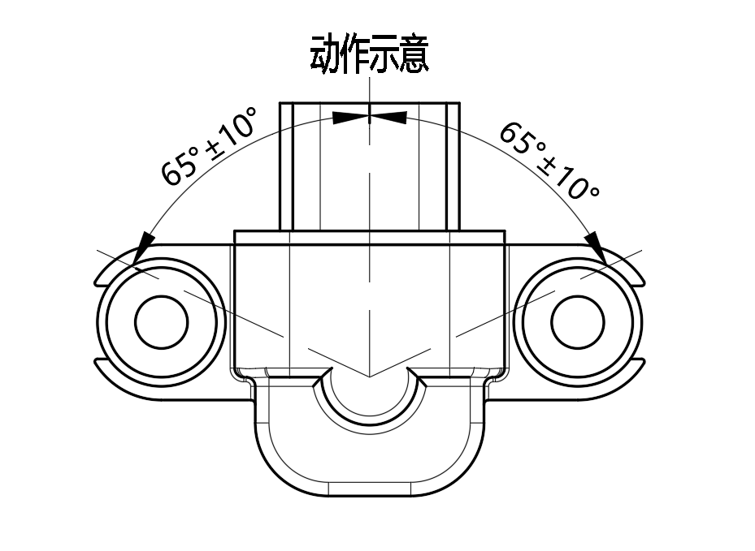
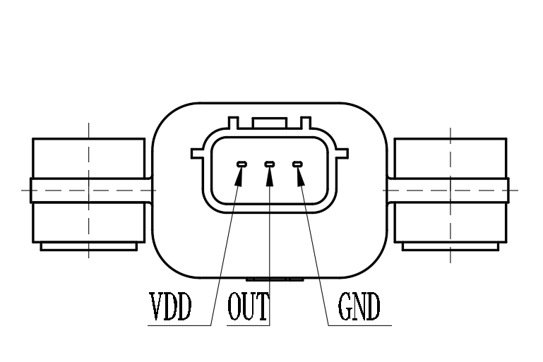
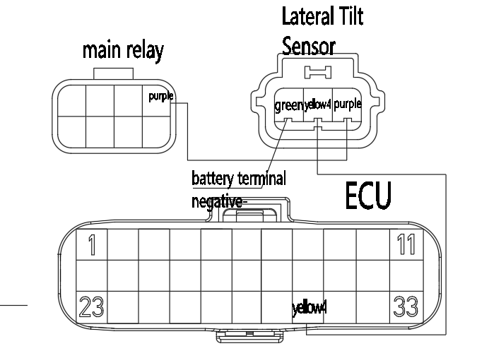
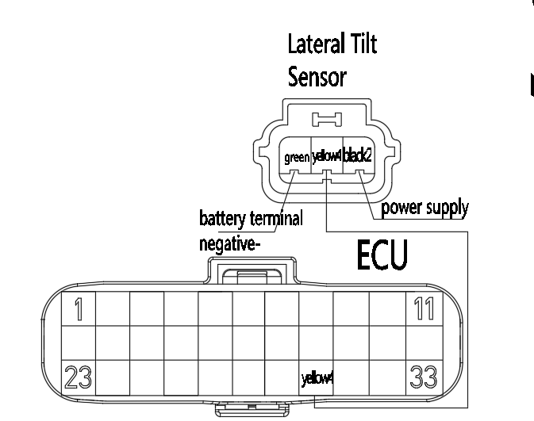
3.11 Sway sensor
The role of this sensor for the side tilt protection, that is, when the car side tilt angle exceeds the allowable angle (65 ° ± 10 °), OUT pin signal to the ECU, the ECU control engine off, so as to achieve the protection of the driver and the vehicle.
As Fig 1: Install with the UP logo facing up.
Fig1
Racing version pin function definition.
VDD: connected to the negative battery terminal - (green)
OUT: connect to ECU30 # pin (yellow 4)
GND: connected to the main relay (purple)
Pin function definition for civilian version.
VDD: connected to the negative battery terminal - (green)
OUT: connect to ECU30 # pin (yellow 4)
GND: connected to the power supply (purple)
factory edition wiring diagram
regular edition wiring diagram
English
version
102

Slide 15
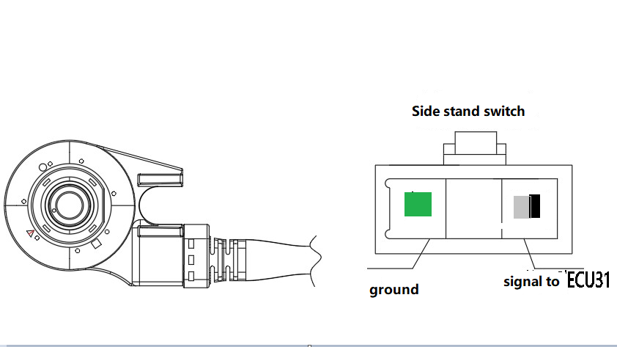
3.12 Side bracket switch
Check
Disconnect the side stand switch 3P (white) connector [1].
Check the switch side connector terminal.
The vehicle can be started normally when the side stand is lowered, and automatically turns off after shifting.
When the side stand is retracted, the vehicle can be started and driven normally in gear.
Removal/Installation
Remove the following parts.
- Disconnect the side bracket switch connector and remove the side bracket wiring harness from the frame.
- Remove the bolt [1] and side switch [2].
Install in the reverse order of removal.
Caution.
-Align the switch pin with the hole in the side sill.
-Align the switch slots with the return spring pins.
-Replace the switch bolt with a new one.
[1]
[2]
Fig1
Fig 1: shows the wiring diagram of the side bracket switch and ECU.
English
version
103

Slide 16
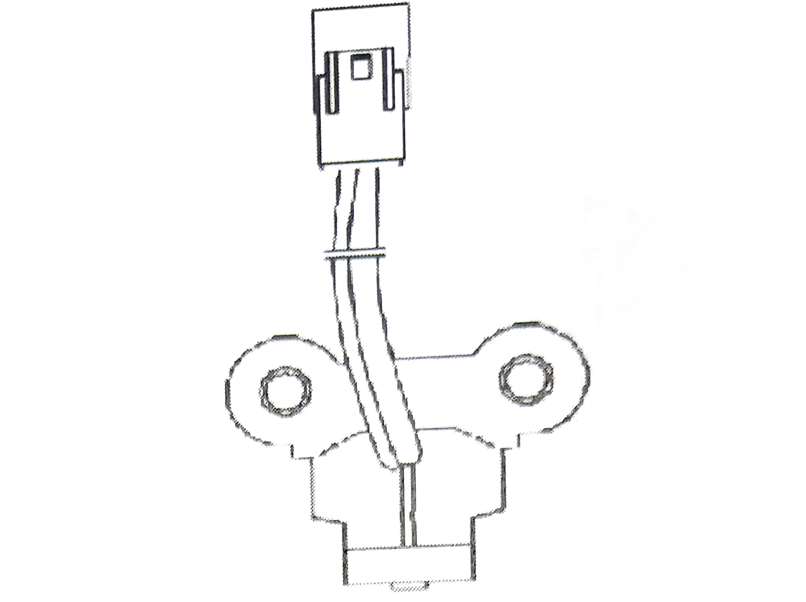
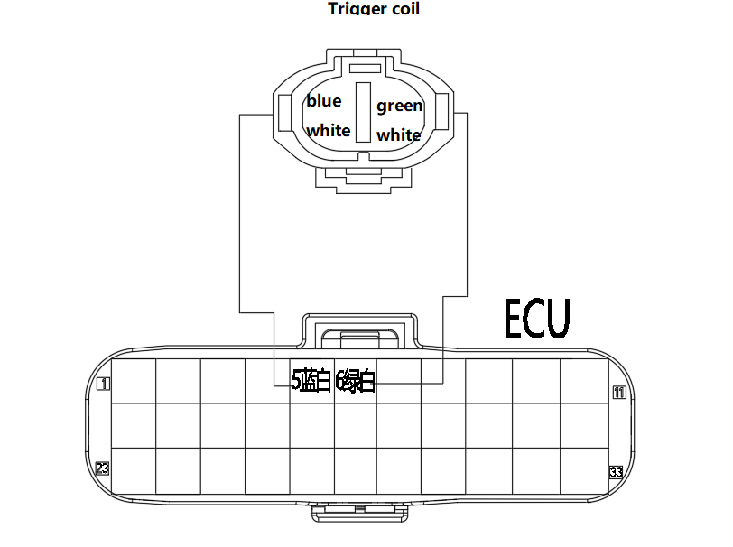
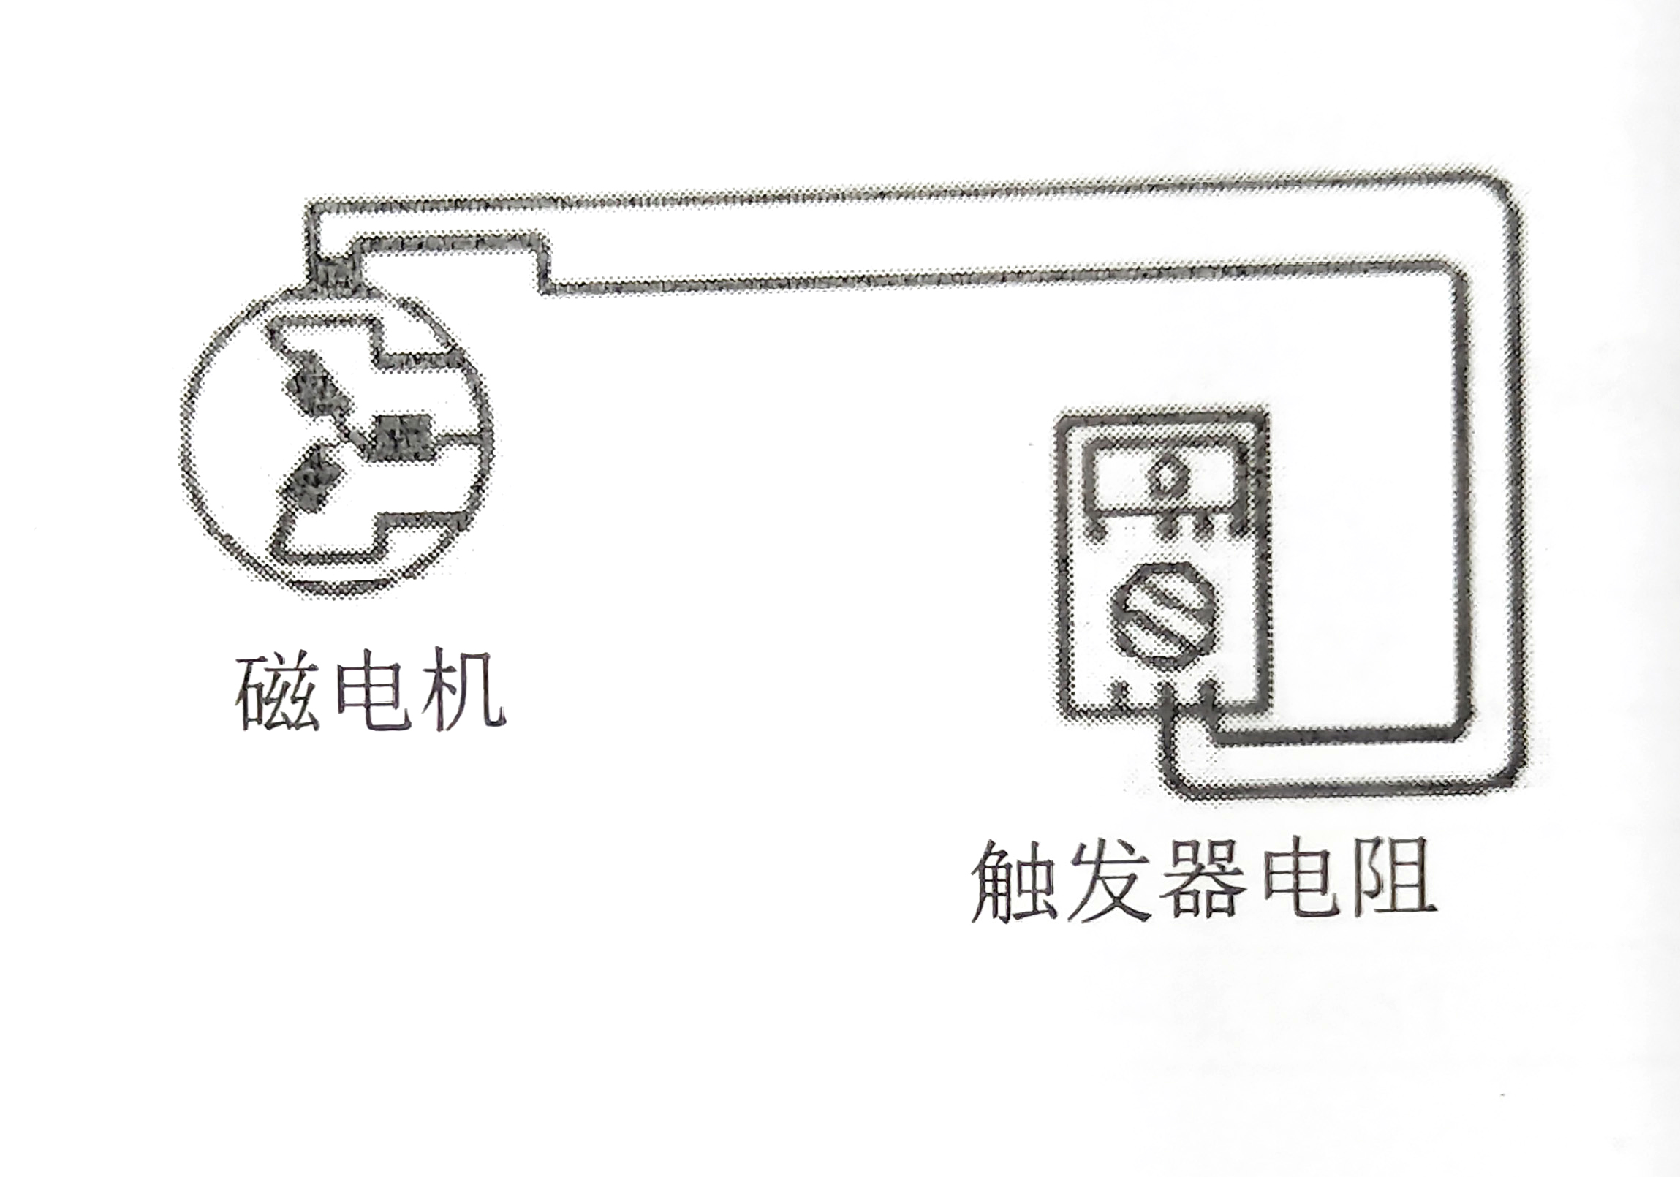
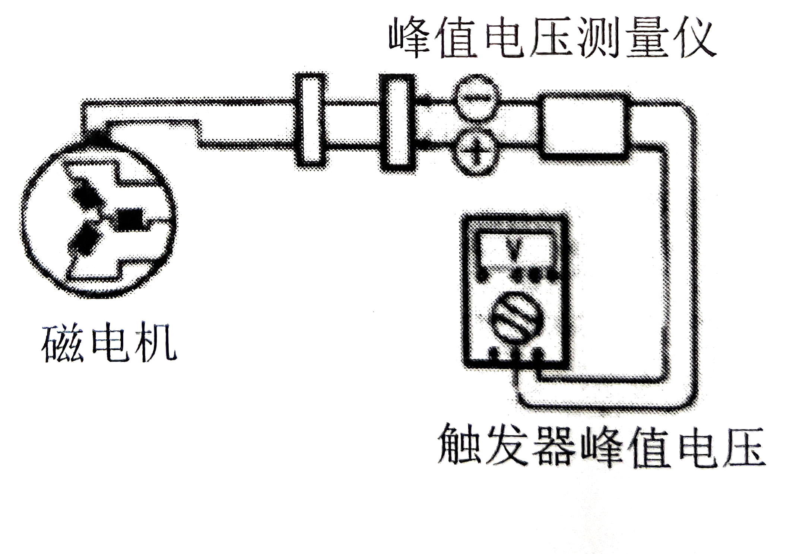
3.13 Trigger
Provide the engine speed signal to the ECU, and the ECU determines the ignition angle, injection phase, etc. based on this signal.
Trigger profile drawing
Fig1
Fig 1: The wiring diagram of the trigger and ECU
Measure the resistance value of the trigger.
Multimeter hit in 1X100Ω file.
Trigger coil resistance: 100Ω-160Ω (20 °)
If the trigger resistance value is not in the above range, replace a trigger.
Measure the peak voltage of the trigger
Connect the multimeter and peak voltage adapter according to the diagram as follows.
+ probe: green and white (B) lead
+ probe: blue and white (A) lead
magneto
Trigger resistance
With the multimeter in AC gear.
Put the gear in neutral and hold the start button to let the engine turn for a few seconds, then measure the peak voltage of the trigger coil:.
Repeat the measurement several times and measure the highest trigger coil peak voltage.
Trigger coil peak voltage: ≥ 2V (300r/min)
If the trigger peak voltage is not in the above range, replace a new trigger.
Peak Voltage Meter
magneto
English
version
Trigger peak voltage
104

Slide 17
4. System fault diagnosis function introduction
On-board diagnostic system (OBD system) is a diagnostic system integrated in the engine control system that can monitor the status of components affecting exhaust emissions and the main functions of the engine. It has the function of identifying and storing EFI faults.
When repairing a vehicle with OBD system, the repairer can quickly and accurately locate the malfunctioning parts through the diagnostic instrument, which greatly improves the efficiency and quality of repair.
OBD technology involves many brand new concepts, the following is the first introduction to some basic knowledge related to OBD technology, in order to facilitate a better understanding of the subsequent content.
4.1 Fault information logging
The electronic control unit constantly monitors sensors, actuators, associated circuits, fault indicators, battery voltage, etc., and even the electronic control unit itself, and performs confidence checks on sensor output signals, actuator drive signals and internal signals (e.g., closed-loop control, coolant temperature, idle speed control, etc.). As soon as a fault is detected in a link or a signal value is outside the normal range, the electronic control unit immediately records the fault information in the fault memory of the RAM. The fault information is stored in the form of fault codes and is displayed in the order in which the faults appear.
Faults can be divided into "current faults" and "historical faults" according to the time of their occurrence.
EFI system Error diagnosis schematic
4.2 Fault Lamp Description and its Control Strategy
Failure Indicator (MIL): Used to indicate the failure of an emission-related component or system, a MIL light is generally an indicator that can be displayed on the instrument panel and is shaped in accordance with regulatory requirements.
The MIL light is activated according to the following principles.
1) In normal mode and with empty fault memory
The ECU is initialized immediately when the ignition is switched on and the ignition is switched off. From initialization on, the MIL light is on. The MIL light goes off immediately after the engine starts.
2）In normal mode, and the fault memory is already fault
From the time the ECU is initialized with the ignition switch on, the MIL light is on continuously; if the fault manager requires the MIL to be on in fault mode, the MIL light is on during the subsequent driving cycle; if the fault manager does not require the MIL to be on in fault mode, the MIL light is off after starting.
English
version
105

Slide 18
4.3 OBD Interface Introduction
Pin 4, 7 and 16 on the OBD diagnostic connector are used for EMS with engine management system. Pin 4 of the standard diagnostic connector is connected to the negative terminal of the battery; pin 7 is connected to pin E3 of the ECU, which is the "K" wire of the ECU; pin 16 is connected to the positive terminal of the battery
ISO9141-2 standard diagnostic interface pin number
The diagnostic device communicates with the ECU via the "K" wire and can read the following information.
-Version information display
ECU hardware number, ECU software number.
-Fault code display
Intake pressure sensor, intake temperature sensor, engine temperature sensor, throttle position sensor, oxygen sensor, oxygen sensor heating line, air-fuel ratio correction, fuel injector, fuel pump relay, speed sensor, carbon canister control valve, speed signal, idle speed, idle speed regulator, system voltage, ECU, fault light and other fault information.
-Engine parameter display
Battery voltage, engine speed, target idle speed, vehicle speed, engine temperature, engine temperature sensor signal voltage, intake air temperature, intake air temperature sensor signal voltage, intake air pressure, intake air volume, stepper motor target position, throttle position sensor signal voltage, throttle opening, relative throttle position, carbon canister control valve duty cycle, charge time, injection pulse width, ignition advance angle, oxygen sensor Short-term correction, oxygen sensor voltage, oxygen sensor long-term correction, relative engine load, carbon canister control relative fuel injection, carbon canister purge rate, carbon canister load, idle actuator TEV opening, ambient pressure, altitude correction factor, injection phase, and other parameters.
English
version
106

Slide 19
4.4 Maintenance tools
Tool.
EFI system diagnostic instrument
Function.
Read/clear EFI system fault codes and observe data flow.
Tool:
EFI system adapter
Function.
Check the electrical signal of each pin of the electronic control unit, check the wiring condition, etc.
Tool:
Ignition Timing Light
Function.
Check engine ignition timing, etc. .
Tool:
Digital multimeter
Function.
Check the voltage, current, resistance and other characteristic parameters in the EFI system.
English
version
107

Slide 20
Tool:
Vacuum table
Function.
To check the pressure in the intake manifold.
Tool:
Cylinder pressure gauge
Function.
Check the cylinder pressure of each cylinder.
Tool:
Fuel pressure gauge
Function.
To check the pressure of the fuel system
to determine the fuel system
pump and fuel pressure regulator in the fuel system.
Operation.
English
version
108

Slide 21
5. Inspection and diagnosis process
5.1 How to use the diagnostic instrument
1. Connect the diagnostic instrument to the diagnostic interface.
2. Turn on the "ignition switch".
3. Read fault-related information (fault codes, freeze frames, etc.); check the repair manual to confirm the defective parts and types; develop a repair plan based on fault-related information.
4. Troubleshoot.
5. Turn on the ignition again, start the vehicle to read the fault information, and confirm that the fault has been removed.
5.2 Preliminary check
Before starting the troubleshooting steps based on engine fault codes, a preliminary check should first be made to.
1. confirm that the engine fault indicator is working normally.
2. confirm that the fault phenomenon complained by the owner exists and confirm the conditions under which the fault occurs.
Then conduct an external inspection to.
-Check if there is any leakage in the fuel line.
-Check whether the vacuum line is broken, kinked and connected correctly.
-Check for blocked, leaking, crushed or damaged air intake lines.
-Check if the high-voltage wires of the ignition system are broken or aging, and if the ignition sequence is correct.
-Check if the wiring harness joints are clean and firm
-Check whether the sensors and actuators joints are loose or have poor contact.
Important: If the above phenomena exist, the repair work will be carried out for the fault phenomenon first, otherwise it will affect
Otherwise, it will affect the later troubleshooting and repair work.
English
version
6. Troubleshooting according to fault codes
This section introduces the meaning of the fault codes used in the current MSE6.0 system, the corresponding diagnostic strategy and possible causes of the faults, as well as the handling strategy of the faults, which can be referred to during the vehicle maintenance process.
All ECU pins mentioned below are based on the actual wiring harness diagram of the project.
109

Slide 22
6.1error code: P0030 oxygen sensor heating control circuit open circuit or P0053 oxygen sensor heating unreasonable
Repair Tips.
The fault has been identified as possibly having the following problems
(1) Open circuit between the circuit connected to the ECU pin and the upstream oxygen sensor pin 2.
(2) Open circuit between the circuit connected to the main relay at pin 1 of the upstream oxygen sensor.
(3) Open circuit between upstream oxygen sensor pin 1 and pin 2.
Repair Tip.
Check the following items
(1) Measure the resistance of the line between the ECU connector pin and the upstream oxygen sensor pin 2 and determine if it is normal.
(2) Measure the resistance between the upstream oxygen sensor pin 1 and the main relay to determine if it is normal.
(3) Measure the resistance between the upstream oxygen sensor pin 1 and pin 2 to determine if it is normal.
6.2 error code: P0031 oxygen sensor heating circuit short circuit to ground
Repair Tip.
The fault has been identified as possibly having the following problems
1) The circuit connected to the ECU pin is shorted to ground.
Repair Tip.
Check the following items
1) Measure the resistance of ECU pin to ground is normal.
6.3 error code: P0032 oxygen sensor heating circuit short circuit to the power supply
Repair Tip.
The fault has been identified as possibly having the following problems
1) Short circuit between the circuit connected to the ECU pin and the upstream oxygen sensor pin 1 circuit.
2) Short circuit between the circuit connected to the ECU pin and other power circuits.
Repair Tip.
Check the following items
1) Measure the ECU voltage to see if it is normal.
2) Measure the resistance between the ECU pin and the upstream oxygen sensor pin 1 circuit.
6.4 error code: P0107 Intake pressure sensor circuit voltage is too low
Repair Tip.
The fault has been identified as possibly having the following problems
1) The ECU has detected a short to ground in the sensor signal circuit.
Repair Tip.
Check the following items
1) Resistance between ECU pin and ground.
6.5 error code: P0108 Intake pressure sensor circuit voltage is too high
Repair Tip.
The fault has been identified as possibly having the following problems
1) The ECU has detected a short circuit in the sensor signal circuit to the power supply.
Repair Tip.
Check the following items
1) Voltage of ECU pin.
6.6 error code: P0105 intake pressure sensor circuit signal stuck
English
version
Repair Tip.
The fault has been identified as possibly having the following problems
1) The ECU detects that the sensor signal is jumping too much in the intake pressure during normal engine operation
is too small.
Repair Tip.
Check the following items
1) The presence of serious air leaks in the intake system.
2) Clogged intake air pressure sensor sampling port.
3) Pressure sensor picking.
110

Slide 23
6.7 Error code: P0106 Intake pressure sensor circuit signal untrustworthy
Repair Tip.
The fault has been identified as possibly having the following problems
1) The intake pressure sampling value used for load calculation exceeded the limit value.
Repair Tip.
Check the following items
1) The presence of a serious air leak in the intake system.
2) Intake air pressure sensor sampling port is blocked.
6.8 error code: P0112 intake air temperature sensor signal voltage is too low
Repair Tip.
The fault has been identified as possibly having the following problems
1) The sensor signal circuit connected to the ECU pin is shorted to ground.
Repair Tip.
Check the following items
1) Measure the resistance between the sensor signal circuit of ECU pin and ground.
6.9 error code: P0113 Intake air temperature sensor signal is too high
Repair Tip.
The fault has been identified as possibly having the following problems
1) The sensor signal circuit connected to the ECU pin is shorted to the power supply.
Repair Tip.
Check the following items
1) Measure the voltage of the sensor signal circuit at the ECU pin to see if it is normal.
6.10 error code: P0111 Intake air temperature out of range
Repair Tip.
The fault has been identified as possibly having the following problems
1) There is a break, short to 5v or ground in the engine intake air temperature sensor.
Repair Tip.
Check the following items
1) Measure whether the voltage of the sensor signal circuit at the ECU pin is normal.
2) Check whether the temperature sensor model corresponds to the inventory.
6.11 error code: P0114 intake air temperature signal stuck
Repair Tip.
The fault has been confirmed that there may be the following problems
1) The engine temperature starts below 40℃, the engine runs with a certain load for more than 30min, and the rise in intake air temperature is still less than 3℃.
Repair Tip.
Check the following items
(1) whether the intake air temperature sensor installation position to
position.
(2) Whether the ECU PIN pin corresponds.
6.12 error code: P0117 Engine coolant temperature sensor circuit voltage is too low
Repair Tip.
The fault has been identified as possibly having the following problems
1) Short circuit between the circuit connected to the ECU pin and ground.
Repair Tip.
Check the following items
1) Measure the resistance connected to the ECU pin to ground.
English
version
111

Slide 24
6.13 error code: P0118 Engine coolant temperature sensor circuit voltage is too high
Repair Tip.
The fault has been identified as possibly having the following problems
1) Short circuit between the circuit connected to the ECU pin and other power circuits.
Repair Tip.
Check the following items
1) Measure the voltage connected to the ECU pin to see if it is normal.
6.14 error code: P0116 engine temperature over range
Repair Tip.
The fault has been identified as possibly having the following problems
1) There is a break, short to 5v or ground in the engine temperature sensor.
Repair Tip.
Check the following items
1) Measure whether the voltage of the sensor signal circuit at the ECU pin is normal.
2) Check whether the temperature sensor model corresponds to the parts list.
6.15 error code: P0126 Engine temperature signal stuck
Repair Tip.
The fault has been identified as possibly having the following problems
1) As the engine runs, the engine temperature rise performance is not consistent with the actual engine temperature.
Repair Tip.
1) Check whether the engine temperature sensor installation position is in place.
2) Whether the ECU PIN pin corresponds.
6.16 error code: P0122 Throttle position sensor circuit voltage is too low fault
Repair Tip.
The fault has been identified as possibly having the following problems
1) ECU pin is shorted to ground.
Repair Tip.
Check the following items
1) Measure the resistance connected to the ECU pin to ground.
6.17 error code: P0123 Throttle position sensor circuit voltage is too high fault
Repair Tip.
The fault has been identified as possibly having the following problems
1) Short circuit between the circuit connected to the ECU pin and other power circuits.
Repair Tip.
Check the following items
1) Measure the voltage connected to the ECU pin to see if it is normal.
6.18 error code: P0130 Oxygen sensor signal unreasonable fault
Fault cause introduction: The system judges that the oxygen sensor signal is unreasonable when the following conditions occur The oxygen sensor signal circuit is coupled with the heating circuit.
Repair Tip.
The fault has been identified as possibly having the following problems
1) Check whether the oxygen sensor connector is correct and normal.
2) Check whether the oxygen sensor signal circuit is coupled with the heating circuit.
Repair Tip：
English
version
112

Slide 25
6.19 error code: P0131 Oxygen sensor circuit voltage is too low
Repair Tip.
The fault has been identified as possibly having the following problems
1) The signal circuit connected to the ECU pin is shorted to ground.
Repair Tip.
Check the following items
1) Measure the resistance between the signal circuit connected to the ECU pin and ground.
6.20 error code: P0132 oxygen sensor circuit voltage is too high
Cause of failure: When the ECU measures the oxygen sensor circuit voltage after the engine starts, when the signal voltage is higher than 1.5 volts for a long time, it is judged that the oxygen sensor signal circuit is short-circuited to the power supply failure.
Repair Tip.
The fault has been identified as possibly having the following problems
1) Short circuit between the signal circuit connected to the ECU pin and oxygen sensor pin 1.
2) Short circuit between the signal circuit connected to the ECU pin and other power circuits.
Repair Tip.
Check the following items
1) Measure the resistance between the signal circuit connected to the ECU pin and the oxygen sensor pin 1.
2) Measure the voltage of the signal circuit connected to the ECU pin.
6.21 error code: P0133 Oxygen sensor response is slow
Repair Tip.
The fault has been identified as possibly having the following problems
1) The oxygen sensor has aged and the sensing element is poisoned and contaminated.
Repair Tip.
Check the following items
1) Replace the oxygen sensor and fix the fault.
6.22 error code: P0134 oxygen sensor signal circuit open circuit fault"
Fault cause: When the ECU measures the oxygen sensor circuit voltage after the engine is started, the system judges that the oxygen sensor signal circuit is open-circuit fault when the signal voltage is always above 1.2 volts.
Repair Tip.
The fault has been identified as possibly having the following problems
1) an open circuit in the circuit connecting the oxygen sensor to the ECU pin.
2) poor connection of the oxygen sensor connector (oxidation of the pin).
Repair Tip.
Check the following items
1) Measure the resistance from the ECU connector to oxygen sensor No.4.
6.23 error code: P0201 One-cylinder injector control circuit open circuit
Repair Tip.
The fault has been identified as possibly having the following problems
1) whether the injector coil is open circuit.
2) whether the injector connector pin to the ECU pin is well connected.
(3) whether the injector connector pin to the main relay connection is good.
Repair Tip.
Check the following items
English
version
113

Slide 26
6.24 error code: P0261 One-cylinder injector control circuit short circuit to ground
Repair Tip.
The fault has been identified as possibly having the following problems
1) Each drive circuit circuit connected to the ECU pin is shorted to ground.
Repair Tip.
Check the following items
1) Measure the resistance of the circuit connected to the ECU pin to ground.
6.25 error code: P0262 One-cylinder injector control circuit short-circuit to the power supply
Repair Tip.
The fault has been identified as possibly having the following problems
1) The circuit connected to the ECU pin is shorted to another power source.
Repair Tip.
Check the following items
1) Measure the voltage of the circuit connected to the ECU pin.
6.26 error code: P0322 No tacho sensor pulse signal (open or short circuit)
Fault cause: When the engine is started the ECU monitors both the tacho sensor signal and other signals.
By the signal reasonableness system is judged to be the loss of tacho sensor signal.
Repair Tip.
The fault has been identified as possibly having the following problems
1) an open circuit in the circuit connecting the tacho sensor to the ECU.
2) Short circuit in the circuit connecting the tacho sensor to the ECU.
3) Open circuit in the tacho sensor coil.
Repair Tip.
6.27 error code: P0444 carbon canister control valve control circuit open circuit
Repair Tip.
The fault has been identified as possibly having the following problems
1) Open circuit between the circuit connected to the ECU and the carbon canister control valve pin 2.
2) An open circuit between the carbon canister control valve pin 1 and the main relay.
3) Open circuit in the solenoid coil between pin 1 and pin 2 of the carbon canister control valve.
Repair Tip.
6.28 error code: P0458 carbon canister control valve control circuit voltage is too low
Repair Tip.
The fault has been identified as possibly having the following problems
1) The circuit connected to the ECU is shorted to ground.
Repair Tip.
Check the following items
1) Measure the resistance to ground connected to the ECU pin to see if it is normal.
English
version
114

Slide 27
6.29 error code: P0459 carbon canister control valve control circuit voltage is too high
Repair Tip.
The fault has been identified as possibly having the following problems
1) Short circuit between the circuit connected to the ECU and the carbon canister control valve pin 1 circuit.
2) Short circuit between the circuit connected to the ECU pin and other power circuits.
Repair Tip.
Check the following items
1) Measure the voltage at the ECU pin to see if it is normal.
2) Measure the resistance between the ECU pin and the carbon canister control valve pin 1 circuit.
6.30 error code: P0508 stepper motor drive pin shorted to ground
Fault code: P0509 stepper motor drive pin short circuit to power
Fault code: P0511 stepper motor drive pin open circuit or overload
Cause of failure: When the circuit control module in the ECU after the engine is started to continuously monitor the voltage of the idle stepper motor drive circuit, when any of the four circuits have a short circuit to ground/short circuit to power supply/open circuit/overload, the system determines that the stepper motor circuit corresponds to a fault.
Repair Tip.
The fault has been identified as possibly having the following problems
1) Any of the stepper motor drive circuits connected to the ECU is shorted to ground to the power supply short/open circuit.
Repair Tip.
Check the following items
1) Measure the resistance or voltage between each stepper motor drive circuit connected to the ECU and ground.
6.31 error code: P0560 system battery voltage signal is not reasonable
Fault code: P0562 system battery voltage is too low
Fault code: P0563 system battery voltage is too high
Repair Tip.
The fault has been identified as possibly having the following problems
1) the generator has been damaged unable to generate electricity or battery leakage.
2) An open circuit in the generator excitation circuit.
3) generator regulator has been damaged can not control the amount of power generation resulting in high generation voltage.
Repair Tip.
Check the following items
1) Check generator power generation capability (measure generator voltage after starting).
6.32 error code: P0627 oil pump relay control circuit open circuit
Fault code: P0628 Oil pump relay control circuit short-circuit to ground
Fault code: P0629 oil pump relay control circuit short-circuit to power
Repair Tip.
The fault has been identified as possibly having the following problems
1) open circuit/short circuit to ground/short circuit to power supply between the oil pump relay control circuit connected to the ECU and the oil pump relay.
2) Open circuit between the relay connection to the main relay.
3) Open circuit in the solenoid coil of the relay.
Repair Tip.
Check the following items
1) Measure the resistance or voltage of the fuel pump relay control circuit connected to the ECU.
2) The resistance between the relay to the main relay.
3) The resistance between the two legs of the relay.
English
version
115

Slide 28
6.33 error code: P0650 MIL lamp driver stage circuit failure
Repair Tip.
The fault has been identified as possibly having the following problems
1) open circuit/short circuit to ground/short circuit to power supply in the MIL lamp drive circuit connected to the ECU.
2) Open circuit between the MIL connection to the main relay.
3) MIL lamp burned out.
Repair Tip.
Check the following items
1) Measure the resistance or voltage of the MIL lamp driver circuit connected to the ECU.
6.34 error code: P2300 Ignition coil short to ground
Repair Tip.
The fault has been identified as possibly having the following problems
1) The ignition coil drive circuit is shorted to ground.
Repair Tip.
Check the following items
1) Measure the resistance and voltage of the ignition coil drive circuit connected to the ECU.
6.35 error code: P0301 engine misfire fault
Repair Tip.
The fault has been identified as possibly having the following problems
1) abnormal ignition coil drive circuit drive.
2) Abnormal injector circuit drive.
3) Wire harness interference exists in the DG signal.
Repair Tip.
Check the following items
6.36 Error code: P0507 Engine idle speed is too high
Repair Tip.
The fault has been identified as possibly having the following problems
1) Air leakage from the air intake system.
2) stepper motor plug jammed at a large opening.
3) Large air leakage from the valve body.
Repair Tip.
Check the following items
6.37 Error code: P0506 Engine idle speed is too low
Repair Tip.
The fault has been identified as possibly having the following problems
1) abnormal stepper motor drive and plug jammed at a lower opening.
2) blockage of the air intake system.
3) Small air leakage from the valve body.
Repair Tip.
Check the following items
English
version
116

Slide 29
6.38 Error code: P2177 Non-idling mixture is too lean
Repair Tip.
The fault has been identified as possibly having the following problems
1) Low oil supply pressure.
2) Insufficient oil supply.
Repair Tip.
Check the following items
1) Whether the fuel pressure regulating valve (3.5 bar) is normal.
2) The fuel supply line is bent and blocked.
6.39 Error code: P2178 Non-idling mixture is too rich
Repair Tip.
The fault has been identified as possibly having the following problems
1) The oil supply pressure is high.
Repair Tip.
Check the following items
1) Is the fuel pressure regulating valve (3.5 bar) normal.
6.40 Error code: P2187 Idle speed mixture is too lean
Repair Tip.
The fault has been identified as possibly having the following problems
1) Low oil supply pressure.
2) Insufficient oil supply.
Repair Tip.
Check the following items
1) Whether the fuel pressure regulating valve (3.5 bar) is normal.
2) The fuel supply line is bent and blocked.
6.41 Error code: P2188 Idle speed mixture is too rich
Repair Tip.
The fault has been identified as possibly having the following problems
1) The oil supply pressure is high.
Repair Tip.
Check the following items
1) Is the fuel pressure regulating valve (3.5 bar) normal.
6.42 error code: P0501 speed signal break
Repair Tip.
The fault has been identified as possibly having the following problems
(1) The vehicle is coasting, the speed signal is less than 5km/h, and the duration is greater than 10s.
Repair Tip.
Check the following items
(1) Check whether the speed sensor connector is loose and
whether the sensor installation position is facing the signal plate.
(2) The distance between the sensing part of the speed sensor and the signal plate is less than 1.8mm.
English
version
117

Slide 30
7. Troubleshooting according to the fault phenomenon
This section introduces the meaning of the current fault phenomenon, the corresponding diagnosis strategy and possible causes of the fault, as well as the treatment strategy of the fault, which can be referred to during the vehicle maintenance.
7.1 When starting, the engine does not turn or turns slowly.
General fault parts: 1, battery; 2, starter motor; 3, wiring harness or ignition switch; 4, engine mechanical parts.
General diagnostic process.
No. | Procedure | Testing results | Following Steps
1 | Use a multimeter to check the voltage between the two terminals of the battery when the engine is started whether around 8-12V. | Y | Next setp
 |  | N | Battery replacement
2 | Keep the ignition switch in the starting position and use a multimeter to check if the positive terminal of the starter motor has a voltage of 8V or more. | Y | Next setp
 |  | N | Repair or replace wiring harnesses
3 | Disassemble the starter motor and check the working condition of the starter motor. Focus on checking if it has a broken circuit or is stuck due to poor lubrication. | Y | Repair or replace starter motor
 |  | N | Next setp
4 | If the fault occurs only in winter, check whether the resistance of the starter motor is too high due to improper selection of engine lubricant。 | Y | Change the appropriate grade of lubricant
 |  | N | Next setp
5 | Check if the internal mechanical resistance of the engine is too large, resulting in the starter motor not turning or turning slowly. | Y | Checking internal engine resistance
 |  | N | Repeat the above stepsRepeat the above steps
7.2 When starting, the engine can be towed, but cannot be started successfully.
General fault parts: 1, no oil in the fuel tank; 2, fuel pump; 3, speed sensor; 4, ignition coil; 5, engine mechanical parts.
General diagnostic process.
No. | Procedure | Testing results | Following Steps
1 | Connect the fuel pressure gauge (access point injector inlet pipe front), turn on the ignition switch, repeat several times if necessary, or start the engine and check whether the fuel pressure is around 300kPa. | Y | Next setp
 |  | N | Inspection and repair of the oil supply system
2 | Connect the EFI system diagnostic instrument, observe the "engine speed" data item, start the engine, and observe whether there is a speed signal output. | Y | Next setp
 |  | N | Repair of speed sensor wiring
3 | Pull out the ignition high voltage wire, connect the spark plug, make the spark plug electrode from the engine body about 5mm, start the engine, check whether there is blue and white high voltage fire. | Y | Next setp
 |  | N | Inspection of ignition system
4 | Check the pressure condition of the engine cylinder and observe whether there is insufficient pressure in the engine cylinder. | Y | Troubleshooting engine mechanical problems
 |  | N | Next setp
5 | Connect the EFI adapter, turn on the ignition switch, and check whether the power supply of pins 4# and 15# is normal; check whether the overlap of pins 7# and 10# is normal. | Y | Diagnostic Help
 |  | N | Inspection of the corresponding wiring
English
version
118

Slide 31
7.3 Difficult to start when cold and hot.
General fault parts: 1, fuel containing water; 2, fuel pump; 3, engine temperature sensor; 4, injectors; 5, ignition coil; 6, throttle body and idle bypass airway; 7, engine mechanical parts.
General diagnostic process.
No. | Procedure | Testing results | Following Steps
1 | Connect the fuel pressure gauge (access point for the front of the injector inlet pipe), start the engine, and check whether the fuel pressure is around 300kPa. | Y | Next setp
 |  | N | Inspection and repair of oil supply system
2 | Pull out the ignition high-voltage wire, connect the spark plug, so that the spark plug electrode is about 5mm from the engine body, start the engine, check whether there is blue and white high-voltage fire. | Y | Next setp
 |  | N | Inspection of ignition system
3 | Dial off the engine temperature sensor connector, start the engine, and observe whether the engine starts successfully at this time. (Or connect a 2500 ohm resistor in series with the engine temperature sensor connector instead of the engine temperature sensor, and observe whether the engine starts successfully at this time. start.) | Y | Repair the wiring or replace the sensor
 |  | N | Next setp
4 | Pull the throttle gently and observe if it starts easily. | Y | Throttle and idle airway cleaning
 |  | N | Next setp
5 | Disassemble the injector and check whether there is leakage or blockage in the injector with the special cleaning analyzer for injectors. | Y | Replacement of faults
 |  | N | Next setp
6 | Check the fuel condition and observe whether the failure phenomenon is caused by just after refueling. | Y | Fuel Replacement
 |  | N | Next setp
7 | Check the pressure condition of the engine cylinder and observe whether there is insufficient pressure in the engine cylinder. | Y | Troubleshooting engine mechanical problems
 |  | N | Next setp
8 | Connect the EFI adapter, turn on the ignition switch, and check whether the power supply of pins 4# and 15# is normal; check whether the overlap of pins 7# and 10# is normal. | Y | Diagnosis Help
 |  | N | Inspection of the corresponding wiring
English
version
119

Slide 32
7.4 Start normally, but idle speed is unstable at any time.
General fault parts: 1, fuel containing water; 2, injector; 3, spark plug; 4, throttle body and idle bypass airway; 5, air intake; 6, idle speed regulator; 7, ignition timing; 8, spark plug; 9, engine mechanical parts.
General diagnostic process.
No. | Procedure | Testing results | Following Steps
1 | Check if the air filter is clogged and if there are air leaks in the air intake tract. | Y | Inspection of air intake system
 |  | N | Next setp
2 | Check if the idle speed regulator is stuck. | Y | Cleaning or replacement
 |  | N | Next setp
3 | Check the spark plug of the cylinder and observe whether its model and gap meet the specification. | Y | Next setp
 |  | N | Adjustment or replacement
4 | Check the throttle body and idle bypass airway for carbon buildup. | Y | Cleaning
 |  | N | Next setp
5 | Disassemble the injector and use the special cleaning analyzer for injectors to check whether there are leaks, blockage or flow rate over-performance. | Y | Faulty replacement
 |  | N | Next setp
6 | Check the fuel condition and observe whether the failure phenomenon is caused by just after refueling. | Y | Fuel Replacement
 |  | N | Next setp
7 | Check the pressure of the engine cylinders and observe whether there is a large difference in the engine cylinder pressure. | Y | Troubleshooting engine mechanical problems
 |  | N | Next setp
8 | Check whether the mechanical ignition timing of the engine meets the specification. | Y | Next setp
 |  | N | Checking ignition timing
9 | Connect the EFI adapter, turn on the ignition switch, and check whether the power supply of pins 4# and 15# is normal; check whether the overlap of pins 7# and 10# is normal. | Y | Diagnostic Help
 |  | N | Inspection of the corresponding wiring
English
version
120

Slide 33
7.5 The speed does not go up or stalls when accelerating.
General fault parts: 1, fuel containing water; 2, intake pressure sensor and throttle position sensor; 3, spark plug; 4, throttle body and idle bypass airway; 5, intake airway; 6, idle speed regulator; 7, injector; 8, ignition timing; 9, exhaust pipe.
General diagnostic process.
No. | Procedure | Testing results | Following Steps
1 | Check the air filter for blockage。 | Y | Inspection of air intake system
 |  | N | Next setp
2 | Connect the fuel pressure gauge (access point for the front of the injector inlet pipe), start the engine, check the fuel pressure at idle speed in about 350kPa. | Y | Next setp
 |  | N | Inspection and repair of oil supply system
3 | Check the spark plug of the cylinder and observe whether its model and gap meet the specification. | Y | Next setp
 |  | N | Adjustment or replacement
4 | 4 Remove the idle speed regulator, check the throttle body, idle speed regulator and idle speed bypass airway for carbon accumulation. | Y | Cleaning of related parts
 |  | N | Next setp
5 | Check whether the intake pressure sensor, throttle position sensor and its wiring are normal. | Y | Next setp
 |  | N | Repair the wiring or replace the sensor
6 | Disassemble the injector and check whether there is leakage or blockage in the injector with the special cleaning analyzer for injectors. | Y | Faulty replacement
 |  | N | Next setp
7 | Check the fuel condition and observe whether the failure phenomenon is caused by just after refueling. | Y | Fuel Replacement
 |  | N | Next setp
8 | Check whether the engine ignition sequence and ignition timing meet the specifications | Y | Next setp
 |  | N | Checking ignition timing
9 | Check the exhaust pipe for smooth exhaust. | Y | Next setp
 |  | N | Repair or replace exhaust pipes
10 | Connect the EFI adapter, turn on the ignition switch, and check whether the power supply of pins 4# and 15# is normal; check whether the overlap of pins 7# and 10# is normal. | Y | Diagnostic Help
 |  | N | Inspection of the corresponding wiring
English
version
121

Slide 34
7.6 Slow response during acceleration.
General fault parts: 1, fuel containing water; 2, intake pressure sensor and throttle position sensor; 3, spark
plug; 4, throttle body and idle bypass airway; 5, air intake; 6, idle speed regulator; 7, fuel injector; 8.
Ignition timing; 9, exhaust pipe.
General diagnostic process.
No. | Procedure | Testing results | Following Steps
1 | Check the air filter for clogging. | Y | Inspection of air intake system
 |  | N | Next setp
2 | Connect the fuel pressure gauge (access point for the front of the injector inlet pipe), start the engine and check whether the fuel pressure is around 350kPa at idle speed. | Y | Next setp
 |  | N | Inspection and repair of oil supply system
3 | Check the spark plug of the cylinder and observe whether its model and gap meet the specification. | Y | Next setp
 |  | N | Adjustment or replacement
4 | Remove the idle speed regulator, check the throttle body, idle speed regulator and idle speed bypass airway for carbon accumulation。 | Y | Cleaning of related parts
 |  | N | Next setp
5 | Check whether the intake pressure sensor, throttle position sensor and its wiring are normal. | Y | Next setp
 |  | N | Repair the wiring or replace the sensor
No. | Procedure | Testing results | Following Steps
6 | Disassemble the injector and check whether there is leakage or blockage in the injector with the special cleaning analyzer for injectors. | Y | Faulty replacement
 |  | N | Next setp
7 | Check the fuel condition and observe whether the failure phenomenon is caused by just after refueling. | Y | Fuel Replacement
 |  | N | Next setp
8 | Check whether the ignition sequence and ignition timing of the engine meet the specification. | Y | Next setp
 |  | N | Checking ignition timing
9 | Check the exhaust pipe for smooth exhaust. | Y | Next setp
 |  | N | Repair or replace exhaust pipes
10 | Connect the EFI adapter, turn on the ignition switch, and check whether the power supply of pins 4# and 15# is normal; check whether the overlap of pins 7# and 10# is normal. | Y | Diagnostic Help
 |  | N | Inspection of the corresponding wiring
English
version
122

Slide 35
8. Annexes:
•-List of error codes (PCODE)
No. | Error Code | Instructions（ UAES）
1 | P0030 | Oxygen sensor heating control circuit open circuit
2 | P0031 | Oxygen sensor heating control circuit shorted to ground
3 | P0032 | Oxygen sensor heating control circuit shorted to power supply
4 | P0053 | Oxygen sensor heating unreasonable
5 | P0107 | Intake pressure sensor shorted to ground
6 | P0108 | Intake pressure sensor circuit voltage is too high
7 | P0106 | Intake pressure sensor signal exceeds limit
8 | P0105 | Intake pressure signal stalling
9 | P0112 | Intake air temperature sensor signal voltage is too low
10 | P0113 | Intake air temperature sensor signal voltage is too high
11 | P0114 | Intake air temperature signal stalling
12 | P0111 | Intake air temperature signal exceeds limit
13 | P0117 | Engine coolant temperature sensor circuit voltage is too low
14 | P0118 | Engine coolant temperature sensor circuit voltage is too high
15 | P0126 | Engine coolant temperature sensor signal stalling
16 | P0116 | Engine coolant temperature sensor overrun
17 | P0122 | Throttle position sensor circuit voltage is too low fault
18 | P0123 | Throttle position sensor circuit voltage is too high fault
19 | P0130 | Oxygen sensor signal unreasonable fault
20 | P0131 | Oxygen sensor circuit voltage too low
21 | P0132 | Oxygen sensor circuit voltage is too high
22 | P0134 | Oxygen sensor signal circuit open circuit failure
23 | P0133 | Oxygen sensor deterioration
24 | P0201 | One-cylinder injector control circuit open circuit
25 | P0261 | One-cylinder injector control circuit shorted to ground
26 | P0262 | One-cylinder injector control circuit shorted to the power supply
27 | P0322 | No speed sensor pulse signal (open circuit or short circuit)
28 | P0444 | Carbon canister control valve control circuit open circuit
29 | P0458 | Carbon tank control valve control circuit voltage is too low
30 | P0459 | Carbon tank control valve control circuit is too high voltage
31 | P0508 | Stepper motor drive pins shorted to ground
32 | P0509 | Stepper motor drive pins shorted to power supply
33 | P0511 | Stepper motor drive pin open circuit or overload
34 | P0560 | System battery voltage signal is not reasonable
35 | P0562 | System battery voltage is too low
36 | P0563 | System battery voltage is too high
37 | P0627 | Oil pump relay control circuit open
38 | P0628 | Oil pump relay control circuit shorted to ground
39 | P0629 | Oil pump relay control circuit shorted to the power supply
40 | P0650 | MIL lamp driver stage circuit failure
41 | P0501 | Speed signal disconnection fault
42 | P2300 | Ignition coil shorted to ground
43 | P0301 | Engine Misfire Failure
44 | P0507 | Engine idle speed high fault
45 | P0506 | Low engine idle speed fault
46 | P2177 | Lean mixture at non-idle speed
47 | P2178 | Thick mixture at non-idle speed
48 | P2187 | Lean mixture at idle speed
49 | P2188 | Thick mixture at idle speed
English
version
123

