Slide 1
Fuel System
1 Maintenance information .................................................................................... 125
2 Parts Location .......................................................................................................... 126
3 Fuel Line Inspection .............................................................................................. 127
4 Fuel Pressure Relief ............................................................................................... 127
5 Quick Connect Removal ..................................................................................... 128
6 Quick Connect Head Installation ..................................................................... 129
7 Increasing Fuel Pressure ..................................................................................... 130
8 Fuel pump unit ....................................................................................................... 130
9 Fuel pump filter ....................................................................................................... 131
10 Front side fuel tank and rear fuel tank mounting fuel line connection check ............. 132
11 EFI (evaporative fuel emission) carbon canister/dump valve ............... 133
12 Air filter assembly ............................................................................................... .134
13 Throttle Free Travel .............................................................................................. 135
14 Throttle assembly and air intake hose ......................................................... 136
15 Throttle Valve Body .............................................................................................. 137
16 Oil rail assembly .................................................................................................... 138
English
version
124

Slide 2
Maintenance information
Overview
-Bending or twisting control cables can interfere with smooth operation and can cause cables to stick or become tangled, which can cause loss of vehicle control.
-Work in a well-ventilated area. Smoking or allowing flames or sparks in the work area or where gasoline is stored can cause a fire or explosion.
-Release fuel pressure in the system before disconnecting the fuel supply hose.
-Don't open the throttle from fully open to fully closed after removing the throttle cable. It may result in improper idle operation.
-Seal the air inlet with a piece of tape or clean cloth to prevent dirt and debris from entering the engine after the throttle body is removed.
-Do not damage the throttle body. This may cause the throttle to operate incorrectly.
-Prevent dust and debris from entering the throttle bores and air passages after the throttle body is removed. Clean them out using compressed air if necessary.
-Do not loosen or tighten the white painted nuts and bolts on the throttle body. Loosening or tightening them will cause throttle valve and idle speed control failure.
-Do not apply commercial carburetor cleaner to the inside of the throttle bore.
-Throttle body parts not shown in this manual should not be removed.
-For injector and idle air control valve repairs, throttle body removal/installation is required.
-For checking the fuel level sensor.
English
version
125

Slide 3
Parts Location
Dumping valve
Throttle Valve
fuel pump carbon tank
English
version
126

Slide 4
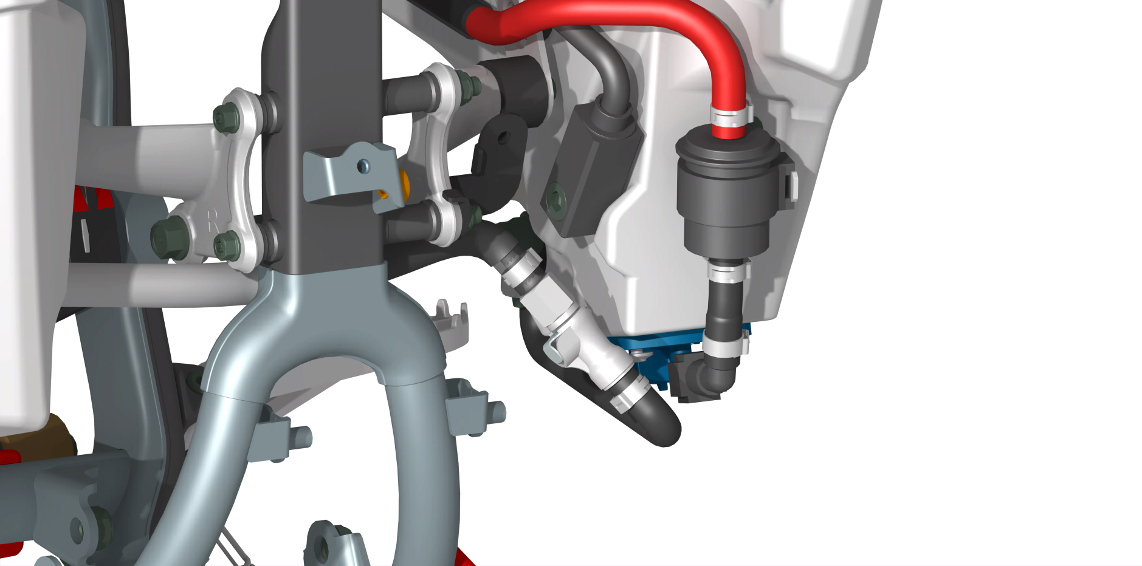
P1
※Fuel Line Inspection
Before and after the tank inspection before remove the following content:
- fuel tank vent;
- seat cushion assembly;
- before tank decoration or so; - remove the engine protection plate assembly.
[1]
[2]
Inspection.
Hang the front left fuel tank on the left side of the frame
1. Check (as right P1) the connection condition such as aging damage of the left and right fuel tank connecting hose quick connect connector [1].
2. Check (as right P1, 2) whether the left and right fuel tank connecting hoses and double-hole over fuel bolts [1], [2] are loose, damaged or leaking.
3. Check (such as right P2) whether the fuel check valve [2] and single-ear induction clamps are loose, damaged or leaking.
Is the rear fuel tank and front right fuel tank connection hose accurately stuck into the wire hook bracket [3].
4. Check (e.g. right P3) whether the connection condition of the rear tank and the front right tank connecting hose quick-connect fitting [1] is damaged by aging.
5. Check (e.g. right P3) whether the rear fuel tank connecting hose and the double-hole over-fuel bolt [2] are loose, damaged or leaking.
If the quick connect fitting and its surroundings are dirty, clean them.
Replace them if necessary.
Contact your dealer for replacement of the injector fitting/oil supply hose assembly.
Caution.
-Be careful not to damage the fuel supply hose fitting and fuel line. -Do not use tools.
P2
[1]
[2]
[3]
P3
[1]
[2]
※Fuel Pressure Relief
Caution.
-Before disconnecting the fuel supply hose, relieve system pressure as follows.
1. remove the lower engine shield assembly.
2. disconnect the fuel pump 2P (black) fitting [1].
3. start the engine and allow it to idle until the engine stalls.
4. Turn off the ignition switch.
English
version
127
[1]

Slide 5
※ Quick Connect Removal
Disassembly
Caution.
-Before disconnecting the fuel supply hose, clean around the quick disconnect and make sure no dirt enters the fuel system.
Do not bend or twist the fuel supply hose. This may cause a fuel leak.
1. relieve fuel pressure.
2. Remove the seat cushion assembly.
3. Remove the front trim assembly.
4. Remove the lower engine shield.
5. remove the battery terminal bolt [1] disconnecting the negative (-) battery cable [2].
6. remove the front side 2 fuel tanks and air filter assembly waste gas pipe, leaky water pipe.
6. Press and hold the fuel connector release button [3], [4] respectively, and disconnect the quick connect connector from the fuel pump unit connector and the injector connector.
Caution.
-Drain the remaining fuel from the fuel supply hose into a suitable container.
-Wipe off any spilled fuel immediately.
-Be careful not to damage the slide retainer and hose. Do not use tools.
7. To prevent damage and entry of foreign objects, cover the disconnected connector [1] and fuel fitting end [2] with a plastic bag.
[1]
[2]
[3]
[4]
English
version
[1][2]
128

Slide 6
※ Quick Connect Head Installation
Caution.
-Do not bend or twist the fuel supply hose, this may cause fuel leaks.
-Do not reuse kinked or damaged fuel supply hoses.
-Do not use gloves or rags when installing quick-connect couplings.
1. Connect quick-connect fittings [1], [2] to the fuel pump unit connector and injector connector, respectively, while holding the quick-connect housing until you hear a "click".
Caution.
-Be careful not to damage the sliding ring and fuel supply hose.
-Do not use tools.
If connection is difficult, apply a small amount of oil to the fuel fitting end.
Make sure the connection is secure and the quick connect coupling is locked firmly in place; visually inspect and pull on the connector housing [1].
2. Connect the negative (-) battery cable [1].
Install and tighten the battery terminal bolts [2] to the specified torque.
Torque.
2.0 N-m (0.2 kgf-m ,1.5 lbf-ft)
[1]
[2]
[1]
[2]
English
version
129

Slide 7
※Increasing Fuel Pressure
1. Connect the fuel pump power supply wire quick plug connector (black) 2p[1]; 2. Temporarily left before the fuel tank is installed on the frame; 3. In the case of throttle fully closed, pull the clutch handle to the bottom, and press the starter switch; The engine will increase the fuel pressure to start; 4. Turn off the engine check whether there is a leak in the fuel line.
※Fuel pump unit
Removal/Installation
- Disassemble the front trim assembly [1];
- Disassemble the front fuel tank vent pipe [2];
- Disassemble the seat cushion assembly [3];
- Remove the lower engine shield assembly [4];
Before removing the fuel tank, disconnect the fuel pump supply line speed connector fuel line quick release fitting.
Remove the front fuel tank upper connecting bolts [5] and left and right side fuel tank connecting bolts [6], the left and right 3 of the turn over bushing [7] and the left and right fuel tanks [7].
The installation order is opposite to the disassembly order.
(The left and right side fuel tanks are installed in the same way)
Front fuel tank upper connecting bolt and side connecting bolt installation
Torque.
Fuel tank mounting nut. 22 N-m (2.2kgf-m, 16 lbMt)
[1]
[5]
[2]
[7]
[1]
[3]
[4]
[2]
[3]
Disassembly/Installation
Remove the following components.
Remove the fuel tank and clean around the fuel pump. Cross loosen the 4 mounting bolts [1] and remove them in several steps as shown in Figure 1. Remove the fuel pump and rubber seal [2].
Install in the reverse order of removal.
Caution.
-Be careful not to damage the fuel pump unit.
Drain the remaining fuel from the fuel pump unit into a suitable container and wipe off the spilled fuel immediately.
Replace the rubber seal with a new one [2].
-Clean the rubber seal seating area of the fuel tank and fuel pump base plate to ensure that there are no foreign objects.
-Place the rubber seals with the tabs facing the fuel line.
-Tighten the 4 mounting nuts to the specified torque in the order shown. Torque.
Fuel pump mounting bolts.
8 N-m (0.8 kgf-m, 6.0 lbf.ft)
[5]
[6]
[1]
[2]
English
version
图1
130

Slide 8
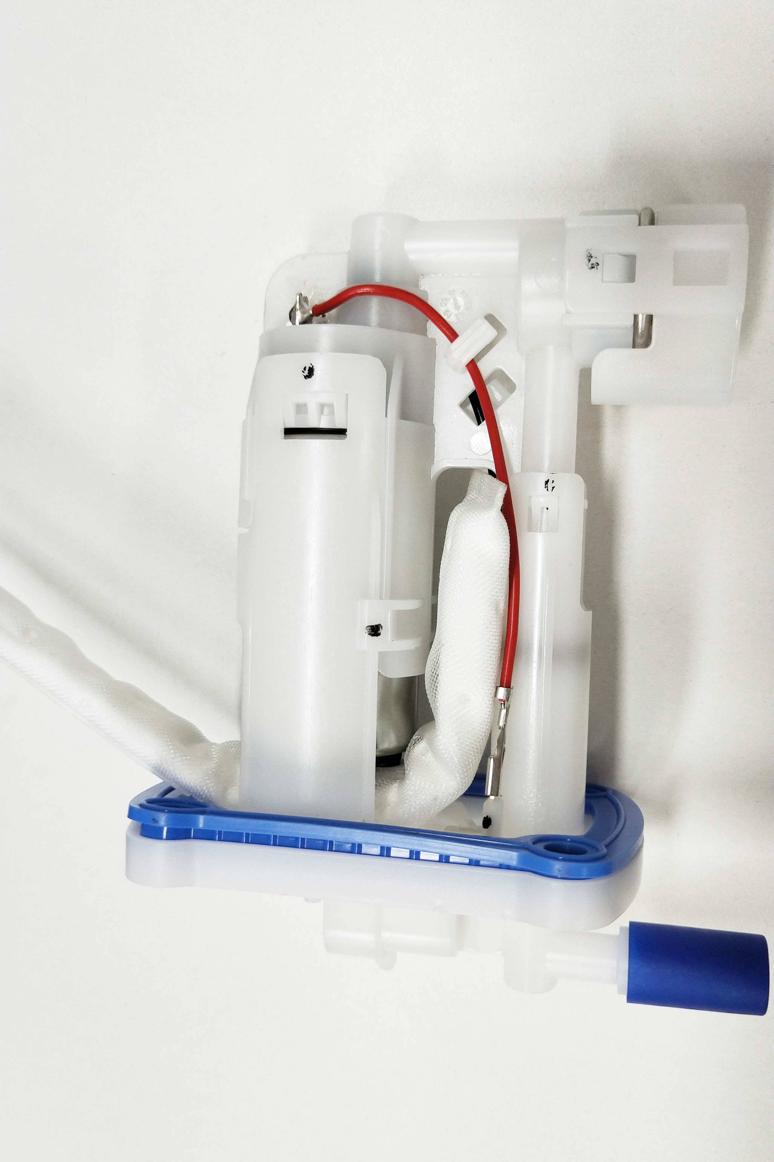
[3]
※Fuel pump filter
Remove/check/installation dismantling the pump unit disconnect pump motor wiring harness connector [7], [8]. As shown, open fuel pump bracket left and right sides of the card buckle [1], [2], remove the fuel pump bracket. Note: • don't use tools in order to avoid damage to the pump unit.
[1]
[2]
Disassemble the fuel pump unit as shown in the figure on the right.
- Fuel pump base [1].
- O-ring x3 [2].
- Rubber seal [3].
- Fuel filter (screen) [4].
- Fuel pump [5].
- Fuel pump unit bracket [6].
- Fuel pressure regulating valve [9].
Caution.
-Check the fuel filter for clogging, damage or deterioration, and replace it if necessary.
-Lay the black wire [7] and red wire [8] correctly.
-Align the rubber seal with the fuel pump base unit recess.
Install in the reverse order of removal.
[2]
[2]
[4]
[6]
[9]
[2]
[5]
[7]
[8]
[1]
[3]
[3]
※Installation
Apply engine oil to the new rubber seal [1].
Install the following components.
- 4 x M5x16 fuel pump unit mounting bolts.
Caution.
-Make sure the rubber seal [1] is located in the fuel pump base recess [2].
Install the fuel pump bracket and fuel pump onto the fuel base.
-Align the fuel pump plate slots with the fuel pump unit lugs.
Install the fuel pump assembly so that the fuel fitting [3] is toward the left front of the fuel tank.
-Be careful not to damage the fuel pump unit.
Tighten the fuel pump unit mounting bolts [4] to the specified torque in the order shown in Figure 1.
Torque.
8.0 N-m (0.8kgf-m , 6lbf-ft)
[1]
[2]
图1
[4]
English
version
131

Slide 9
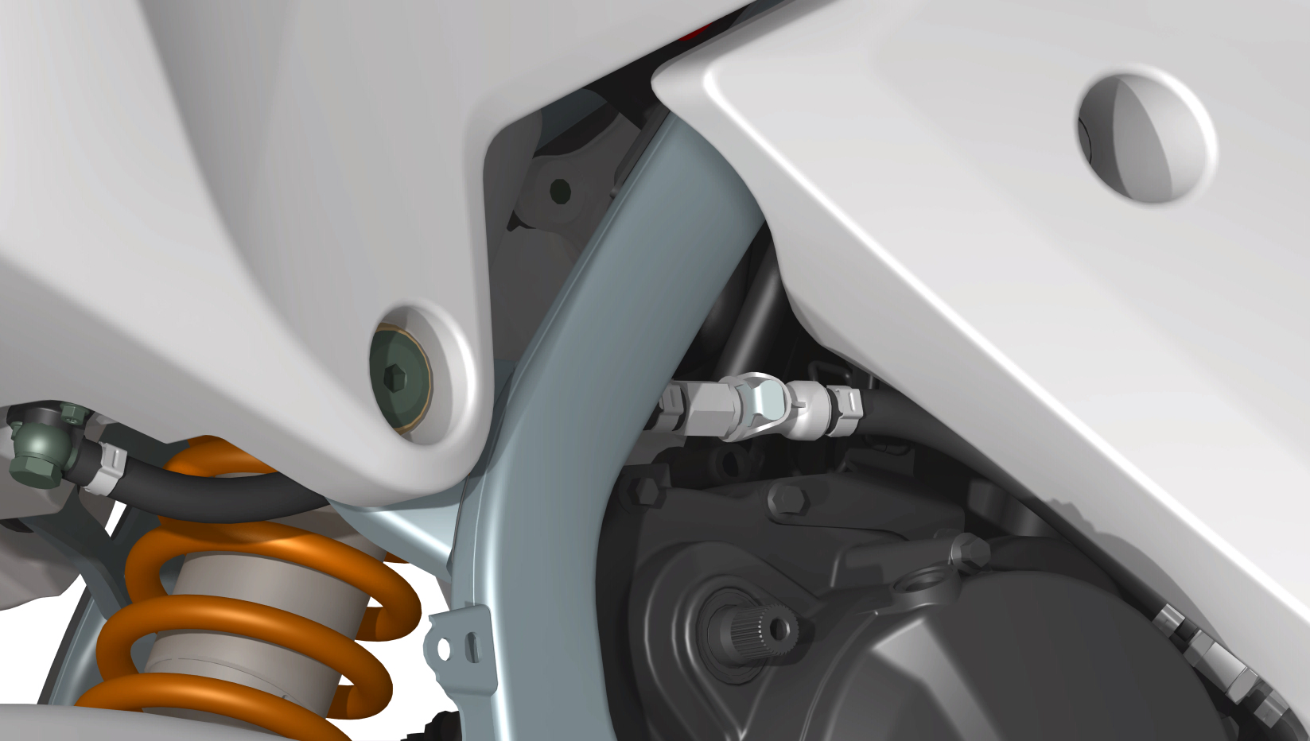
※Front side fuel tank and rear fuel tank mounting fuel line connection check
Disassembly/Installation
Remove the following.
Before installing the fuel tank, disconnect the fuel pump supply line speed connector fuel line quick release connector.
-Check the P1 rubber screw bolt [1] for looseness, breakage, and deterioration.
and tighten the bolts to the specified torque.
Torque: rubber screw [1]
22N-m (2.2kgf-m, 16 lbMt)
-Check P1 bolt [1] for looseness adjust tank mounting bracket to proper angle and tighten bolt to specified torque.
Torque: front fuel tank mounting bracket bolts [2];
15N-m (1.5kgf-m, 11 lbMt)
-Adjust the Figure 1 hexagonal nuts [3] to the proper position and tighten the bolts to the specified torque before installation.
Torque: front fuel tank mounting hex nut to frame connection [3];
15 N-m (1.5 kgf-m, 11 lbMt)
(Left and right side fuel tank mounting bolts are adjusted with the same locking torque)
As P2.
first hang the right side tank on the frame and tighten the bolt through the turning over inch sleeve to the specified torque.
Torque: fuel tank mounting screw [1]
22N-m (2.2kgf-m, 16 lbMt)
and connect the tank vent hose [2].
The installation order is the reverse of the disassembly order.
(The left and right side tanks are installed in the same way)
As in P3.
Connect the right side tank fuel hose [1] through the engine and frame lower beam to the left side tank quick plug [2] and check for looseness, damage or leaks.
Replace if necessary.
As in P4.
The rear tank fuel hose is connected to the front right side tank using the quick plug [1] then check for looseness, damage or leaks.
The rear fuel tank and front right side fuel tank connection hose is accurately seated in the wire hook bracket.
P1
[1]
[2]
[3]
[3]
P2
[left]
[right]
[2]
[1]
[1]
P3
[1]
[2]
P4
[1]
English
version
132

Slide 10
[1]
[3]
※EFI (evaporative fuel emission) carbon canister/dump valve
（regular edition only）
Disassembly/Installation
Disassembly of the following.
- Disassembly of the dump valve and carbon tube.
- Removal of the lower engine guard assembly.
- Removal of the left front fuel tank.
- Disconnecting the fuel tank connecting dump valve hose [1], connecting dump valve carbon tube hose [2] removing the dump valve [3].
- Disconnect the carbon canister discharge connection throttle hose [4]
Remove the carbon canister [5] from the carbon canister retaining rubber sleeve [6].
Install in the reverse order of removal.
[2]
[4]
[6]
[5]
English
version
133

Slide 11
※Air filter assembly
Remove the air filter housing assembly from the frame by loosening the air intake hose [1] toward the rear and from the throttle side.
Install in the reverse order of removal.
Caution.
- When placing the assembly into the frame, carefully install the crankcase breather hose [2], making sure it is not kinked or deformed.
-Tighten the intake hose holding screws [3] with a distance of 10 ± 1.0 mm between the band ends.
-When connecting the injector 2P (gray) fitting [4
Align the notch with the lug of the injector fitting.
Torque.
Air filter assembly mounting bolts.
10N-m (kgf-m, lbMt)
Throttle cable attachment bolt (at throttle body).
3.0 N-m (0.3 kgf-m, 2.2 lbf-ft)
Adjust throttle handle free play If the sensor unit has been removed, perform the throttle position sensor reset procedure.
[4]
[1]
[3]
[2]
- Anisotropic bolt M5X78 [1].
- Air filter sponge [2].
- Air filter housing [3].
- Rubber bolt X4 [4].
-Air filter element leakage pipe [5].
-Air filter end of intake tube assembly [6].
-Intake duct assembly clutch X2 [7].
-Injector [8].
- Injector O-ring X2 [9]; - Injector O-ring [9].
- Injector clamps [10].
-Oil rail [11].
- Three-in-one sensor [12].
- Idle motor valve body [13].
- Engine side air intake hose [14].
[1]
[2]
[10]
[3]
[4]
[11]
[8]
[9]
[6]
[5]
[14]
[12]
[7]
English
version
[13]
134

Slide 12
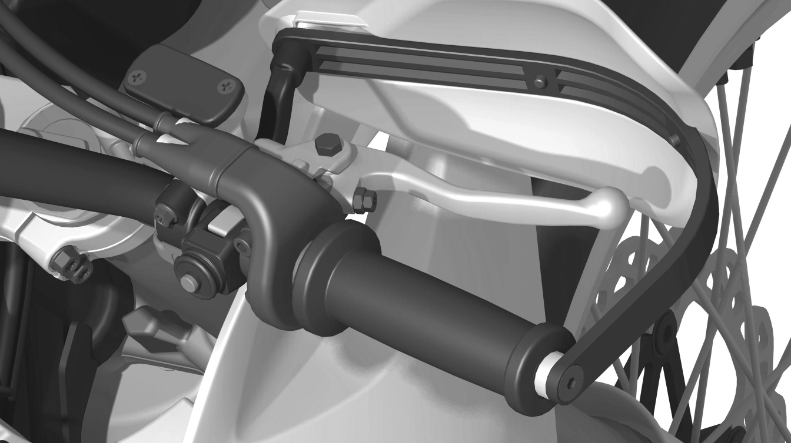
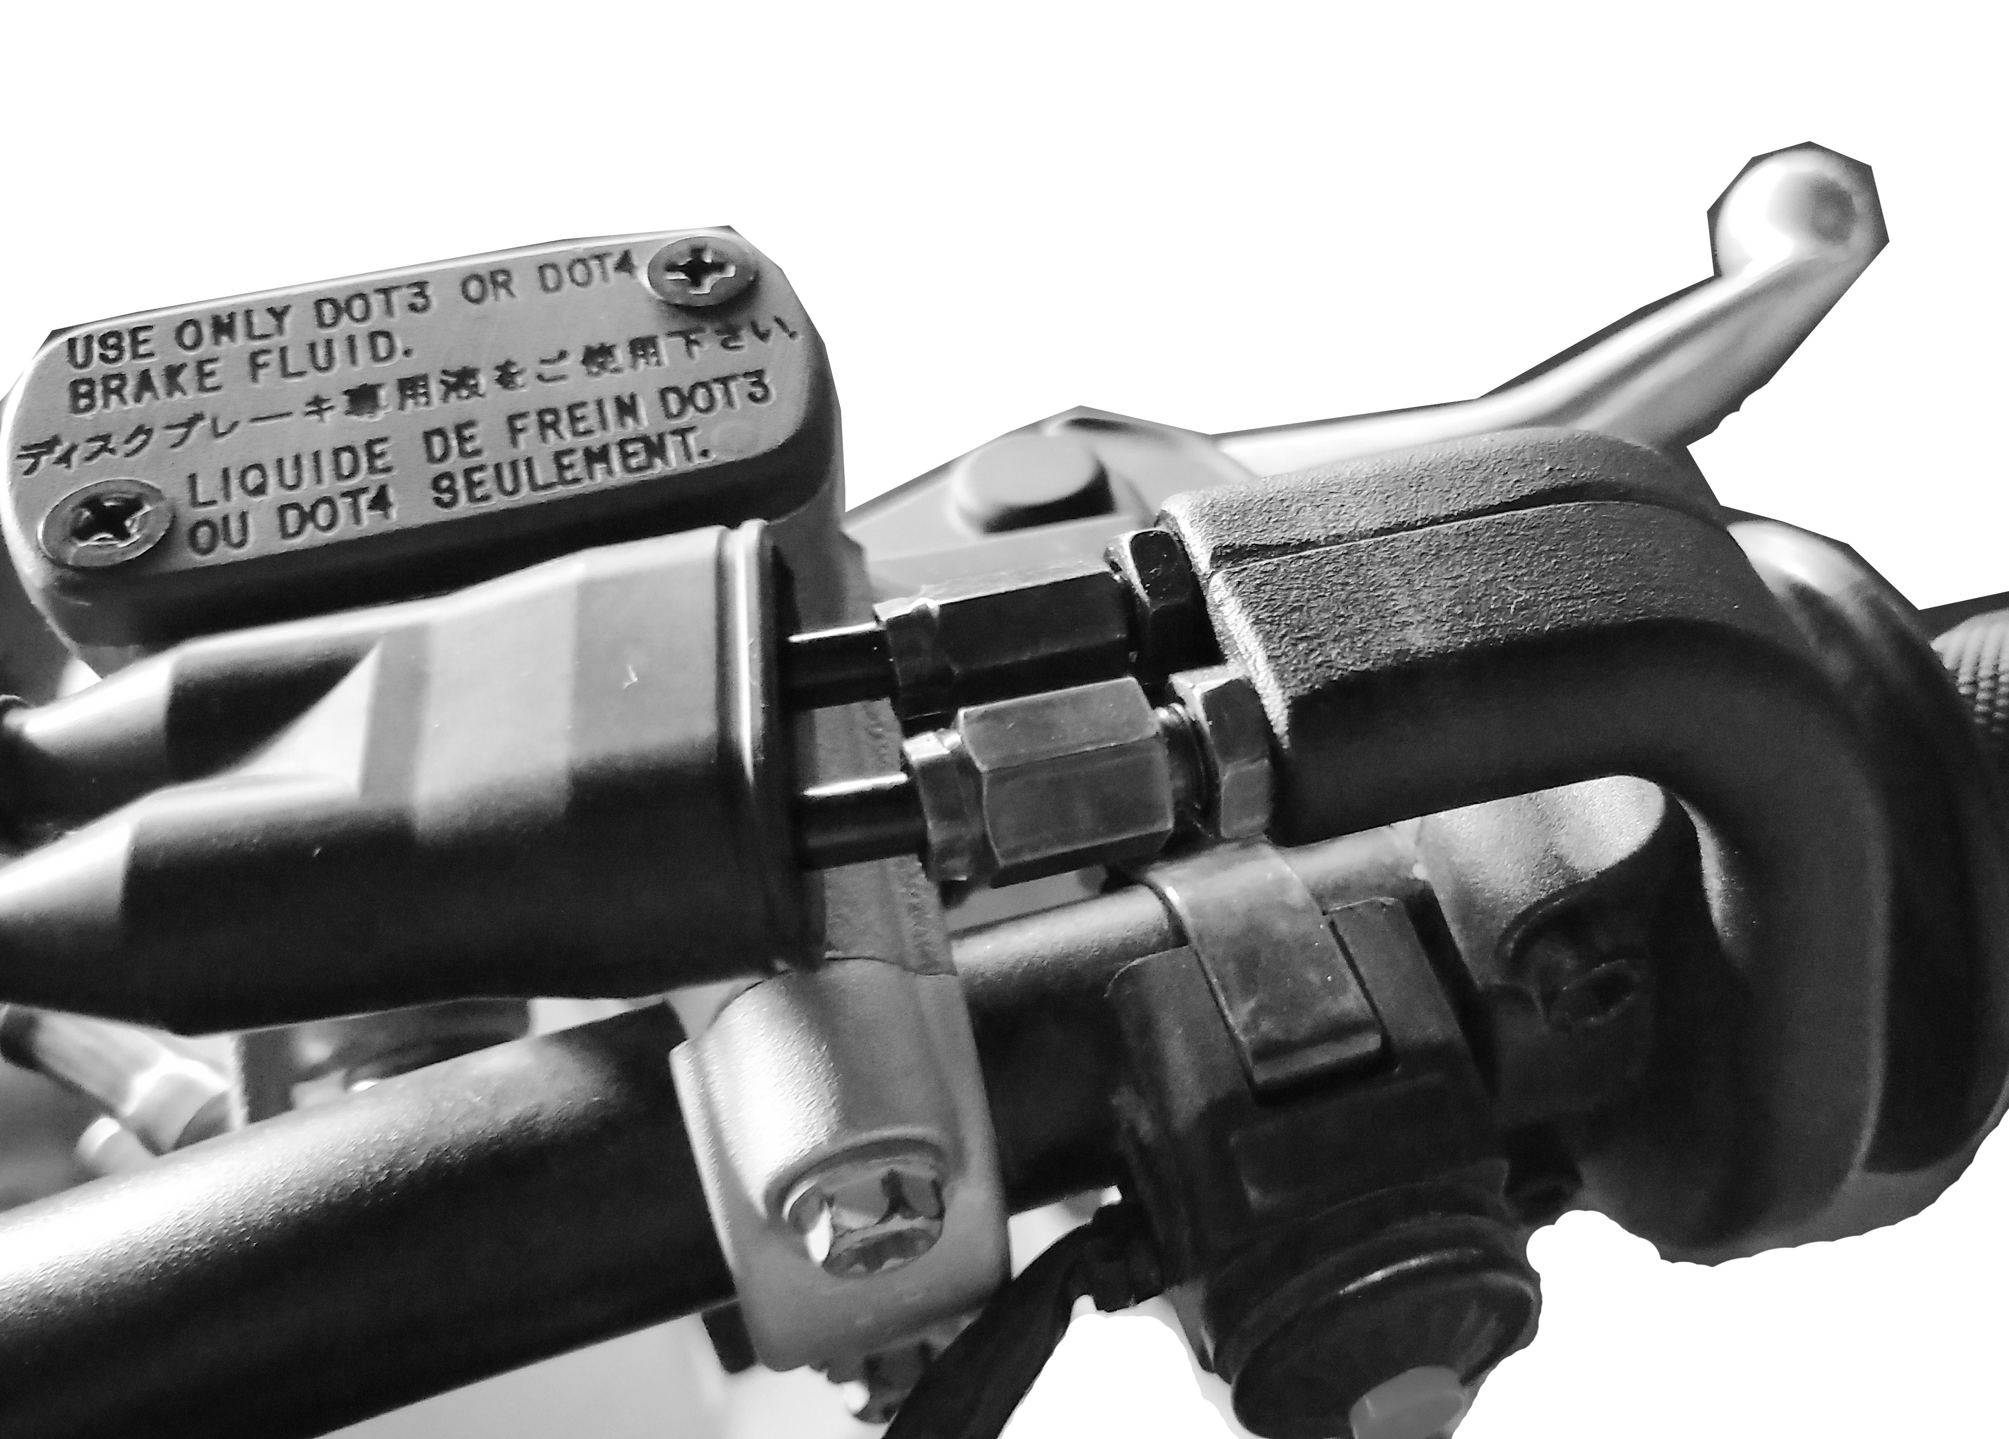
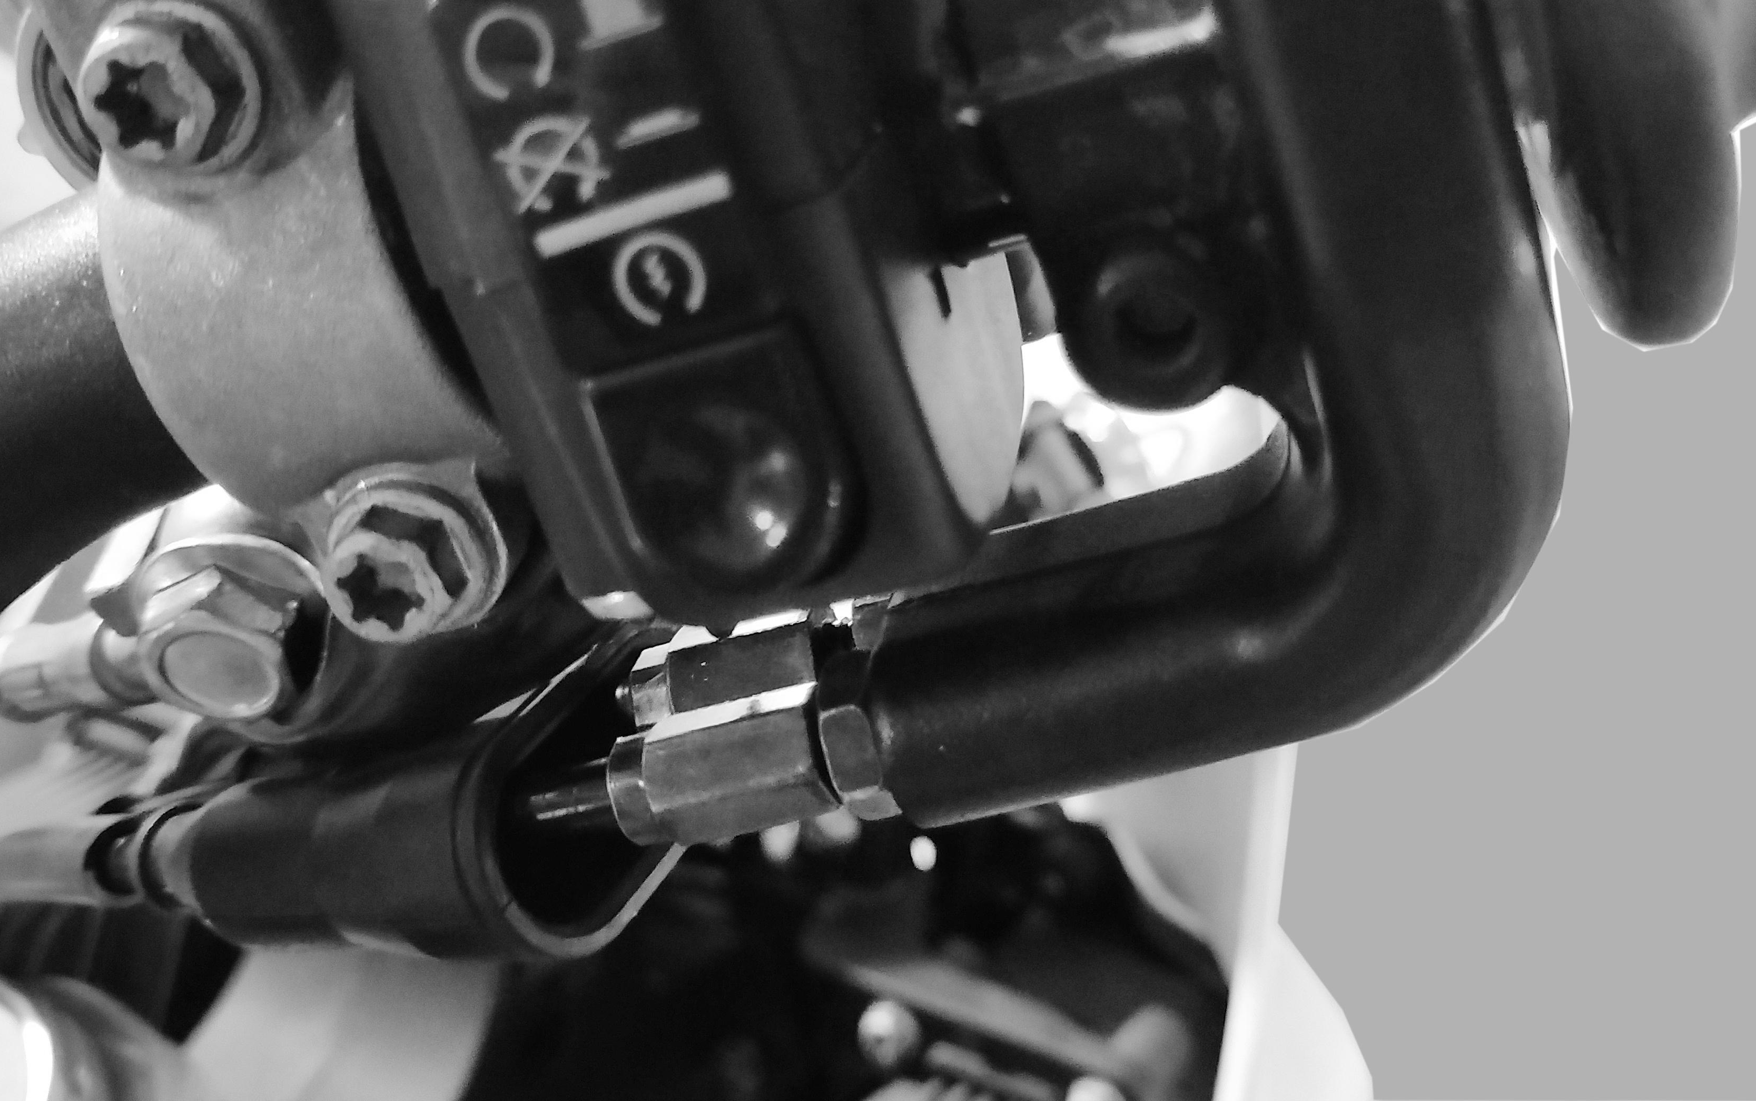
2-6 mm (0.08-0.24 in)
※Throttle Free Travel
Check that the throttle cable is not aged, damaged or kinked.
Turn the throttle handle and check that the throttle opens smoothly and closes automatically in any steering position.
If the throttle handle does not turn smoothly and smoothly, check that the cable is properly routed, that the throttle lever is clean and lubricated with the recommended lubricant (engine oil or appropriate cable lubricant), and that the throttle drum is turning properly.
If there are no abnormalities, but the throttle does not turn smoothly, replace the throttle cable (oil feed, return cable).
Measure the free clearance at the throttle handle flange.
Free clearance: 2-6mm (0.08-0.24in)
P1
1. Fine adjustment on the throttle side
Loosen the locknut [1] and turn the adjuster [2].
Turning the adjuster in the (-) direction will decrease the free play and turning it in the (+) direction will increase the free play.
After adjustment, hold the adjuster and tighten the lock nut.
If the correct free clearance is not obtained even after turning the adjuster to the bottom, return it to the (+) direction until it gently touches the bottom and turn it one turn to the (-) direction, then make more adjustments on the throttle side.
Nut [1] Torque.
5.0 N.m (0.5 kgf.m, 3.7 lbf.ft)
Note: P1 is factory edition and P2 is regular edition.
（+）
[2]
（-）
[1]
P2
（+）
[2]
（-）
[1]
2. Throttle body side for significant adjustment
Loosen the intake throttle cable adjuster lock nut [1] and turn the adjuster [2] in the (-) direction to reduce free play and in the (+) direction to increase free play.
After adjustment, hold the adjuster and tighten the inlet throttle cable adjuster lock nut to the specified torque.
Torque.
4.0 N.m (0.4 kgf.m, 3.0 lbf.ft)
(The oil inlet cable and the oil return cable are adjusted the same)
Caution.
-Re-check that the throttle handle turns smoothly with no sticking.
（-）
[2]
English
version
（+）
135
[1]

Slide 13
※Throttle assembly and air intake hose
①. Throttle
Removal/Installation
Remove the following parts.
- Remove the fuel line quick coupling [1];
- Remove the fuel rail cap mounting screw [2] and the fuel rail mount injector;
- Disconnect the triple sensor plug 5p [3];
- Disconnect the stepper motor motor plug 4p[4];
- Loosen the throttle cable adjustment nut [5];
- Remove the throttle cable from the turntable [6];
- Remove the intake pipe clamp fastening screws at both ends [7];
- Remove the throttle valve body [9] and intake pipe [10].
The installation order is the reverse of the disassembly order.
Caution.
-Installation of intake pipe clamps should be in the limit point [11], intake pipe and engine connection aligned with the limit tab [8] within.
Torque.
M6x20
Injector cap and throttle connecting bolt
8.0 N.m (0.8 kgf.ft, 6 lbf.ft)
Note. Throttle inlet pipe mounting clamps can be screwed to the limit.
[1]
[2]
[3]
[4]
[6]
[5]
[6]
[5]
[11]
[11]
[7]
[7]
[9]
[8]
English
version
[10]
136

Slide 14
Throttle Valve Body
Removal/installation
note: • throttle body, is the factory assembly good way to remove the outside not shown in this manual. , throttle pull don't will throttle after removed from open to close, which may lead to damage of throttle. Don't damage the throttle body; This may cause the throttle to not work properly. • don't loosen or tighten the nuts and bolts, coated with torsion logo loosen or tighten they lead to throttle body malfunction.
Prohibit disassembly
Disassemble the idle motor / triple sensor
Inspect the idle motor air passage in the throttle body for carbon buildup.
Inspect the O-ring on the idle motor/triple sensor for deterioration or damage.
Remove the following parts.
- 2 screws [1];
- Remove the 3-in-1 sensor unit [2];
- 2 screws [3];
- Idle speed motor valve body [4];
Clean the throttle body and idle motor valve body piping with compressed air.
Caution.
-Cleaning with a wire ball will damage the throttle valve body.
The installation order is the reverse of the removal order.
Caution.
-Replace new rubber seals
-Install each clamp in the intake tube assembly with the screw head [5] facing the right side and align the left side band hole [6] with the locating tab.
-Install each clamp with the "UP" mark facing up
Facing the throttle body and aligning the notch [7] with the lug.
-Tighten the clamp screws so that the distance between the two ends is
10±1.0 mm (0.4±0.04 in)
Install the tightening bolts to the specified torque.
Torque.
3-in-1 sensor mounting screws.
3.4 N-m (0.3 kgf-m, 2.5lbf.ft)
Idle motor valve body mounting screw: 3.4 N-m (0.3 kgf-m, 2.5lbf.ft)
3.4 N-m (0.3 kgf-m, 2.5lbf.ft)
maintenance
if not for
Prohibit disassembly
[1]
[1]
[2]
[3]
[4]
[3]
[6]
[7]
English
version
137
[5]

Slide 15
※Oil rail assembly
Removal/Installation
Remove the oil rail assembly from the throttle assembly.
Remove the following parts.
- 1 bolt [1];
- 1 wire harness connector [2] ;
- Remove the oil rail [3];
- Remove the injector clips [4];
- Remove the injector [5];
- Remove the injector O-ring [6].
Check each part for wear or damage and replace if necessary.
Install in the reverse order of disassembly.
Caution.
-Apply oil when replacing the new O-ring and seal.
-Be careful not to damage the O-rings when installing the injectors.
-Insert the injector fitting in line with the fuel fitting.
Torque.
Fuel rail assembly connecting bolt
12 N-m (1.2 kgf-m, 8.9 lbf.ft)
[2]
[1]
[4]
[5]
[3]
[6]
English
version
138

