Slide 1
Cooling System
1 Maintenance information ............................................................................... 140
2 Cooling System Flow Chart ........................................................................... 141
3 Cooling System Test ........................................................................................ 142
4 Coolant change................. ................................................................................ 143
5 Thermostat .......................................................................................................... 145
6 Water reservoir, radiator grille .................................................................... 146
7 Fans, water pipes, radiators ........................................................................... 147
8 Water pump ........................................................................................................ 148
9 Oil-cooled radiators ........................................................................................ 149
English
version
139

Slide 2
Maintenance information
Overview
Do not remove the radiator cap before the engine and radiator cool down to prevent the coolant from splashing out and scalding people
NOTE
The use of coolant with silicate inhibitors can lead to premature wear of water pump seals or blockage of radiator passages.
Using tap water can cause engine damage.
l - Add coolant to the reservoir; do not remove the radiator cap except to add or drain coolant.
Do not remove the engine from the frame when servicing the cooling system.
-Avoid leakage of coolant to painted surfaces.
Check for leaks with a cooling system tester after system maintenance.
Check the coolant temperature indicator/water temperature sensor.
Check the fan control relay.
Troubleshooting
Engine temperature is too high
-Coolant temperature indicator/water temperature sensor failure
-Throttle valve not open
-Faulty radiator cap
-Insufficient coolant
-Blocked radiator passages, hoses, water pipes
-Circulation system air intake
-Failure of cooling fan motor
-Fan control relay failure
-Faulty water pump
Engine temperature too low
-Faulty coolant temperature indicator/water temperature sensor
-Throttle valve open
-Fan control relay failure
Coolant leakage
-Defective water pump mechanism
-O-ring deterioration
-Radiator cap failure
-Damaged or deteriorated cylinder head gasket
-Hose connection is loose or not clamped
-Damaged or deteriorated hoses
-Damaged radiator
-Thermostat cover, water pump cover pipe joint is loose
English
version
140

Slide 3
Cooling System Flow Chart
[3]
[4]
[5]
[6]
[7]
[2]
[8]
[1]
[9]
[10]
[11]
[12]
[13]
[14]
[15]
[16]
[17]
1 | Radiator fan left | 6 | Siphon Tube | 11 | Thermostat | 16 | Oil Cooled Radiators
2 | Water reservoir | 7 | Radiator cap | 12 | Engine Intake Hose | 17 | Radiator grille
3 | Radiator left | 8 | Engine outlet pipe | 13 | Water pump
4 | Radiator left and right connecting pipes | 9 | Radiator fan right | 14 | Oil-cooled radiator inlet pipe
5 | Overflow pipe | 10 | Radiator right | 15 | Oil-cooled radiator discharge pipe
English
version
141

Slide 4
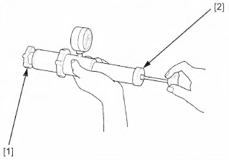
※Cooling System Test
Radiator system pressure check.
Disassembly/Installation
Removal of the following components.
- Removal of the front trim assembly.
- Remove the radiator cap [1].
[1]
Lubricate the sealing surface of the cap [1]; then install the cap on the tester [2].
Use the tester to pressurize the radiator cap.
Replace the radiator cap if it does not hold pressure or if the release pressure is too high or too low.
The radiator cap must hold the specified pressure for at least 6 seconds
Radiator cap release pressure.
108-133Kpa
Connect the detector to the radiator.
Use the tester to pressurize the radiator, engine and hoses to test their airtightness.
Caution.
-High pressure can damage cooling system components, do not exceed 133kPa.
-If the system does not maintain the specified pressure for at least 6 seconds, repair or replace the components.
[2]
[1]
Note. This operation is performed when the bike is running cold.
English
version
142

Slide 5
[3]
※Coolant change
When adding coolant to the tank radiator or sub-tank or checking the coolant dose, the motorcycle should be placed on a level flat surface and in an upright position.
Disassembly/Installation
Remove the following components.
- Removal of the front right side fuel tank and lower guard assembly.
- Removal of water pump drain bolts [1] and flat washers [2].
- Remove the radiator cap [3] and drain the coolant.
Drain the coolant :
-After replacing the flat washer with a new one, install the drain bolt.
Tighten the drain bolt to the correct torque.
Torque.
Water pump drain bolt.
10 N.m (1.0 kgf.m, 10 lbf.ft)
[1]
[2]
• After motorcycle shuts off, wait for the car to cool down for a while, and then perform the following operations to avoid the risk of burns due to excessive coolant temperature.
English
version
143

Slide 6
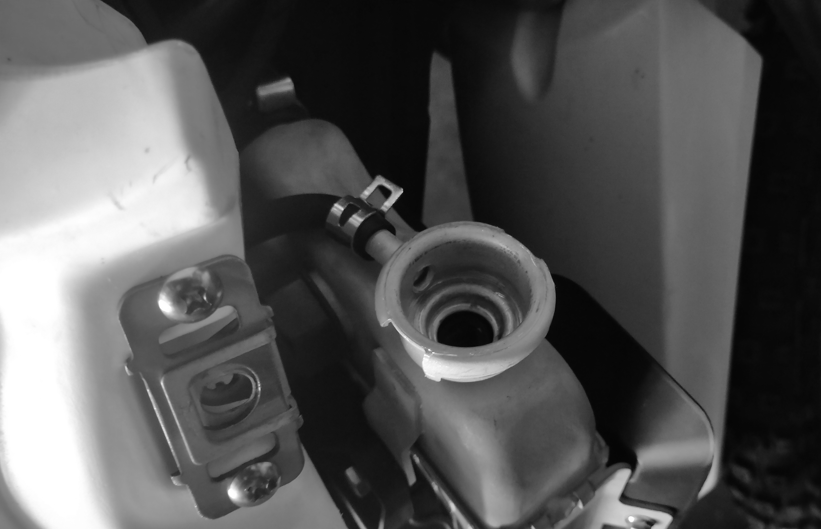
Disconnect the siphon hose from the radiator [1] and pull the siphon hose out of the hose clamp.
Place the hose in a lower position outside the engine frame and drain the coolant from the storage tank.
Drain the coolant, flush the inside of the storage tank with water, and install the hose into the hose clamp and over the radiator
[1]
Fill the cooling system up to the neck with the recommended coolant through the water injection hole [1]. Not recommended with antifreeze: including ethanol containing silicate cooling fluid
[1]
※Air is discharged from the radiator
Recommended antifreeze.
Remove air from the system as follows.
1. Shift the engine to neutral, start the engine and allow it to idle for 2-3 minutes.
2. Open and close the throttle three to four times to remove the air from the radiator system.
3. Turn off the engine and fill it with coolant if necessary. 4.
4. Install the radiator cap.
Fill the reservoir with the recommended coolant to the standard scale and close the reservoir cap.
• After motorcycle shuts off, wait for the car to cool down for a while, and then perform the following operations to avoid the risk of burns due to excessive coolant temperature.
English
version
144

Slide 7
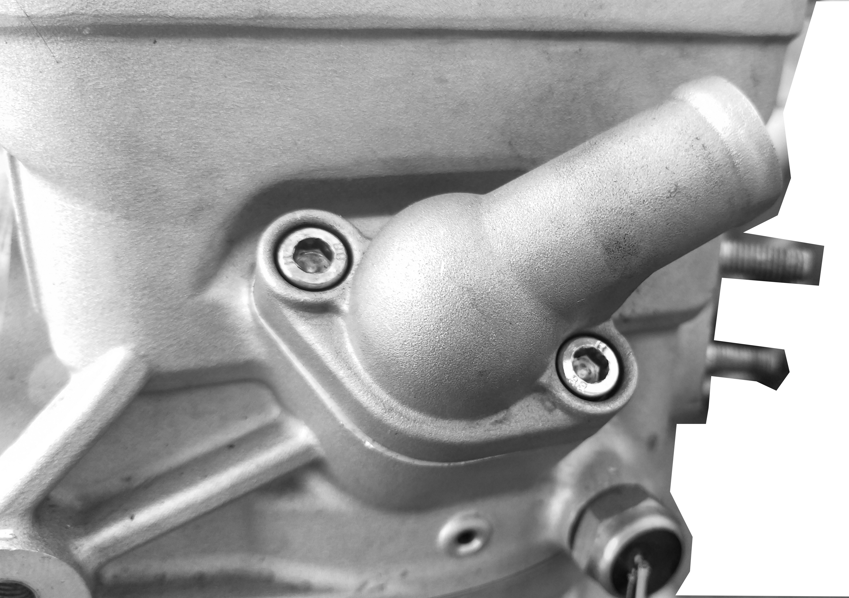
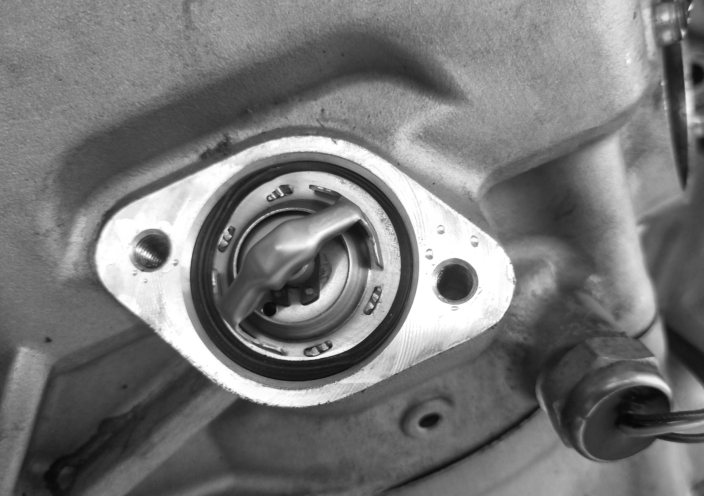
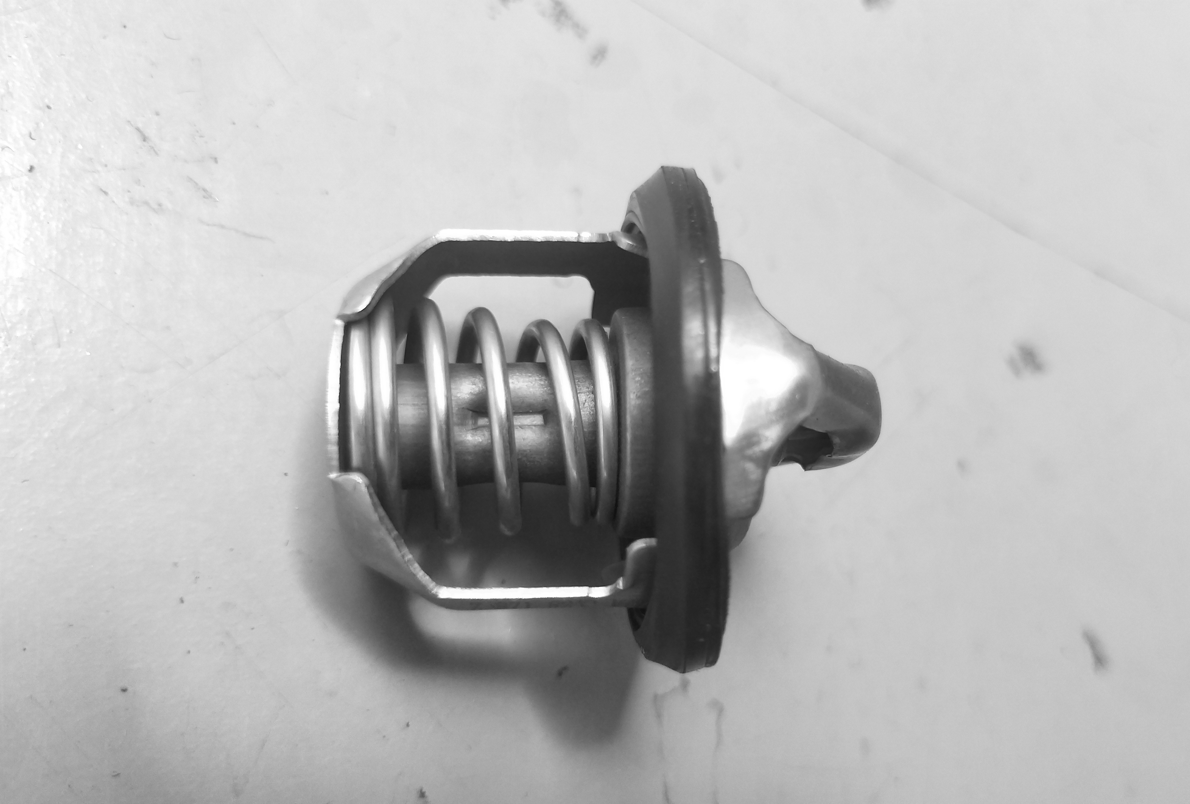
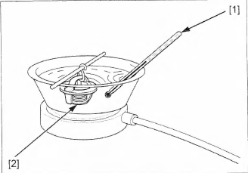
[2]
※Thermostat
Remove/install
- emptying of coolant.
- remove the bolts [1] and [2] thermostat cover.
[1]
Remove the thermostat from the cylinder head [1].
Install in the reverse order of removal.
Torque.
Thermostat cover bolts.
12 N.m (1.2 kgf.m, 9.0 lbf.ft)
Caution.
-When installing the thermostat, be careful to install the thermostat seal properly and snap it into the round recess in the waterway of the middle cylinder.
[1]
[1]
[2]
Inspection：
Thermostat [1] appearance whether there is damage. If the thermostat valves are open at room temperature, need to change. Check whether the seal [2] is damaged, if you need the replacement.
[1]
Heat the water to operating temperature for 5 minutes with an electric heating element.
Suspend the thermostat [2] in hot water and check its operation.
Thermostat starts to open at.
82±2°C (176-183°F)
Valve ramp-up.
92°C (197.6°F) not less than 8 mm
If the thermostat responds at a temperature other than that specified, replace the thermostat.
English
version
145
[2]

Slide 8
※Water reservoir
Disassembly/Installation
Remove the following components.
Drain the sub kettle coolant .
- Remove the sub kettle mounting bolts [1];
- Remove the siphon hose clamps [2].
- Remove the sub kettle [3].
Install in reverse order of removal.
Torque :
Reservoir mounting bolts.
10 N-m (1.0 kgf-m, 7.4 lbf.ft)
[3]
[2]
[1]
※Radiator grille
Disassembly/Installation
Remove the following components.
- Remove the front trim assembly;
- Remove the lower engine shield assembly;
- Remove the front left and right side fuel tanks;
- Disconnect the fuel line and fuel pump harness connector 2P (black);
- Remove the radiator grille mounting bolts [1][2];
- Remove the radiator left and right grilles [3][4].
The installation order is the reverse of the removal order.
Torque:
Radiator grille mounting bolts.
8 N-m (0.8 kgf-m, 6.0 lbf.ft)
[1]
[2]
[3]
[4]
English
version
146

Slide 9
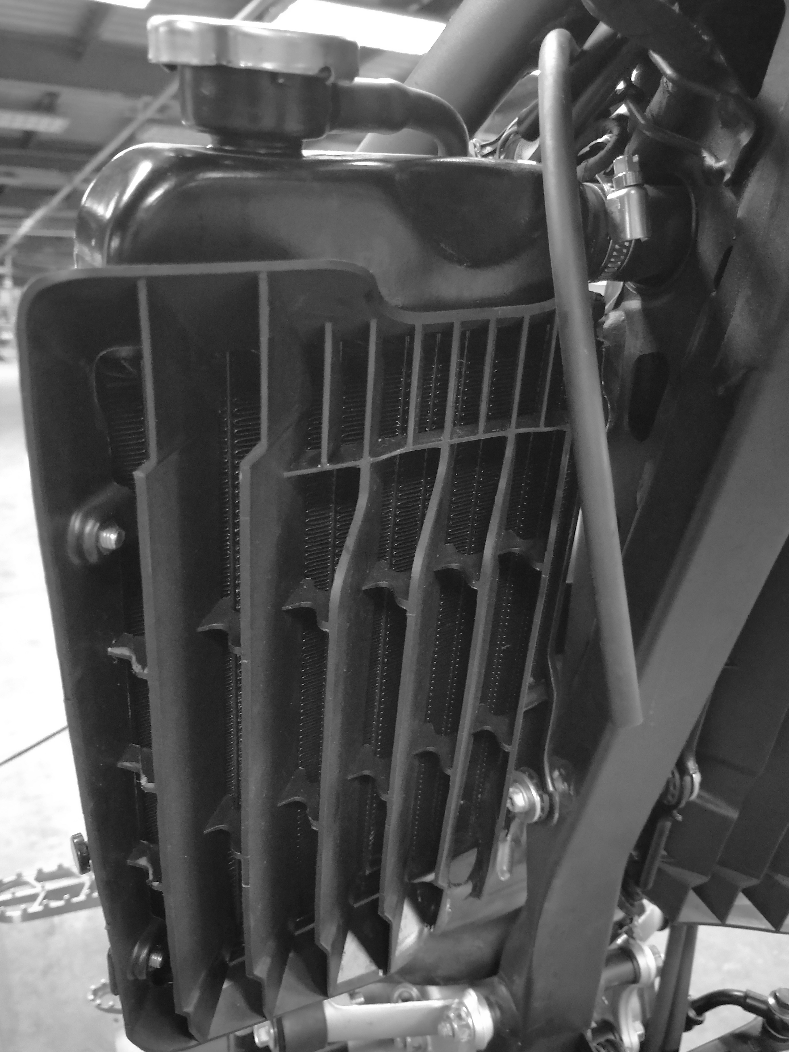
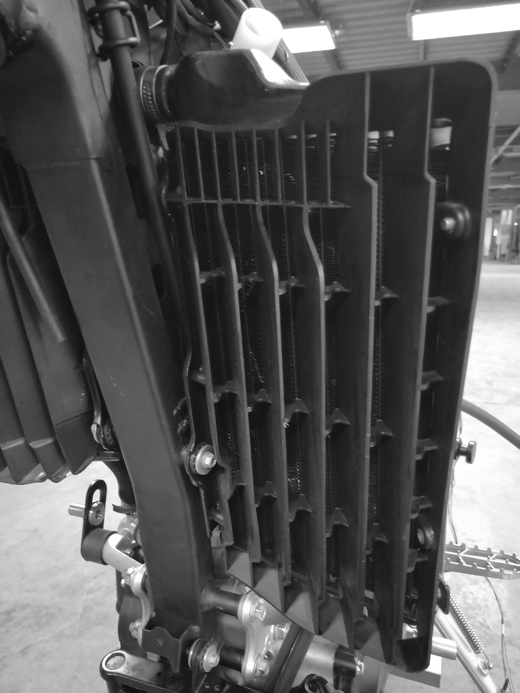
※Fans
Disassembly/Installation
Disassemble the following components.
- Drain radiator tank coolant;
- Disconnect the radiator fan motor 2P (white) wire harness connector;
- Remove the radiator fan left and right side mounting 6 bolts [1];
- Remove the radiator fans on the left and right sides.
The installation order is the reverse of the removal order.
Torque :
Radiator fan cover mounting bolts.
8 N-m (0.8 kgf-m, 6.0 lbf.ft)
Fan motor check.
Battery voltage 12V Motor running at full speed with amperometer current not exceeding 3A, if motor does not rotate or current exceeds specified then replace fan motor.
[1]
[1]
※Water pipes
Disassembly/Installation
Remove the following parts.
- Loosen the pipe clamps [1] and loosen the water pipe above the radiator [2];
- Loosen the pipe clamp [3] and loosen the water pipe [4] on the right side of the radiator;
- Loosen the clamp [5] and loosen the water pipe [6] on the lower left side of the radiator;
- Loosen the pipe clamp [7] and loosen the water pipe [8] on the lower right side of the radiator.
The installation sequence is the reverse of the removal sequence.
[2]
[4]
[3]
[5]
[8]
[6]
[7]
[1]
[2]
※Radiator
Disassembly/Installation
Remove the following parts.
- Remove the radiator left and right side mounting bolts [1], [2];
- Remove the left and right radiator assemblies;
Install in the reverse order of disassembly.
Torque:
Radiator do superior both sides mounting bolts
12 N-m (1.2 kgf-m, 8.8 lbf.ft)
English
version
147

Slide 10
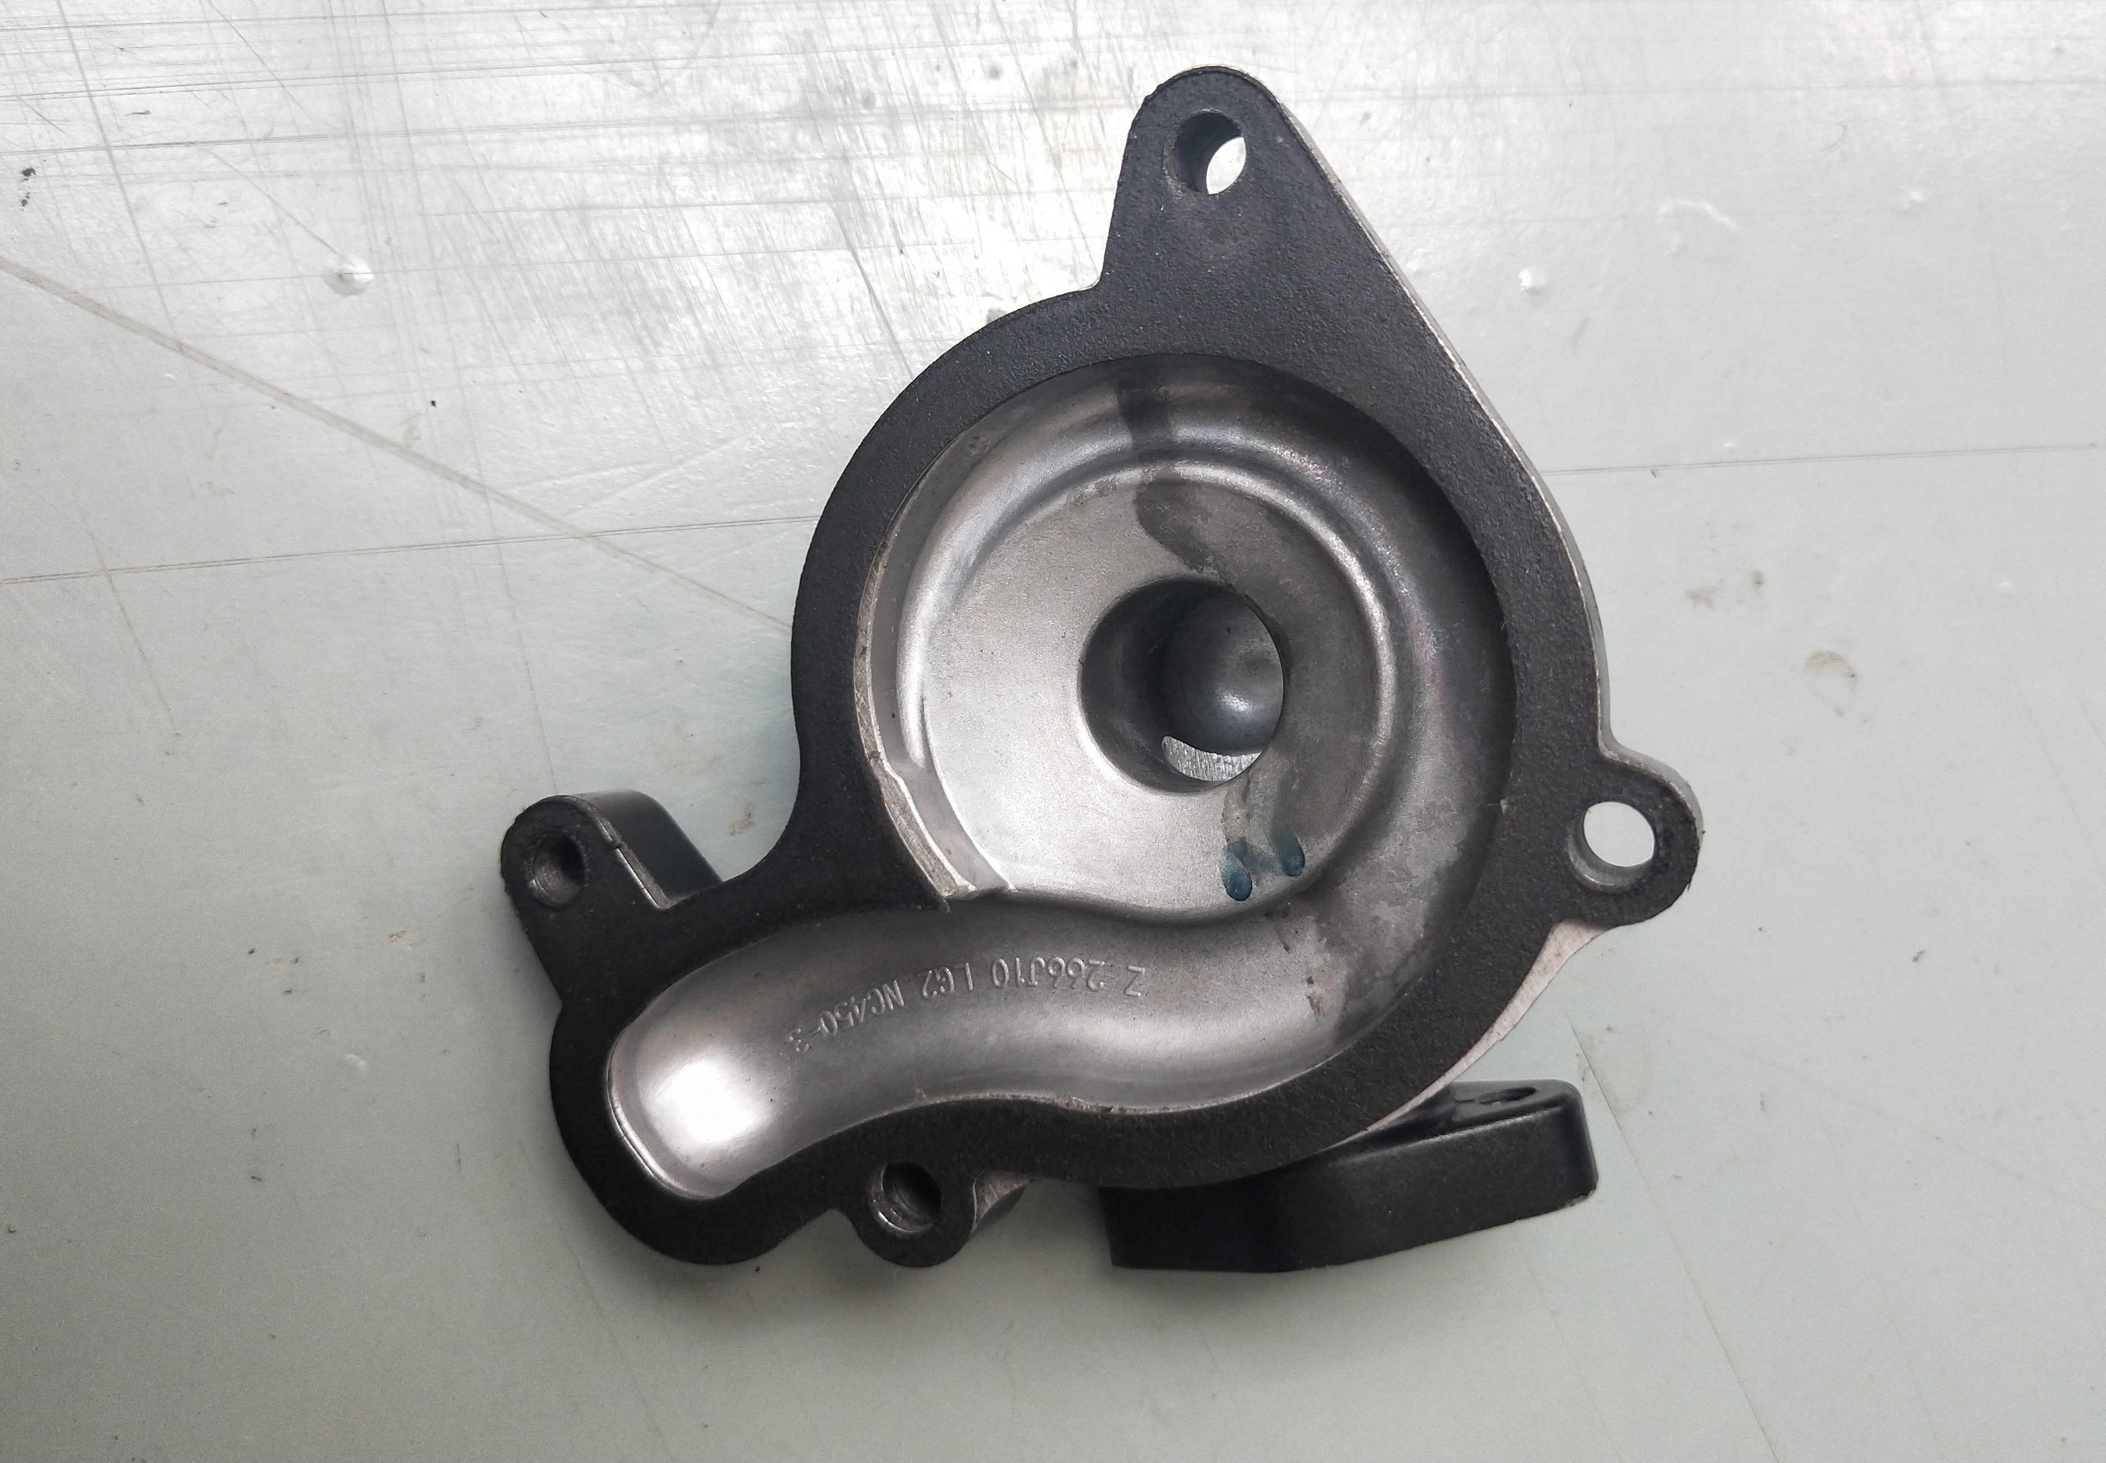
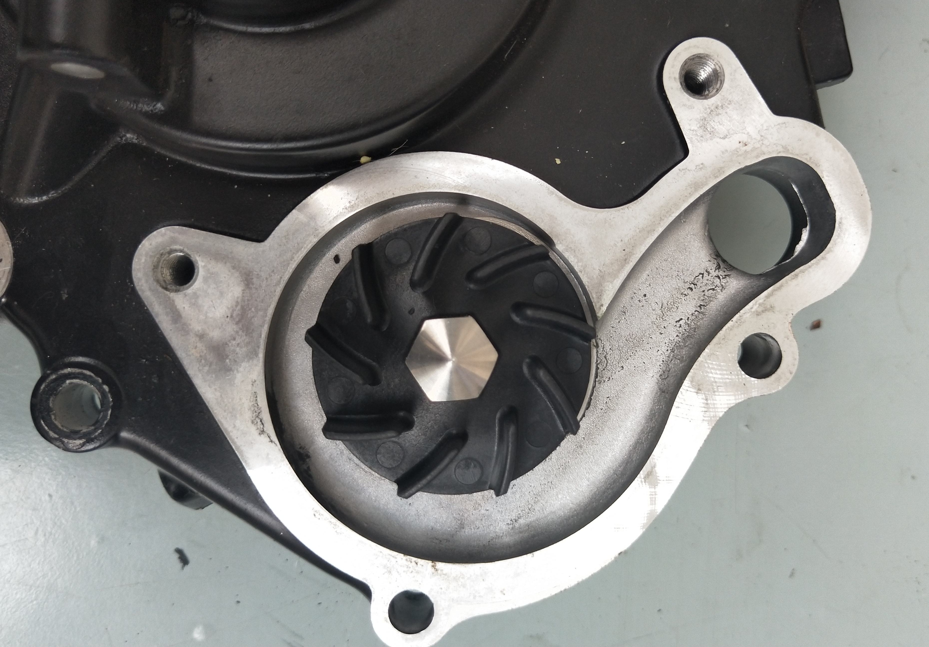
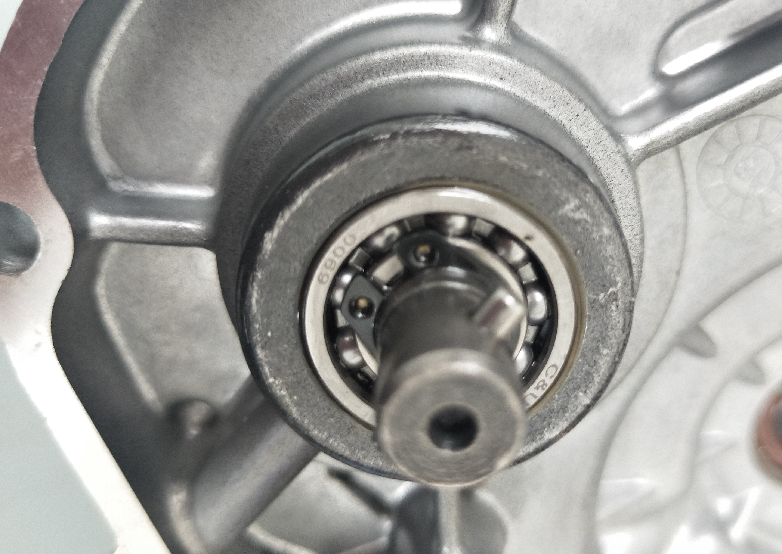
※Water pump
End face seal inspection.
Make sure there is no continuous coolant leakage when starting the engine.
If necessary, replace the water pump as an assembly.
Caution.
Place a clean oil pan under the engine, coolant will flow when the water pump body is removed.
After installation, add the specified coolant.
Keep the motorcycle in an upright position on level ground.
Removal/Installation
Remove the following parts.
- Water drain bolt and gasket [1];
- Remove the lower radiator hose clamp [2], [3];
- Remove the water inlet pipe [4], [5];
- Install the water pump valve body cover bolts [6].
The installation sequence is the reverse of the disassembly sequence.
Torque:
Water pump body cover mounting bolts.
12 N-m (1.2 kgf-m, 9.0 lbf.ft)
Water pump discharge bolt.
10 N.m (1.0 kgf.m, 7.5 lbf.ft)
[5]
[2]
[3]
[2]
[4]
[1]
[6]
[2]
[1]
※Water pump impeller
Disassembly/Installation
Remove the following components.
- Remove the right side cover of the crankcase;
- Remove the water pump valve body cover [1] and gasket [2] from the right side cover of the crankcase;
- Remove the C-clamp [3] and retaining pin [4] at the rear of the crankcase side cover;
- Remove the water pump impeller [5].
Inspect.
Whether the water pump cover gasket is broken If broken, replace it in time.
Replace the water pump impeller in time if it is broken.
The installation order is the reverse of the disassembly order.
Crankcase side cover mounting bolts.
10 N.m (1.0 kgf.m, 7.5 lbf.ft)
[5]
[3]
[4]
English
version
148

Slide 11
※ Oil-cooled radiator
Make sure there is no continuous oil leakage when starting the engine.
If necessary, replace the oil cooled radiator as an assembly.
Caution.
Place a clean oil pan under the engine where oil will escape when the oil cooled radiator is removed. After installation, add the specified oil.
Keep the motorcycle in an upright position on level ground.
Removal/Installation
Remove the following parts.
- Remove the inlet and outlet oil pipe overflow bolts [1];
- Remove the oil-cooled radiator mounting bolts [2];
- Remove the oil cooled radiator [3];
The installation order is the reverse of the removal order.
Torque:
Mounting oil-cooled radiator over-oil bolt.
12 N-m (1.2 kgf-m, 8.8 lbf.ft)
[2]
[3]
[1]
English
version
149

