Slide 1
Engine removal/installation
1 Maintenance information ....................................................................................... 151
2 Parts Location ............................................................................................................. 152
3 Engine Removal ......................................................................................................... 153
4 Engine Installation .................................................................................................... 157
English
version
150

Slide 2
Maintenance information Overview Removing and installing, you need to use professional table or equivalent to support the motorcycle. You need to use a jack or other adjustable bracket to support and control the engine
English
version
151

Slide 3
Parts Location
[1]
[1]
[1]
[1]
[2]
[3]
[4]
[2]
[5]
[9]
[9]
[6]
[5]
[12]
[6]
[7]
[10]
[11]
[8]
[1] | Engine upper suspension and frame attachment bolts x4 | 36N.m | [7] | Engine and front suspension connecting bolts | 54N.m
[2] | Engine upper suspension bracket left and right |  | [8] | Self-locking nuts for engine and front suspension connection | 54N.m
[3] | Engine upper suspension and engine connecting bolt left | 54N.m | [9] | Engine front suspension bracket left and right
[4] | Engine upper suspension and engine connecting bolt right | 54N.m | [10] | Engine lower front, lower rear suspension and frame connecting bolt x2 | 54N.m
[5] | Frame and front suspension attachment bolts x2 | 26N.m | [11] | Engine lower front, lower rear suspension and frame attachment self-locking nuts x2 | 54N.m
[6] | Frame and front suspension connecting self-locking nut x2 | 26N.m | [12] | Flat fork axle fastening nut and flat fork axle | 88N.m
English
version
152

Slide 4
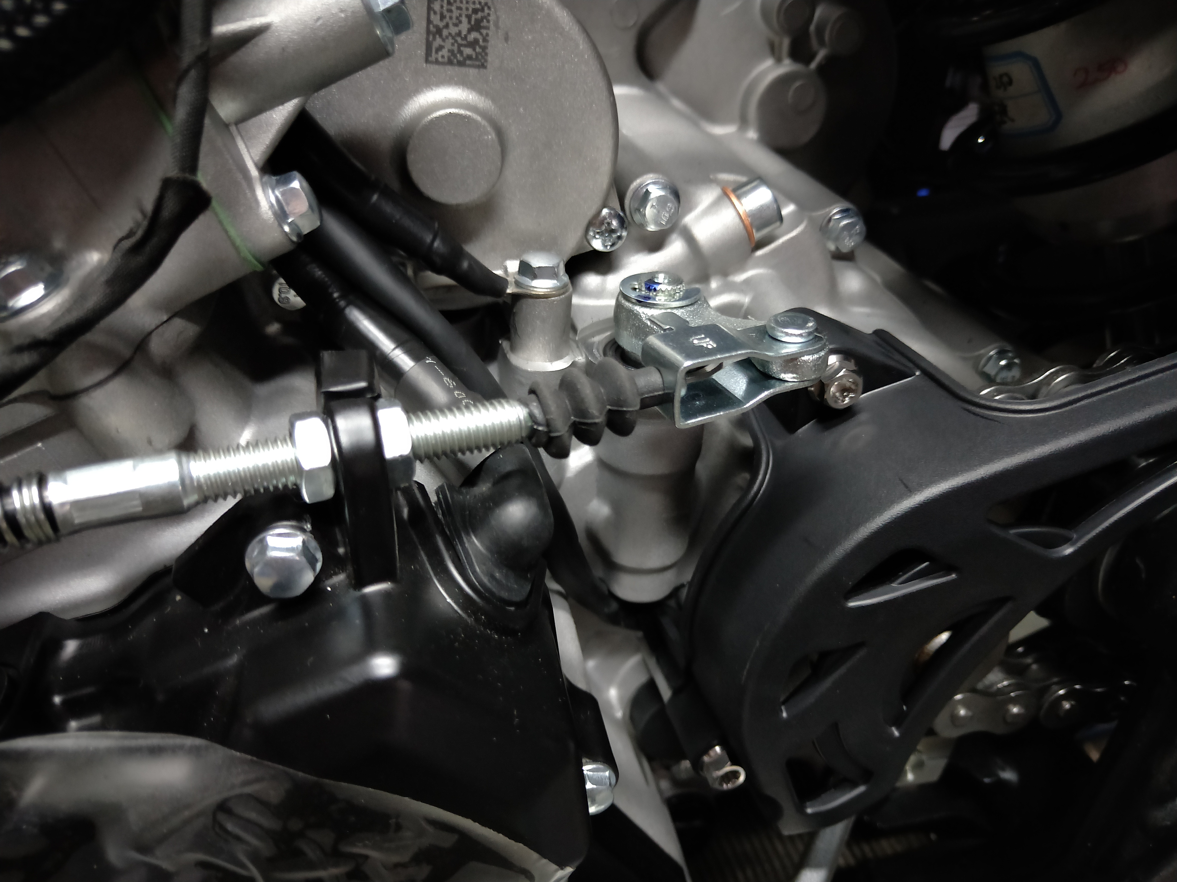
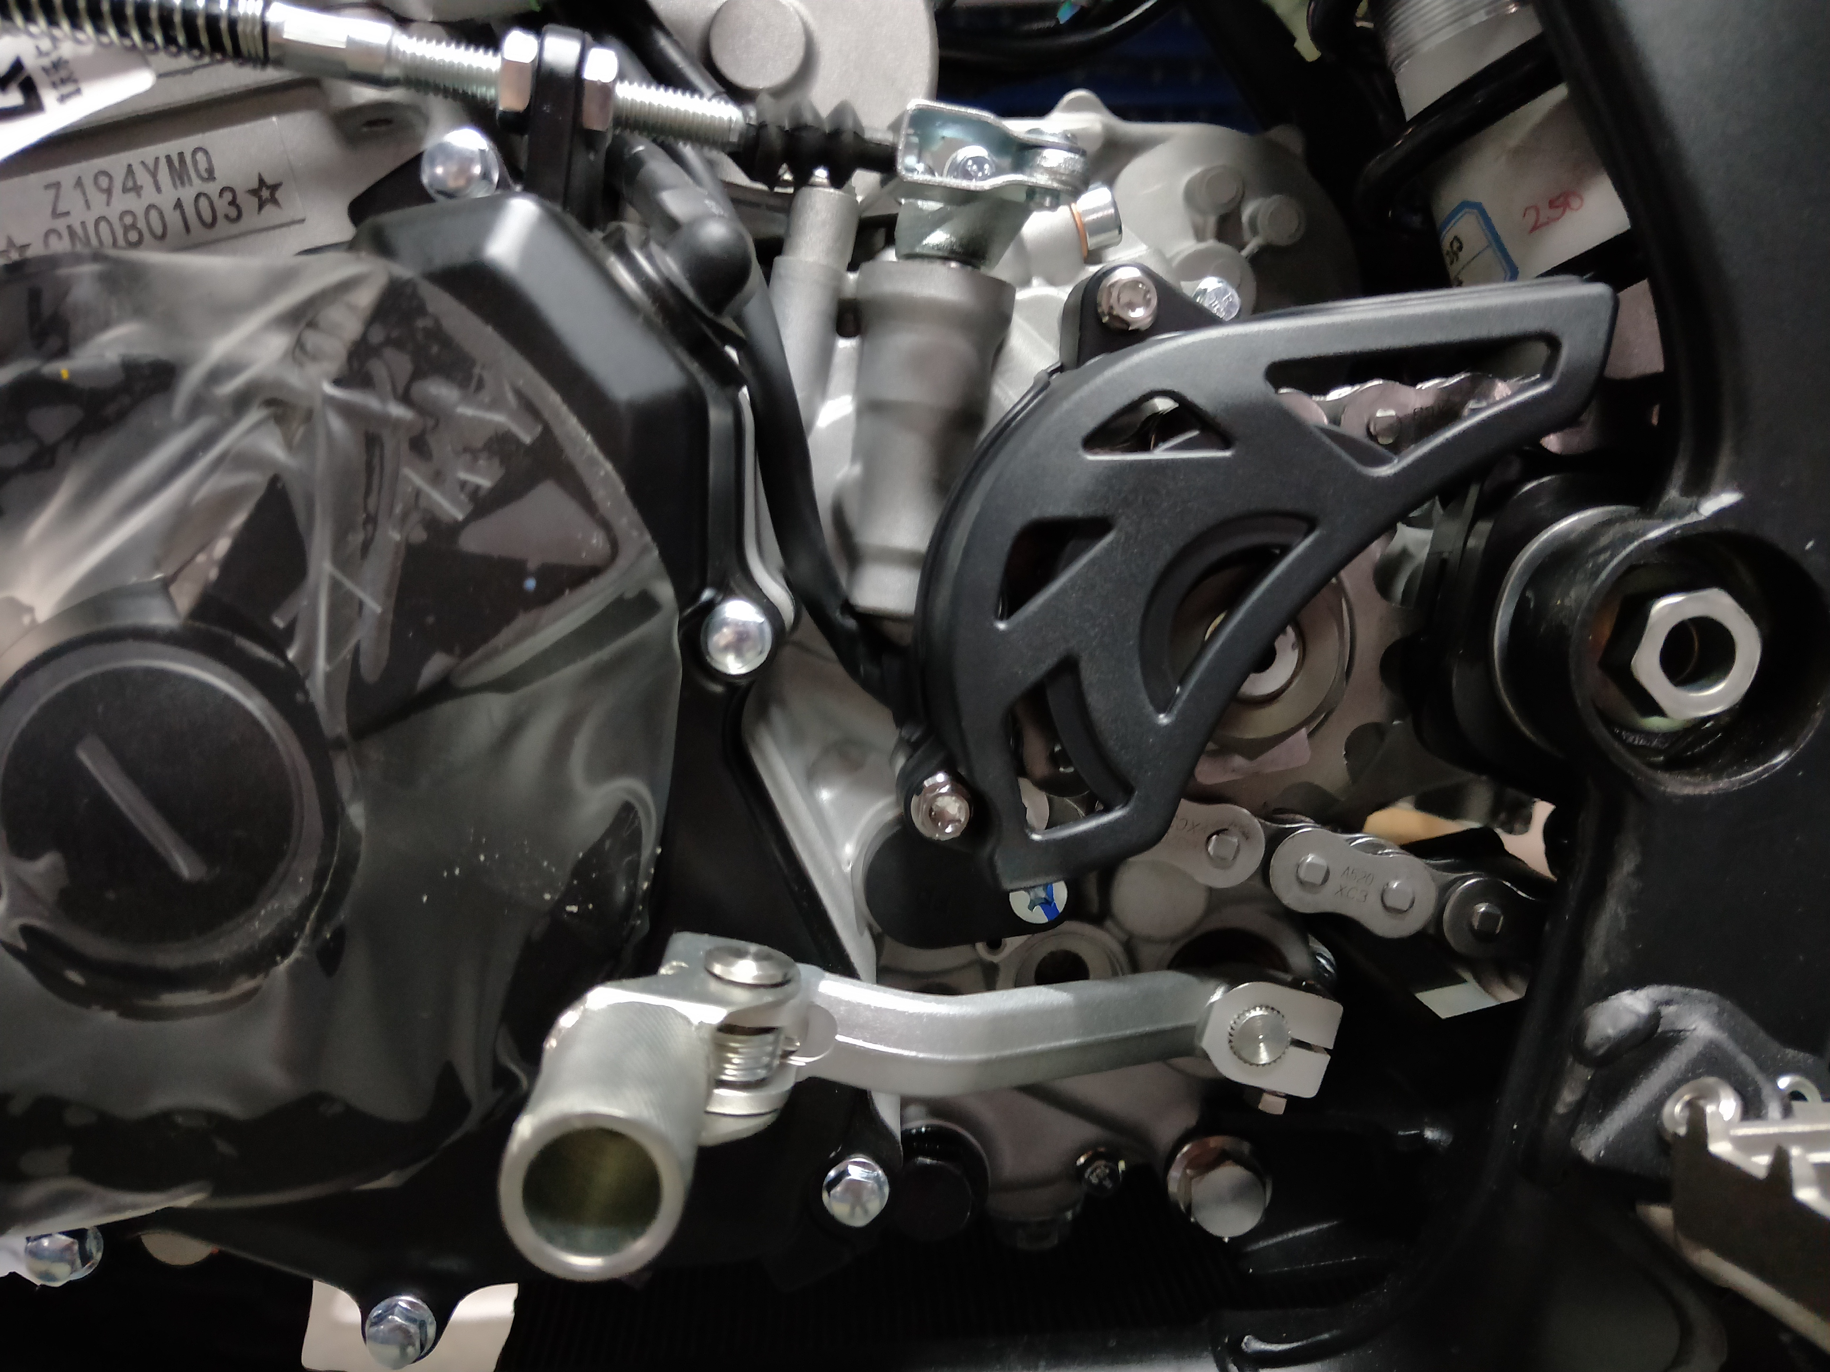
※Engine Removal
- Removing the seat cushion assembly.
- Disconnecting the negative battery terminal.
- Removing the front trim assembly.
- Removing the lower engine guard assembly.
- Removing the fuel tank vent pipe.
- removing the front left and right side fuel tank and fuel pump connector fuel line quick release fittings.
- Drain the engine oil.
- Evacuate the coolant.
Caution.
-Let the vehicle stand still for a period of time to avoid high temperature burns when draining the engine coolant.
Remove the following components.
- Fuel evaporation system and associated components [1].
- Exhaust gas pipe assembly [2].
Install in the reverse order of removal.
[1]
[2]
[1]
[2]
① Clutch cable
Installation / Disassembly
Remove the following parts.
- Loosen the travel adjustment bolt [1] and disengage the clutch safety plate [2].
Then disconnect the clutch pull cable [3] from the clutch tappet arm [4].
The installation sequence is the reverse of the disassembly sequence.
[3]
[4]
[1]
[2]
② Engine flywheel cover/shift lever assembly
Installation / Disassembly
Remove the following components.
- Removal of bolts [1].
- Removal of the small flywheel cover [2].
- Remove the bolts [3].
- Remove the gearshift lever assembly [4].
The installation order is the reverse of the disassembly order.
[3]
[4]
[2]
③ Small engine driven flywheel
Installation / Disassembly
Remove the following parts.
- Disengage the drive small flywheel fastening nut locking tab [1] and remove the small flywheel fastening nut [2].
- Remove the drive small flywheel.
The order of installation is the reverse of the order of disassembly.
English
version
153
[1]

Slide 5
④ Air filter assembly
Installation / Disassembly
Remove the following parts.
- Remove the air filter assembly left and right 2 side bolts [1], [2];
- Remove the air filter assembly connecting the throttle intake pipe holding hoop [3];
- Remove the air filter assembly [4].
The installation order is the reverse of the disassembly order.
[1]
[2]
[3]
[4]
⑤ Throttle assembly
Installation / Disassembly
Remove the following parts.
- Remove the intake pipe clamps [1];
- Unplug the fuel injector [2];
- Unplug the triple sensor [3];
- Unplug the stepper motor motor [4];
- Remove the throttle assembly [5];
- Loosen the adjustment nut [6];
- Remove the throttle wiring harness [7].
The installation sequence is the reverse of the disassembly sequence .
[1]
[7]
[2]
[6]
[3]
[5]
[4]
English
version
154

Slide 6
⑥ Oil-cooled radiator
Keeps the motorcycle upright on level ground.
Disassembly/Installation
Remove the following parts.
- Removal of the inlet and outlet oil pipe over oil bolts [1], [4].
- Remove the oil-cooled radiator mounting bolts [2].
- Remove the oil-cooled radiator [3].
The installation order is the reverse of the disassembly order.
Torque :
Installation of oil-cooled radiator over-oil bolt.
12 N-m (1.2 kgf-m, 8.8 lbf.ft)
[2]
[3]
[1]
[4]
English
version
155

Slide 7
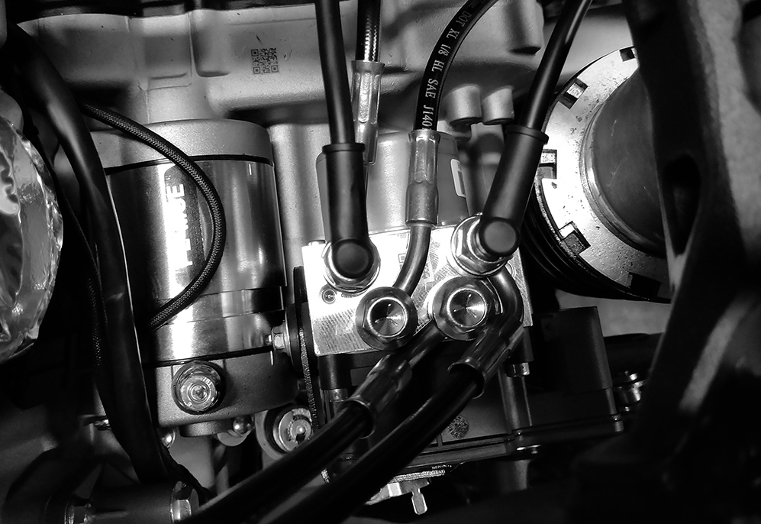
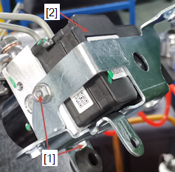
⑦ ABS pump
Disassembly/Installation
Disassemble the following components.
Drain the brake fluid from the front and rear brake hydraulic system.
- Seat cushion assembly.
- Air filter assembly.
- ABS pump bracket.
Disconnect the ABS pump 18P (black) connector
Remove the brake hose brake light switch nut [1] and the upper and lower 2 sealing washers [2].
removing the ABS nut [3] to disconnect the brake hose [4].
- Removal of ABS bracket mounting nut [5].
- Remove the ABS bracket ABS pump [6].
Install in reverse order of removal.
Note: factory edition do not have an ABS pump.
[1]
[1]
[2]
[2]
[3]
[3]
[6]
[5]
Remove the two mounting bolts [1] and the ABS pump 2] from the bracket.
Torque.
ABS pump to bracket attachment bolts.
12 N.m (1.2 kgf.m, 8.8 lbf.ft)
Brake hose oil bolt.
22 N.m (2.2 kgf.m, 16 lbf.ft)
[2]
English
version
[1]
156

Slide 8
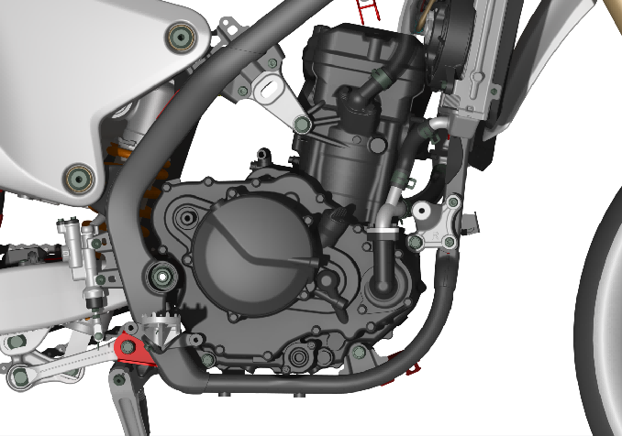
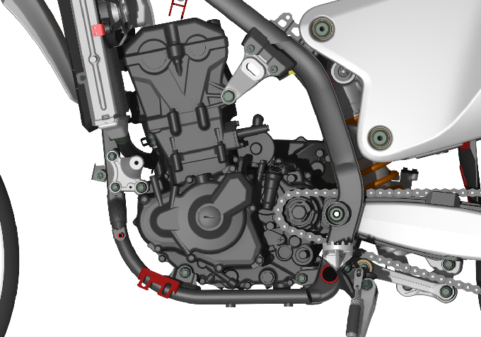
⑧ Engine
Disassembly/Installation
Remove the following parts.
- Removal of bolts [1] engine outlet pipe hugger [2].
- Remove the rear flat fork shaft nut [3] to remove the rear flat fork shaft [6] and spacer.
- Remove the engine upper suspension left and right attachment bolts [4] and [5].
- Removing the front engine suspension attachment nuts [7], washers and bolts.
- Removing the lower engine front and rear attachment nuts [8][9], bolts.
- Removal of the engine assembly [10].
The installation order is the reverse of the disassembly order.
[4]
[2]
[3]
[1]
[10]
[5]
[7]
[6]
[8]
[9]
Engine Installation Caution.
-Not applicable to oil filters as jacking points.
-Jack height must be constantly adjusted to relieve pressure for bolt-on installation.
-Carefully align the mounting points with the jack to prevent damage to the engine, frame, radiator, hoses, wires and cables Raise the rear of the motorcycle so that the rear wheel is 150mm off the ground
placing the engine on a jack or other adjustable bracket under the frame.
aligning the front engine suspension bolt holes with the frame mount, then installing the bolts and bushings.
lifting the engine while rotating it upward at the rear to install the other hanger bolts and bushings.
Installing the rear engine suspension nuts with washers.
Tighten the bolts and nuts to the specified torque in the order indicated.
English
version
157

