Slide 1
Cylinder head and valve
1 Maintenance information .......................................................................... 159
2 Troubleshooting ............................................................................................ 160
3 Cylinder head assembly drawing .............................................................. 161
4 Disassembly of cylinder head cover .......................................................... 163
5 Disassembly of cylinder head ...................................................................... 163
6 Disassembly of the cylinder head ............................................................... 164
7 Inspection of valves and valve springs ..................................................... 164
8 Inspection of valve tappet, camshaft, cylinder head ........................... 165
9 Assembly of cylinder head components ................................................. 166
10 Installation of cylinder head ....................................................................... 167
11 Engine Timing Adjustment Method ....................................................... 167
12 Installation of cylinder head cover ......................................................... 168
English
version
158

Slide 2
Maintenance information
Overview
-This chapter covers maintenance and inspection of cylinder heads, valves, camshafts, and tappets.
-When repairing the cylinder head, camshaft and tensioner, judge whether the engine needs to be removed from the frame according to the model and shade; when repairing the cylinder head and valve, the engine must be removed from the frame.
-When disassembling, mark the disassembled parts and put them away to ensure that they are correctly placed when reassembling.
-Before inspection, clean all disassembled parts with a cleaning agent and blow them dry with compressed air.
-Camshaft lubricant is injected through the oil lines in the cylinder head and camshaft bracket, so the oil lines should be cleaned before assembling the cylinder head and camshaft bracket.
-When removing the cylinder head and cylinder head cover, be careful not to damage the joint surface.
Cylinder head/valve specification
item | standard value mm | Maintenance limit value mm
Valve spring free length | inner:47.5 outter:38.1 | inner:47.35 outter:37.95
valve clearance | intake :0.1～0.15 exhaust:0.15～0.2 | intake＞0.17 exhaust＞0.22
Camshaft base circle runout | 0.02 | 0.04
item |  |  | standard value mm | Maintenance limit value mm
valve | Outside diameter of valve stem | intake | φ5.472～φ5.487 | φ5.46
 |  | exhaust | φ5.46～φ5.475 | φ5.44
 | Valve tube inner diameter | intake | φ5.505～φ5.515 | φ5.535
 |  | exhaust | φ5.505～φ5.515 | φ5.535
 | Valve stem and tube clearance | intake | 0.018～0.043 | 0.07
 |  | exhaust | 0.03～0.055 | 0.08
 | Valve seal tape width |  | 1.2 | ----
Cylinder Head | flatness |  | 0.05 | 0.06
 | Width of valve seat face |  | 0.8 | ----
English
version
159

Slide 3
1.Troubleshooting
Low air pressure in the cylinder.
1. valves.
Incorrect adjustment of valve clearance.
Poor valve sealing.
incorrect air distribution timing.
Broken valve springs.
2, cylinder head
The spark plug is not tightly connected to the cylinder head.
Damaged cylinder head gasket.
Cracks or sand holes in the cylinder head.
3、cylinder block, piston, piston ring
Piston ring gap is too large or fracture.
cylinder block pulling.
Exhaust with black smoke.
1, valve guide wear.
2, oil shield leaking or damaged.
3、Leakage of cylinder head gasket.
4, piston ring gap is too large.
Excessive warm-up noise or strange noise
1、Incorrect valve adjustment.
2, valve stuck or broken valve spring.
3, excessive wear of the tappet.
4、Incorrect timing of air distribution.
5, camshaft wear.
6、Fracture of the pressure reducing valve dump block.
English
version
160

Slide 4
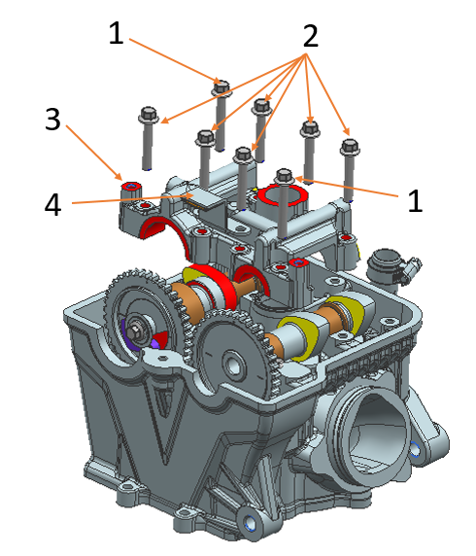
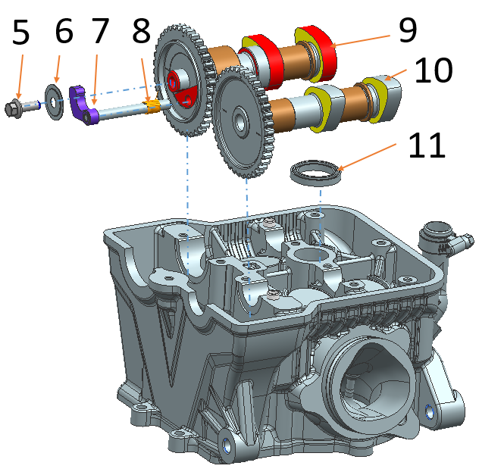
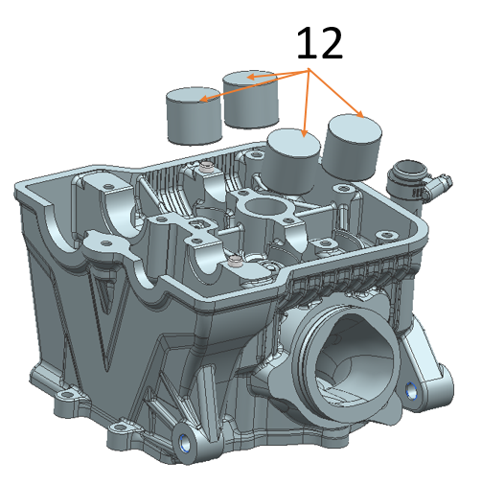
A. Cylinder head assembly drawing.
(1) Small plate bolt M6×40_7 grade 24h.
(2) Small plate bolt M6×35_7 grade 24h.
(3) NC450S camshaft bracket.
(4) NC450S chain pressure plate.
(5)Small plate bolt M6×16_7 grade 24h.
(6)NC250S camshaft stopper.
(7)NC450S camshaft pressure reducing valve.
(8)NC250 cam pressure reducing valve reset torsion spring (2#).
(9) NC450S exhaust camshaft components.
(10) NC450S intake camshaft components.
(11)Derbi125 spark plug hole seal.
(12)NC450S valve tappet (DLC coating).
English
version
161

Slide 5
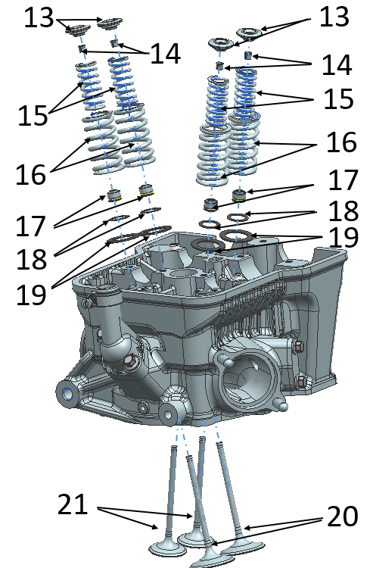
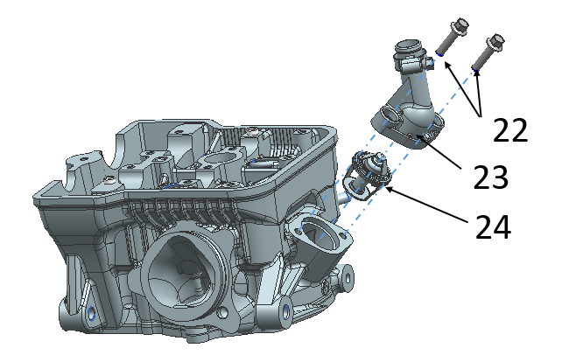
(13) NC450S valve spring upper seat.
(14)CB125 foot valve locking clip (improved type).
(15)NC450S valve inner spring.
(16)NC450S valve outer spring.
(17)CG125D oil shield combination.
(18)CG125D inner valve spring seat (lower).
(19)NC450S outer valve spring seat
(20)NC450S intake valve (rod diameter φ5.5)
(21)NC450S exhaust valve (rod diameter φ5.5)
(22)Bolt M6×25
(23)NC450S thermostat cover
(24)NC450S thermostat (2#_vent hole φ2)
English
version
162

Slide 6
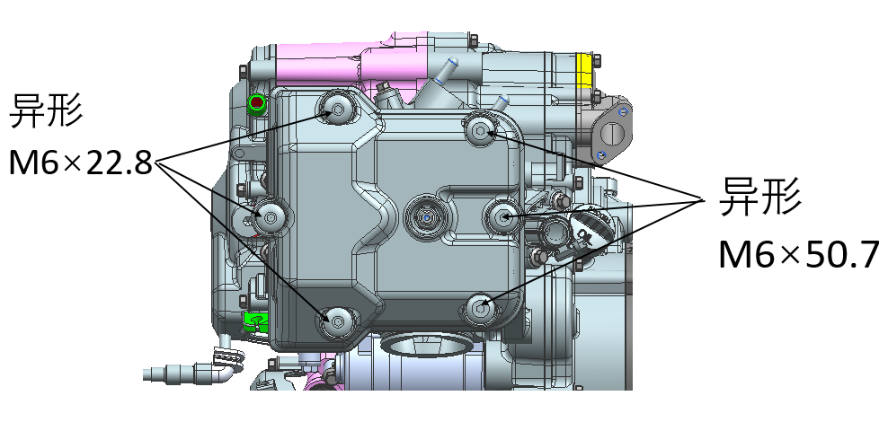
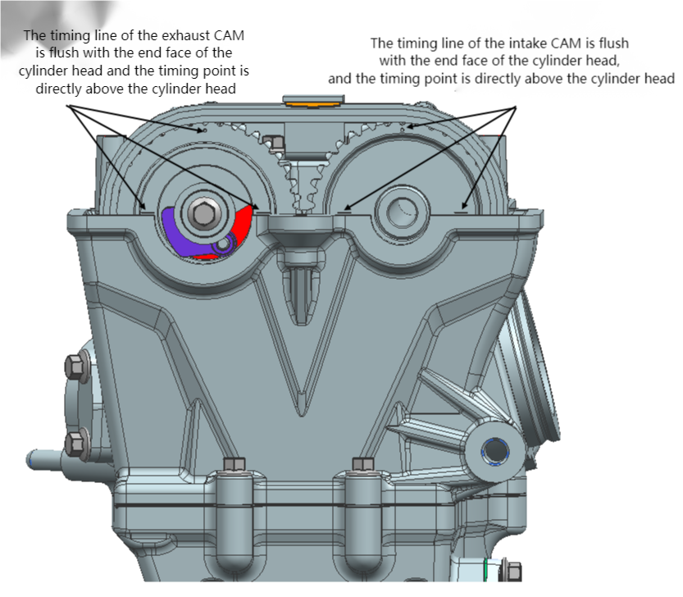
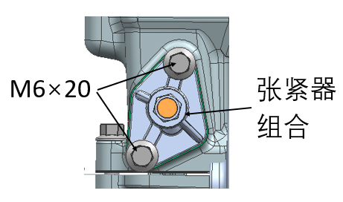
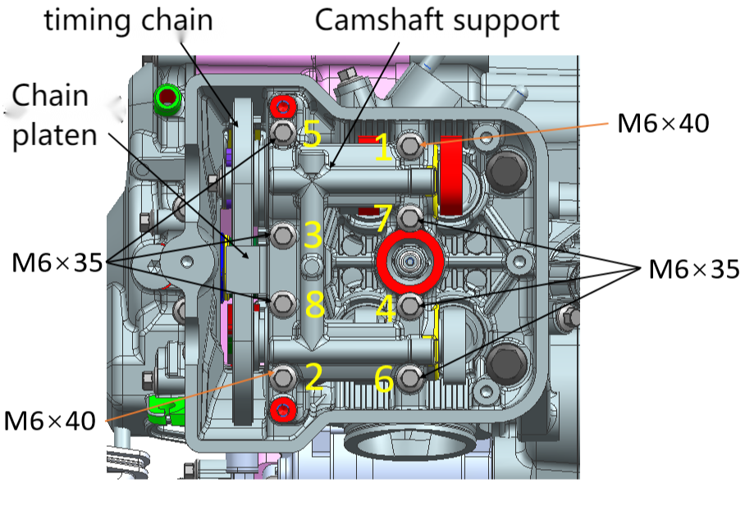
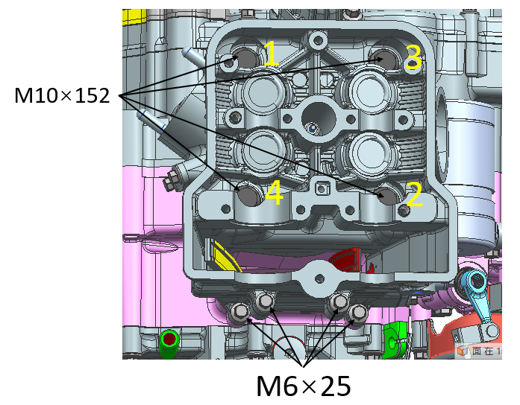
heteroshape
Disassembly of cylinder head cover
1、Remove the 3 NC450S cylinder head cover fixing bolts (shaped M6×22.8) and 3 NC450S cylinder head cover fixing bolts (shaped M6×50.7).
fixing bolts (shaped M6×22.8), 3 NC450S cylinder head cover fixing bolts (shaped M6×50.7).
2、Remove the head cover and the head cover gasket.
Disassembly of cylinder head
1、Turn the timing sprocket to the engine timing position.
The timing sprocket timing line mark is flush with the end face of the cylinder head, and the intake and exhaust camshaft timing point is facing the top of the cylinder head.
2、Remove the 2 bolts of tightening tensioner M6×20.
then remove the tensioner combination and tensioner gasket.
3、Remove the 2 bolts M6×40 and 6 bolts M6×35 that fasten the camshaft bracket in the order of 1→2→3→4→5→6→7→8; then remove the chain pressure plate and camshaft bracket, remove the timing chain on the timing driven sprocket, and remove the intake camshaft parts and exhaust camshaft parts.
4. Remove the four M6×25 cylinder head bolts first.
in removing 4 cylinder double-headed bolts AB (M10×152), in the order of 1→2→3→4, and then remove 4 AB bolts flat washers.
5, remove the cylinder head.
heteroshape
Tensioner combination
English
version
163

Slide 7
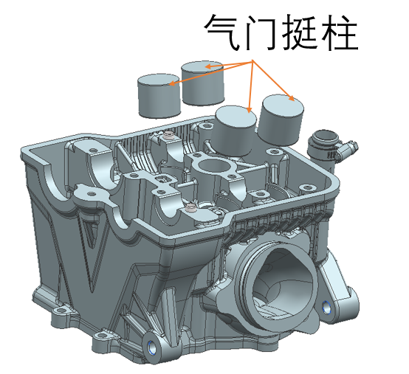
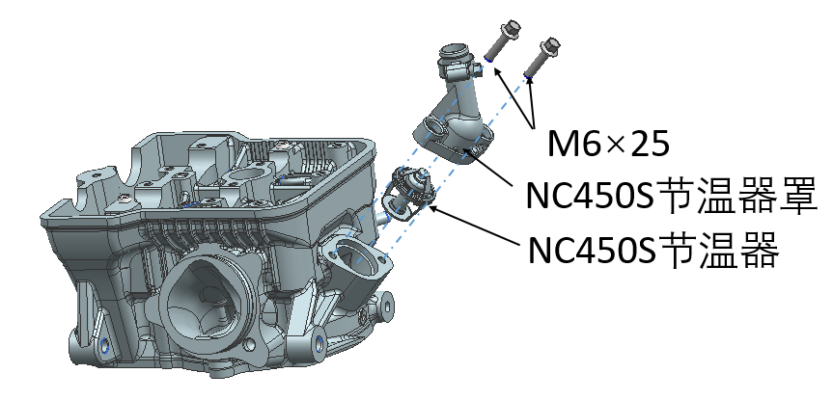
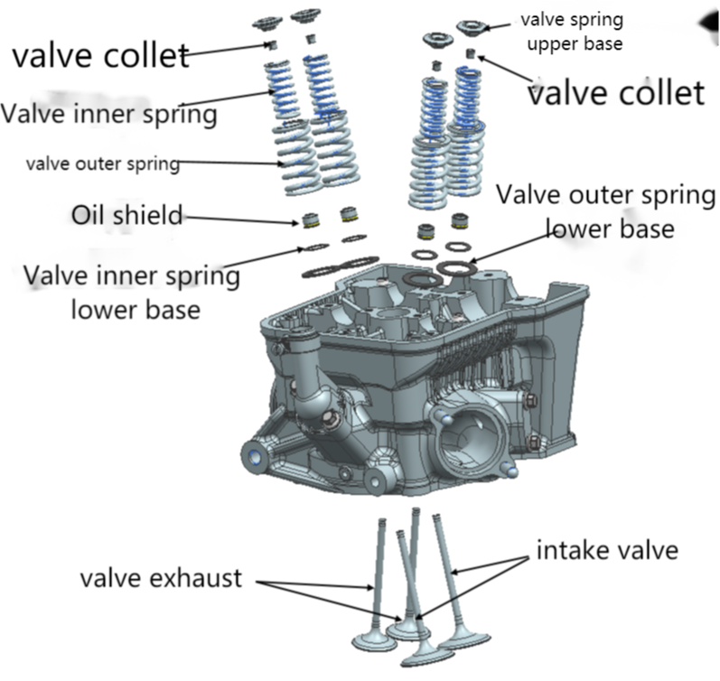
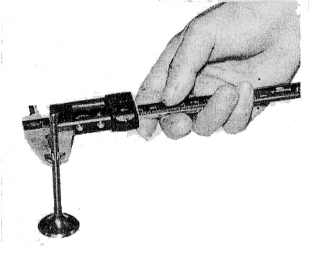
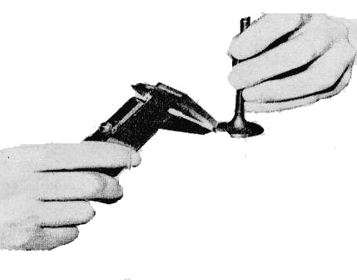
Disassembly of cylinder head
1, remove the four pieces of valve tappet, respectively, a good corresponding mark.
valve lifter
2. Remove the 2 NC450S thermostat cover fastening bolts M6×20 and remove the NC450S thermostat cover and the NC450S thermostat.
3、Use the valve remover to press down the valve spring and remove the valve locking clip; then relax the valve remover and remove the upper seat of the valve spring, the inner and outer valve springs and the lower seat of the inner and outer valve springs as well as the intake and exhaust valves, respectively, to make the corresponding markings.
thermostat cover
thermostat
Caution. -In order to prevent permanent deformation of the valve spring, the valve spring should not be overly compressed, only the valve locking clip should be able to be removed. -All parts removed should be marked to ensure that they reach their original assembly position during assembly.
Inspection of valves and valve springs
1, check whether the valve is bent or the valve stem has abnormal wear, measure the valve stem outer diameter. Maintenance limit value.
Intake: φ5.46mm
Exhaust: φ5.44mm
2、The width of the contact surface maintenance limit value: 1.5mm
Caution. -If the valve contact surface is very rough, uneven abrasion or contact with the valve seat is not normal, can not guarantee the sealing performance, should be replaced valve.
3、Check the valve spring for abnormal wear and measure the free length. Repair limit value.
Outer spring: 47.35mm
Inner spring: 37.95mm
English
version
164

Slide 8
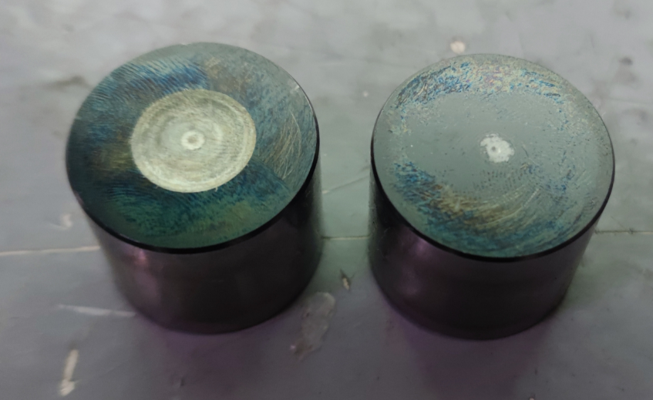
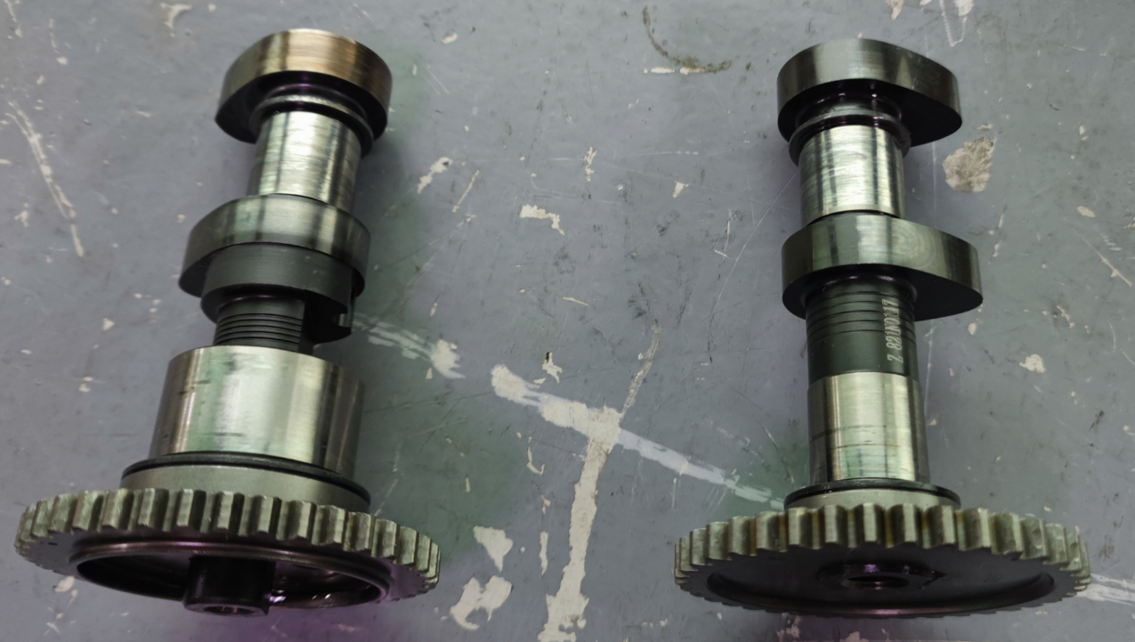
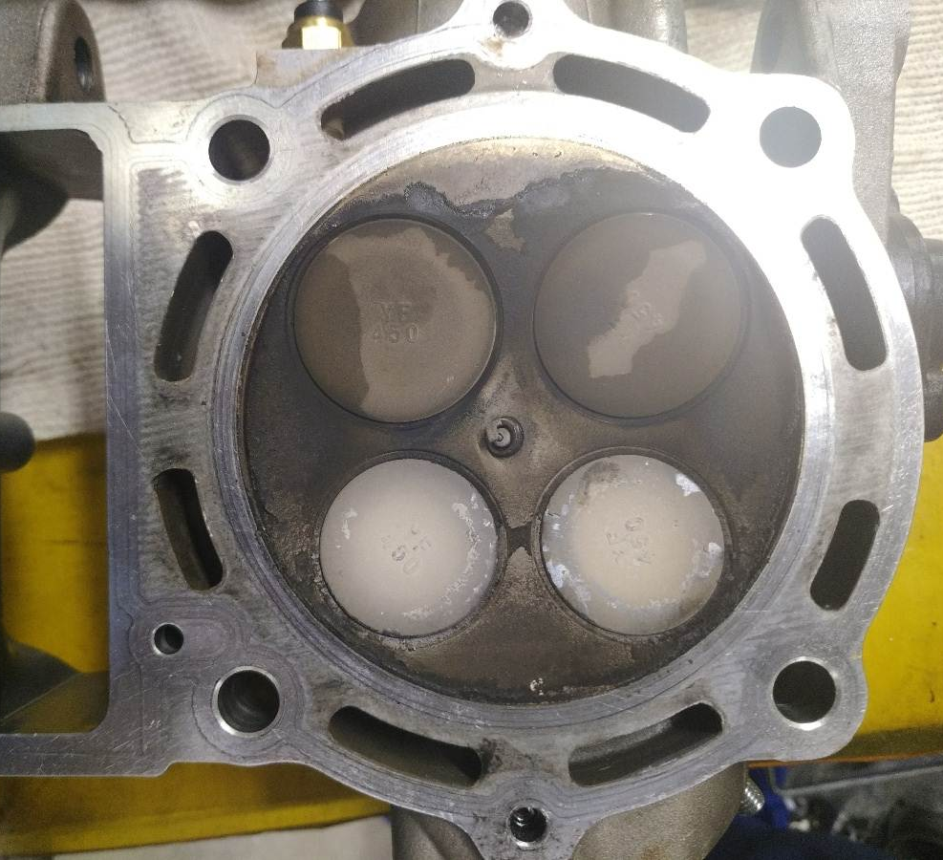
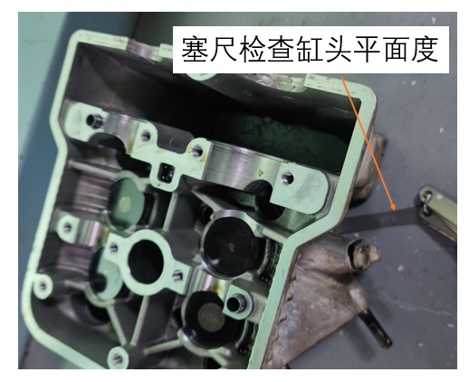
Inspection of valve tappet
Check the front and side of the tappet for abnormal wear. If the wear and tear is serious or the clearance is large after installation, a new tappet is required.
Inspection of camshaft
1. Check whether the camshaft surface is worn and destroyed. If the wear is serious, replace the camshaft parts with new ones.
Inspection of cylinder head
1、Check whether the cylinder head is well sealed, if the cylinder head is poorly sealed, replace the cylinder head or valve with a new one.
2、Check whether the cylinder head is deformed, and check the flatness of the cylinder head with a knife edge ruler and a plug ruler.
Check the flatness of cylinder head with a stopper
Combustion chamber leak detection test: Inflation 0.3Mpa, leakage ≤6000pa/10sec.
Testing parameters: Inflation time 5S, balance time 3S, detection time 2S, deflation time 0.5S, upper limit of pressure detection 320Kpa, lower limit of pressure detection 290Kpa, judgment value 1.2Kpa.
English
version
165

Slide 9
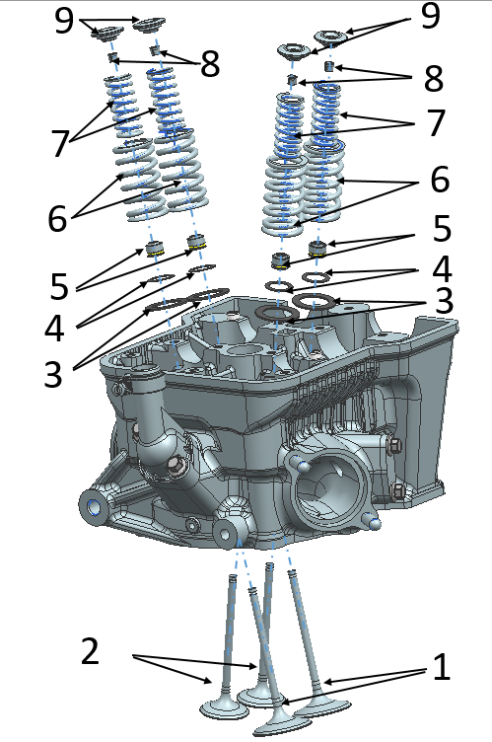
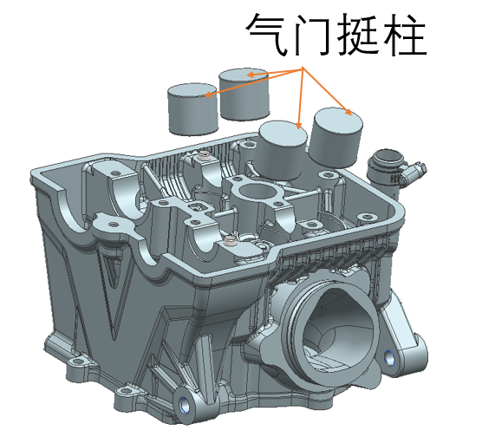
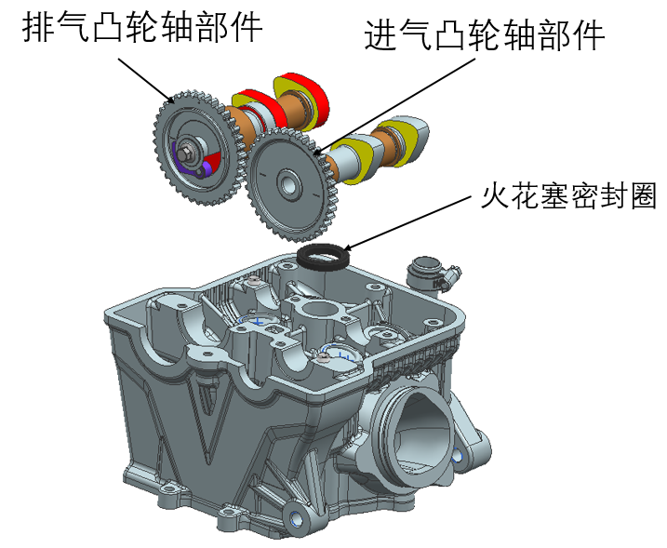
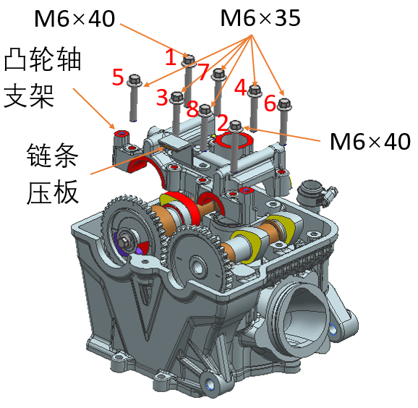
Assembly of cylinder head components
1, the valve spring lower seat (3, 4), oil shield (5) installed on the valve guide.
2, the intake valve rod (1), exhaust valve rod (2) coated with a small amount of lubricant, installed into the valve guide, installed the valve outer spring (6), valve inner spring (7), valve lock clip (8) and valve spring upper seat (9).
3, then use the valve remover to press down the valve spring, and then install the valve lock clip into the valve spring upper seat.
Note:
• to prevent valve spring produce permanent deformation, not overly compression spring, to load the valve lock clamp.
4、Check whether the valve lock clip assembly is in place.
5, the assembled cylinder head combination for gas tightness testing, if the cylinder head combination gas tightness testing qualified then you can proceed to the next step (according to the cylinder head composition diagram assembly).
6, the valve tappet surface lubrication oil into the cylinder head corresponding position.
7、In the intake and exhaust camshaft parts completed by the department, grease the journal surface and assemble them in the camshaft groove position of the cylinder head, and take the spark plug hole seal and install it into the camshaft bracket.
8. then assemble the camshaft bracket and chain pressure plate at the designated position in the cylinder head, and fasten the chain pressure plate and camshaft bracket with two M6×40 and six M6×35 bolts, in the order of 1→2→3→4→5→6→7→8.
Tightening torque: 11~13N.m.
9. After rotating the intake and exhaust camshafts until the timing line is flush with the cylinder head and the timing point is facing upwards, check the intake and exhaust valve clearance with a stopper; intake valve clearance 0.1mm~0.15mm, exhaust valve clearance 0.15mm~0.2mm.
valve lifter
Exhaust valve CAM unit
intake valve CAM unit
Spark plug seal ring
CAM support
Attention.
-Camshaft should rotate flexibly without interference and stalling
-When adjusting the valve lash, make the camshaft in the timing position and torque the camshaft bracket tightening bolt to 10N.m before measuring.
chain plate
English
version
166

Slide 10
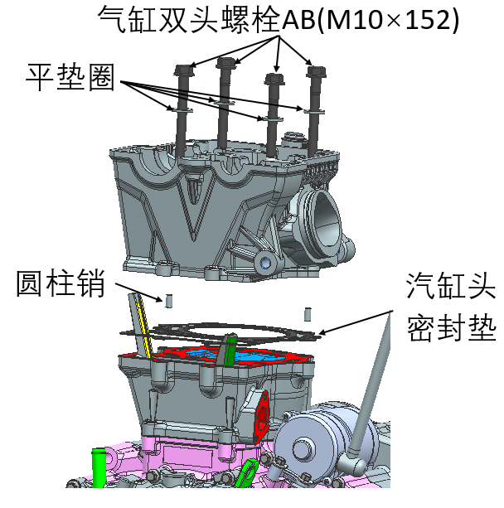
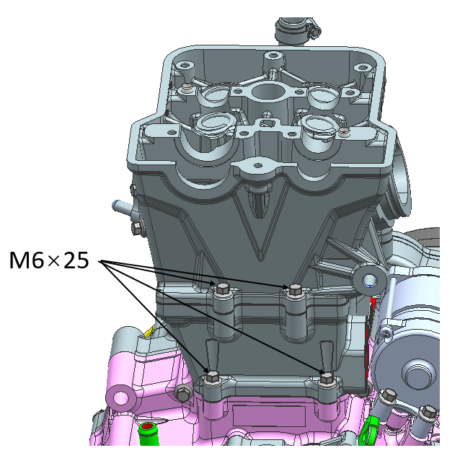
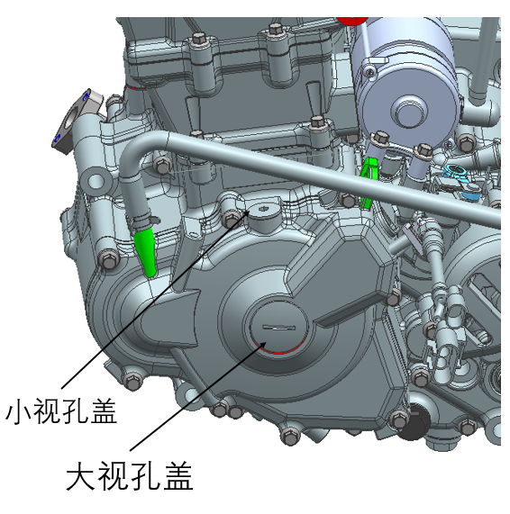
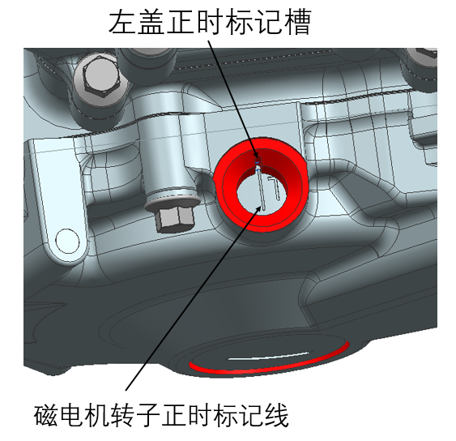
flat washer
Cylinder stud AB(M10×152)
Assembly of cylinder head components
1、Remove the camshaft bracket that has been adjusted for the valve clearance cylinder head, and then remove the intake and exhaust camshaft parts.
2、Remove the old cylinder head gasket, install the new cylinder head gasket, and then install the cylindrical pin (∅6×12).
3, put the cylinder head on the cylinder body, then put the A and B bolts flat washers on the NC450S cylinder double-head bolt AB, then put the NC450S cylinder double-head bolt AB into the cylinder head, cylinder body connection hole and tighten it.
round pin
Cylinder head gasket
Caution.
-The cylinder head gasket must be replaced with a new one.
A, B bolt nut tightening need to be done diagonally, the first time for 20N.m pre-tightening, the second time for 40N.m tightening, and finally the third tightening torque: 55 ~ 60N.m.
4、First put 2pcs M6×25 bolts into the cylinder body, box
Body connection hole and tighten, then put 2 M6×25 bolts into the connection hole of cylinder head and body and tighten.
Tightening torque: 11~13N.m.
5. First check whether the engine is in the timing position, if not, readjust the engine timing position; then install the intake and exhaust camshaft parts so that the camshaft timing line is flush with the end surface of the cylinder head and the timing point is directly above the cylinder head, then install the timing chain to the intake and exhaust camshaft.
Small viewport covergasket
NC450S engine timing adjustment
(1) Remove the large viewport cover and small viewport cover of the left front cover.
(2) Rotate the magneto lock nut with a special tool and observe whether the timing mark line "Ⅰ" on the rotor of the magneto and the timing mark slot on the left front cover are aligned through the screw hole of the small sight hole cover on the left front cover.
(3) After the above timing mark is correct, continue to install the intake and exhaust camshaft parts so that the timing line of the intake and exhaust camshaft parts is flush with the end surface of the cylinder head and the timing point is facing the upper part of the cylinder head, and then install the timing chain to the intake and exhaust cam timing driven sprocket.
☆: Only if (2)(3) is satisfied at the same time, the engine is in the correct timing position.
big viewport covergasket
Left cover timing marker slot
English
version
167
Magneto rotor timing marker line

Slide 11
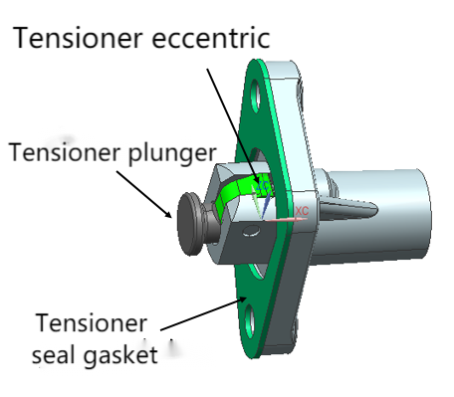
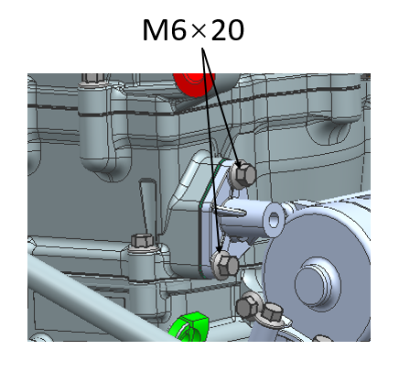
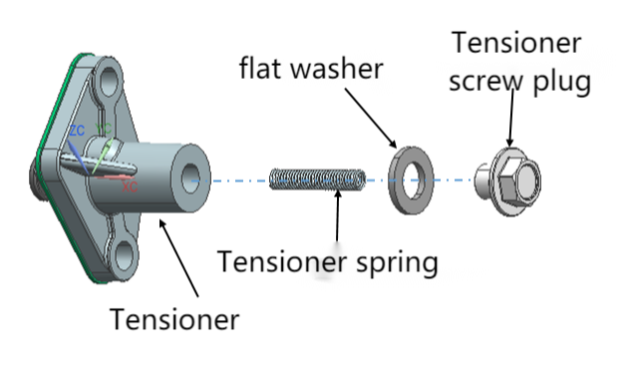
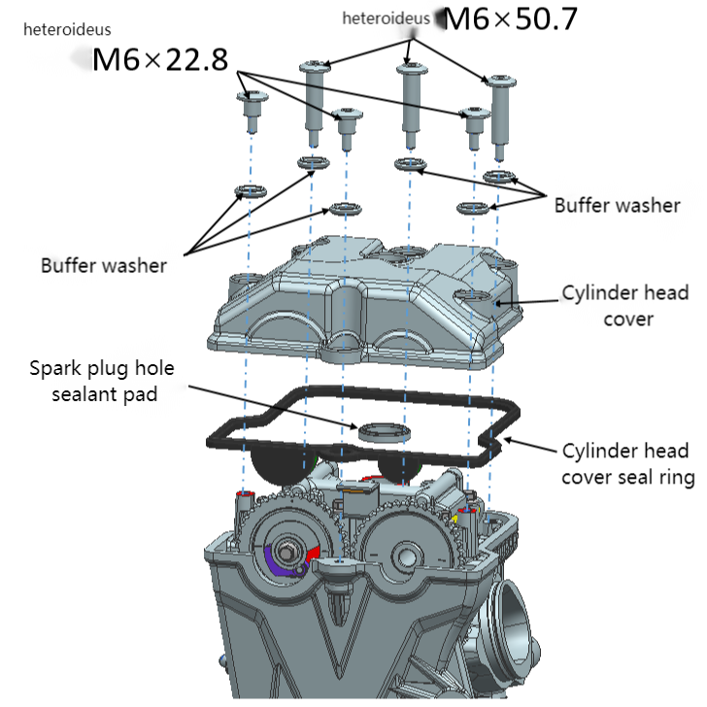
6、After adjusting the timing position, assemble the large viewport cover and small viewport cover to the left front cover.
7. Then install the removed camshaft bracket, spark plug seal and chain pressure plate onto the cylinder head, and tighten 8 bolts of the cylinder head bracket, tightening bolts in the order of 1→2→3→4→5→6→7→8.
Tightening torque: 11~13N-m
8, press down the tensioner eccentric wheel by hand, press the tensioner plunger into the tensioner, make the tensioner plunger in a contracted state, then align the tensioner gasket, tensioner combination to the cylinder mounting hole, and fasten with 2 M6×20 bolts.
Tightening torque: 11 ~ 13N-m
9, and then the tensioner spring, flat washer, tensioner screw plug in turn into the tensioner body, tighten the tensioner screw plug, so that the tensioner plunger pops out.
Tightening torque: 7~9N-m.
10、Check whether the timing chain is tensioned and confirm again whether the engine timing point is correct.
Installation of cylinder head
1、Take NC450S cylinder head cover seal, head cover bolt cushion washer, assemble in NC450S cylinder head cover specified position.
2、Take 3 pieces NC450S cylinder head cover fixing bolt M6×22.8, 3 pieces cylinder head cover fixing bolt M6×50.7, assemble in cylinder head, tighten diagonally in turn.
Tightening torque: 10~12N-m.
English
version
168

